Slide 1

ENDEAVOR study: Kd vs Vd
PFS, OS and Safety subgroup analyses
All studies
Phase 3 Study of Carfilzomib and Dexamethasone vs Bortezomib and Dexamethasone in Patients with Relapsed Multiple Myeloma
SC-CH-CARFILZOMI-00140 Sep 2018

Slide 2
ENDEAVOR
All studies
Kd vs Vd in Patients with Relapsed Multiple Myeloma
K 20/56 mg/m²; D1, 2, 8, 9, 15, 16
Study Overview
Background | Patient demographics and characteristics
Study design | Refractory patient population
Inclusion and exclusion criteria | Patient characteristics substudy Kd vs SC Vd and Kd vs IV Vd
Primary Endpoint
PFS
ITT population | Route of BTZ administration
ITT: Updated results | History of neuropathy (ITT)
Cytogenetic status | Prior ASCT (ITT)
Age | Early and late relapse patients
Prior lines of therapy | Renal Deficiency
Prior bortezomib exposure | Summary
Prior lenalidomide exposure
Overall Survival
Intent-to-treat population | Subsequent anti-myeloma therapy
Subgroup analyses | Summary
Time to next treatment
Overall Response
Intent-to-treat population | PFS by route of BTZ administration
Cytogenetic status | Prior ASCT
Age | Early and late relapse
Prior lines of therapy | Renal deficiency
Prior bortezomib exposure | Summary
Prior lenalidomide exposure

Slide 3
Table of Contents – ENDEAVOR (continued)
All studies
Kd vs Vd in Patients with Relapsed Multiple Myeloma
K 20/56 mg/m²; D1, 2, 8, 9, 15, 16
Grade ≥2 PN
Safety population | Summary
Adverse Events
Intent-to-treat population | Prior ASCT
Safety population | Substudy Kd vs SC Vd and Kd vs IV Vd
Cytogenetic status | Early and late relapse patients
Age | Renal deficiency
Prior lines of therapy | Updated analysis
Prior bortezomib | Summary
Cardio-pulmonary Substudy
Purpose | TEAEs
Cardiac assessments | LVEF, RV function, PASP absolute differences
Patient demographics and characteristics | Clinically significant cardiopulmonary outcomes
Duration of treatment exposure | Summary
LVEF changes from baseline
Quality of life
Quality of life
PN, peripheral neuropathy.

Slide 4
ENDEAVOR
Study Overview
ENDEAVOR TOC
All studies
Background
Study Design
Inclusion and Exclusion Criteria
Patient Demographics and Characteristics
Refractory Patient Population
Patient Characteristics Substudy Kd vs SC Vd and Kd vs IV Vd

Slide 5
Background
ENDEAVOR TOC
Bortezomib with dexamethasone (Vd) is a standard of care for patients with relapsed multiple myeloma (MM)^{1,2}
In a phase 1b/2 study, the maximum tolerated dose for carfilzomib was 20/56 mg/m² infused over 30 minutes in combination with dexamethasone (Kd), which showed higher response rates in relapsed and/or refractory MM compared with lower doses³
Thus, we initiated the randomised, open-label, multicentre phase 3 ENDEAVOR study (NCT01568866), which compared Kd to Vd in patients with relapsed or refractory MM⁴
1.Richardson et al., N Engl J Med 2005;352:2487-98; 2. Richardson et al., N Engl J Med 2003;348:2609-17; 3. Papadopoulos et al., J Clin Oncol 2015;33(7):732–39; 4. Dimopoulos et al., Lancet Oncol 2016;17:27-38.

Slide 6
Study Design:
Randomised, Open-label, Phase 3 Study
ENDEAVOR TOC
1:1 Randomisation N = 929
28-day cycles until PD, withdrawal of consent, or unacceptable toxicity
Kd
(n = 464)
KYPROLIS® (carfilzomib) (30-minute IV)
Cycle 1: 20 mg/m² D1,2 → 56 mg/m² D8,9,15,16
IV hydration 250 – 500 mL before and after Cycle 1
Cycles 2+: 56 mg/m² D1,2,8,9,15,16
Dexamethasone 20 mg Days 1,2,8,9,15,16,22,23
21-day cycles until PD, withdrawal of consent, or unacceptable toxicity
Vd
(n = 465)
Bortezomib 1.3 mg/m² IV bolus or SC injection
Days 1,4,8,11
Dexamethasone 20 mg Days 1,2,4,5,8,9,11,12
Primary endpoint | Progression-free survival
Secondary endpoints | Overall survival Overall response Duration of response | Grade ≥ 2 peripheral neuropathy Safety
Stratification | Prior proteasome inhibitor therapy Prior lines of treatment | ISS stage Route of V administration
IV, intravenous; K, carfilzomib; Kd, carfilzomib and dexamethasone; SC, subcutaneous; V, bortezomib; Vd, bortezomib and dexamethasone.
Dimopoulos et al., Lancet Oncol 2016;17:27-38.
Notes:
Key exclusion criteria:
Grade 3 or 4 peripheral neuropathy (or grade 2 with pain) within 14 days prior to randomisation
Myocardial infarction within 4 months prior to randomisation
New York Heart Association Class III or IV heart failure
Reference:
Dimopoulos et al., Carfilzomib and dexamethasone versus bortezomib and dexamethasone for patients with relapsed or refractory multiple myeloma (ENDEAVOR): a randomised, phase 3, open-label, multicentre study. Lancet Oncol. 2015; doi: http://dx.doi.org/10.1016/S1470-2045(15)00464-7.

Slide 7
Inclusion/Exclusion Criteria
ENDEAVOR TOC
Key inclusion criteria
Age ≥ 18 years
Relapsed or refractory MM
Measurable disease
1-3 prior regimens
ECOG PS 0-2
≥ PR to at least 1 prior therapy
Prior treatment with V or K was allowed if:
  ≥ PR to prior treatment
  Not discontinued due to toxicity
  ≥ 6 month PI treatment-free interval
21 days prior to randomisation:
  ANC ≥ 1000 cells/µL
  Platelet count ≥ 50,000 cells/µL or ≥ 30,000 cells/µL if > 50% bone marrow involvement
LVEF ≥ 40%
Creatinine clearance ≥ 15 mL/min
Key exclusion criteria
Peripheral neuropathy of Grade 2 (with pain) or greater within 14 days prior to randomisation
Myocardial infarction within 4 months prior to randomisation
New York Heart Association Class III or IV heart failure
ANC, absolute neutrophil count; ECOG PS, Eastern Cooperative Oncology Group performance status; K, carfilzomib; Kd, carfilzomib and dexamethasone; LVEF, left ventricular ejection fraction; MM, multiple myeloma; PD, progressive disease; PR, partial response; V, bortezomib; Vd, bortezomib and dexamethasone.
Dimopoulos et al., Lancet Oncol 2016;17:27-38.

Slide 8
Patient Demographics and Baseline Characteristics (ITT) (1)
ENDEAVOR TOC
 | Kd (N = 464), n (%) | Vd (N = 465), n (%)
Median age, years (range) | 65 (35-89) | 65 (30-88)
< 65 years | 223 (48) | 210 (45)
65 - 74 years | 164 (35) | 189 (41)
≥ 75 years | 77 (17) | 66 (14)
Male, n (%) | 240 (52) | 229 (49)
ECOG performance status
0 | 221 (48) | 232 (50)
1 | 211 (45) | 203 (44)
2 | 32 (7) | 30 (6)
ISS stage
I | 205 (44) | 204 (44)
II - III | 259 (56) | 261 (56)
Cytogenetic risk category by FISH*
High-risk | 97 (21) | 113 (24)
Standard-risk | 284 (61) | 291 (63)
Unknown-risk | 55 (12) | 30 (6)
Missing | 28 (6) | 31 (7)
*The high-risk group consisted of patients with the genetic subtypes t(4;14) or t(14;16) in 10% or more of screened plasma cells, or deletion 17p in 20% or more of screened plasma cells based on central review of bone marrow sample obtained at study entry. The standard-risk group consisted of patients without these genetic subtypes.
ECOG, Eastern Cooperative Oncology Group; FISH, fluorescence in situ hybridisation; ISS, International Staging System; ITT, intent-to-treat; Kd, carfilzomib and dexamethasone; Vd, bortezomib and dexamethasone.
Dimopoulos et al., Lancet Oncol 2016;17:27-38; Orlowski, et al. Presented at EHA 2018, Poster abstract PF561.

Slide 9
Baseline Characteristics (ITT) (2)
ENDEAVOR TOC
 | Kd (N = 464) n (%) | Vd (N = 465) n (%)
Creatinine clearance, mL/min
Mean (SD) | 76.7 (31.8) | 75.1 (32.4)
< 30 mL/min | 28 (6) | 28 (6)
30 - < 50 mL/min | 57 (12) | 71 (15)
50 - < 80 mL/min | 186 (40) | 177 (38)
≥ 80 mL/min | 193 (42) | 189 (41)
Serum β₂ microglobulin
Mean (SD), mg/mL | 4.6 (3) | 4.8 (3.9)
< 3.5 mg/L | 220 (47) | 216 (46)
≥ 3.5 mg/L | 244 (53) | 249 (54)
History of peripheral neuropathy
No | 249 (54) | 221 (48)
Yes | 215 (46) | 244 (52)
Ongoing peripheral neuropathy at screening
Grade 1 | 133 (29) | 159 (34)
Grade 2 | 10 (2) | 10 (2)
ITT, intent-to-treat; Kd, carfilzomib and dexamethasone; Vd, bortezomib and dexamethasone.
Dimopoulos et al., Lancet Oncol 2016;17:27-38.

Slide 10
Baseline Characteristics (ITT) (3)
ENDEAVOR TOC
 | Kd (N = 464) n (%) | Vd (N = 465) n (%)
Previous regimens
Median (IQR), n | 2 (1-2) | 2 (1-2)
1 | 232 (50) | 232 (50)
2 | 157 (34) | 145 (31)
3 | 75 (16) | 87 (19)
Prior therapies
Bortezomib* Carfilzomib* No prior bortezomib or carfilzomib* | 250 (54) 2 (< 1) 212 (46) | 252 (54) 1 (< 1) 212 (46)
Lenalidomide | 177 (38) | 177 (38)
Thalidomide | 211 (45) | 247 (53)
* Patients achieved at least a partial response and had ≥6 months since last proteasome inhibitor treatment; all patients who received prior carfilzomib, and all but one patient who received prior bortezomib, met the above entry criteria for previous proteasome inhibitor therapy
ITT, intent-to-treat; Kd, carfilzomib and dexamethasone; Vd, bortezomib and dexamethasone.
Dimopoulos et al., Lancet Oncol 2016;17:27-38.

Slide 11
Patient Demographics and Baseline Disease Characteristics by Cytogenetic Risk Status (1)
ENDEAVOR TOC
 | High Risk |  | Standard Risk |  | Unknown/Missing
 | Kd (n = 97) | Vd (n = 113) | Kd (n = 284) | Vd (n = 291) | Kd (n = 83) | Vd (n = 61)
Age, median years (range) | 65 (35–89) | 65 (41–81) | 65 (36–86) | 65 (39–86) | 66 (36–89) | 66 (30–88)
ECOG PS, n (%)
0 | 47 (48.5) | 53 (46.9) | 135 (47.5) | 152 (52.2) | 39 (47.0) | 27 (44.3)
1 | 43 (44.3) | 50 (44.2) | 131 (46.1) | 125 (43.0) | 37 (44.6) | 28 (45.9)
2 | 7 (7.2) | 10 (8.8) | 18 (6.3) | 14 (4.8) | 7 (8.4) | 6 (9.8)
FISH, n (%)
t(4;14) | 50 (51.5) | 61 (54.0) | 0 (0) | 0 (0) | -- | --
t(14;16) | 10 (10.3) | 9 (8.0) | 0 (0) | 0 (0) | -- | --
del(17p) | 40 (41.2) | 52 (46.0) | 0 (0) | 0 (0) | -- | --
ISS stage, n (%)
1 | 35 (36.1) | 36 (31.9) | 123 (43.3) | 137 (47.1) | 47 (56.6) | 31 (50.8)
2 or 3 | 62 (63.9) | 77 (68.1) | 161 (56.7) | 154 (52.9) | 36 (43.4) | 30 (49.2)
ECOG PS, Eastern Cooperative Oncology Group performance status; FISH, fluorescence in situ hybridisation; ISS, International Staging System; Kd, carfilzomib and dexamethasone; Vd, bortezomib and dexamethasone.
Chng et al., Leukemia 2017;31:1368-74.

Slide 12
Patient Demographics and Baseline Disease Characteristics by Cytogenetic Risk Status (2)
ENDEAVOR TOC
 | High Risk |  | Standard Risk |  | Unknown/Missing
 | Kd (n = 97) | Vd (n = 113) | Kd (n = 284) | Vd (n = 291) | Kd (n = 83) | Vd (n = 61)
Creatinine clearance, mL/min
Mean ± SD | 77.8 ± 31.7 | 73.8 ± 29.7 | 76.0 ± 30.8 | 74.8 ± 32.7 | 77.7 ± 35.3 | 78.8 ± 35.7
Number of prior regimens*, n (%)
1 | 44 (45.4) | 53 (46.9) | 149 (52.5) | 144 (49.5) | 39 (47.0) | 35 (57.4)
2 | 37 (38.1) | 37 (32.7) | 86 (30.3) | 95 (32.6) | 34 (41.0) | 13 (21.3)
3 | 16 (16.5) | 22 (19.5) | 49 (17.3) | 52 (17.9) | 10 (12.0) | 13 (21.3)
Prior therapy, n (%)
Bortezomib | 54 (55.7) | 61 (54.0) | 150 (52.8) | 158 (54.3) | 46 (55.4) | 33 (54.1)
Carfilzomib | 0 (0) | 0 (0) | 1 (0.4) | 0 (0) | 1 (1.2) | 1 (1.6)
Lenalidomide | 43 (44.3) | 51 (45.1) | 100 (35.2) | 104 (35.7) | 34 (41.0) | 22 (36.1)
Thalidomide | 47 (48.5) | 62 (54.9) | 126 (44.4) | 152 (52.2) | 38 (45.8) | 33 (54.1)
* One patient in the bortezomib group (high-risk) had 4 prior regimens
Kd, carfilzomib and dexamethasone; SD, standard deviation; Vd, bortezomib and dexamethasone.
Chng et al., Leukemia 2017;31:1368-74.

Slide 13
Baseline Characteristics by Patient Age (1)
ENDEAVOR TOC
 | < 65 Years |  | 65 – 74 Years |  | ≥ 75 Years
 | Kd56 (n = 223) | Vd (n = 210) | Kd56 (n = 164) | Vd (n = 189) | Kd56 (n = 77) | Vd (n = 66)
Median age, years (range) | 58 (35–64) | 59 (30–64) | 69 (65–74) | 69 (65–74) | 78 (75–89) | 77.5 (75–88)
ECOG PS, n (%)
0 | 119 (53.4) | 111 (52.9) | 71 (43.3) | 93 (49.2) | 31 (40.3) | 28 (42.4)
1 | 95 (42.6) | 81 (38.6) | 80 (48.8) | 88 (46.6) | 36 (46.8) | 34 (51.5)
2 | 9 (4.0) | 18 (8.6) | 13 (7.9) | 8 (4.2) | 10 (13.0) | 4 (6.1)
Cytogenetic risk by FISH at study entry, n (%)
High risk | 48 (21.5) | 52 (24.8) | 33 (20.1) | 49 (25.9) | 16 (20.8) | 12 (18.2)
Standard risk | 136 (61.0) | 132 (62.9) | 103 (62.8) | 116 (61.4) | 45 (58.4) | 43 (65.2)
Unknown/missing | 39 (17.5) | 26 (12.4) | 28 (17.1) | 24 (12.7) | 16 (20.8) | 11 (16.7)
Creatinine clearance (mL/min), n (%)
≥15 to < 50 | 22 (9.9) | 22 (10.5) | 28 (17.1) | 44 (23.3) | 35 (45.5) | 33 (50.0)
50 to < 80 | 64 (28.7) | 53 (25.2) | 85 (51.8) | 97 (51.3) | 37 (48.1) | 27 (40.9)
≥ 80 | 137 (61.4) | 135 (64.3) | 51 (31.1) | 48 (25.4) | 5 (6.5) | 6 (9.1)
ECOG PS, Eastern Cooperative Oncology Group performance status; FISH, fluorescence in situ hybridisation;
Kd, carfilzomib and dexamethasone; Vd, bortezomib and dexamethasone.
Ludwig et al., Leuk Lymphoma 2017; 58:2501-2504; Niesvizky et al, presented at ASH 2017, poster (abstract 1885).
Notes:
Kd: 223 patients (48%) were < 65; 164 (35%) were 65 – 74; and 77 (17%) were ≥ 75 years of age
Vd: 210 patients (45%) were < 65; 189 (41%) were 65 – 74; and 66 (14%) were ≥ 75 years of age

Slide 14
Baseline Characteristics by Patient Age (2)
ENDEAVOR TOC
 | < 65 Years |  | 65 – 74 Years |  | ≥ 75 Years
 | Kd (n = 223) | Vd (n = 210) | Kd (n = 164) | Vd (n = 189) | Kd (n = 77) | Vd (n = 66)
Serum β₂-microglobulin level (mg/L), %
< 3.5 | 125 (56.1) | 113 (53.8) | 74 (45.1) | 84 (44.4) | 21 (27.3) | 19 (28.8)
≥ 3.5 | 98 (43.9) | 97 (46.2) | 90 (54.9) | 105 (55.6) | 56 (72.7) | 47 (71.2)
Prior therapy, n (%)
Bortezomib | 134 (60.1) | 116 (55.2) | 75 (45.7) | 107 (56.6) | 41 (53.2) | 29 (43.9)
Lenalidomide | 78 (35.0) | 58 (27.6) | 69 (42.1) | 88 (46.6) | 30 (39.0) | 31 (47.0)
Patient characteristics were generally balanced between treatment arms within the 3 age subgroups
The average dose received (after cycle 1) of carfilzomib was 54.3 mg/m² for patients < 65; 54.3 mg/m² for those 65 - 74; and 51.7 mg/m² for those ≥ 75
The average dose of bortezomib was 1.2 mg/m² for all 3 subgroups
Kd, carfilzomib and dexamethasone; Vd, bortezomib and dexamethasone.
Palumbo et al., ASH. 2015 (poster 1844). Niesvizky et al, presented at ASH 2017, poster (abstract 1885).

Slide 15
Baseline Characteristics by Patient Age (3)
ENDEAVOR TOC
 | < 65 Years |  | 65 – 74 Years |  | ≥ 75 Years
 | Kd (n = 223) | Vd (n = 210) | Kd (n = 164) | Vd (n = 189) | Kd (n = 77) | Vd (n = 66)
ISS stage at baseline, n (%)
Stage 1 | 121 (54.3) | 109 (51.9) | 70 (42.7) | 80 (42.3) | 21 (27.3) | 16 (24.2)
Stage 2 | 53 (23.8) | 64 (30.5) | 56 (34.1) | 62 (32.8) | 29 (37.7) | 25 (37.9)
Stage 3 | 49 (22.0) | 37 (17.6) | 38 (23.2) | 47 (24.9) | 27 (35.1) | 25 (37.9)
Number of prior regimens*, n (%)
1 | 102 (45.7) | 125 (59.5) | 86 (52.4) | 80 (42.3) | 44 (57.1) | 27 (40.9)
2 | 91 (40.8) | 56 (26.7) | 43 (26.2) | 62 (32.8) | 23 (29.9) | 27 (40.9)
3 | 30 (13.5) | 28 (13.3) | 35 (21.3) | 47 (24.9) | 10 (13.0) | 12 (18.2)
*One patient (age <65 years; Vd) had 4 prior regimens.
Kd, carfilzomib and dexamethasone; Vd, bortezomib and dexamethasone.
Niesvizky et al, presented at ASH 2017, poster (abstract 1885).

Slide 16
Patient and Disease Characteristics at
Baseline by Prior Lines of Therapy
(Intent-to-treat Population) (N = 929) (1)
ENDEAVOR TOC
 | 1 Prior Line |  | ≥ 2 Prior Lines
 | Kd (n = 232) | Vd (n = 232) | Kd (n = 232) | Vd (n = 233)
Median age, years (range) | 66.0 (36.0–89.0) | 63.5 (39.0–88.0) | 64.0 (35.0–89.0) | 66.0 (30.0–86.0)
< 65 years, n (%) | 102 (44.0) | 125 (53.9) | 121 (52.2) | 85 (36.5)
≥ 65 years, n (%) | 130 (56.0) | 107 (46.1) | 111 (47.8) | 148 (63.5)
≥ 75 years, % | 19.0* | 11.4* | 14.2*,† | 16.9*,†
ECOG PS, %
0 | 110 (47.4) | 131 (56.5) | 111 (47.8) | 101 (43.3)
1 | 104 (44.8) | 92 (39.7) | 107 (46.1) | 111 (47.6)
2 | 18 (7.8) | 9 (3.9) | 14 (6.0) | 21 (9.0)
Cytogenetic risk by FISH at study entry, n (%)
High risk | 44 (19.0) | 53 (22.8) | 53 (22.8) | 60 (25.8)
Standard risk | 149 (64.2) | 144 (62.1) | 135 (58.2) | 147 (63.1)
Unknown/missing | 39 (16.8) | 35 (15.1) | 44 (19.0) | 26 (11.2)
*In the ≥75 years population: Kd, 1 prior line (n=231), Vd, 1 prior line (n=229), Kd, ≥ 2 prior lines (n=233), and Vd ≥ 2 prior lines (n=236);
†Data for 2–3 prior lines.
ECOG, Eastern Cooperative Oncology Group; FISH, fluorescence in situ hybridisation; Kd, carfilzomib and dexamethasone;
Vd, bortezomib and dexamethasone.
Moreau et al., Leukemia 2017;31:115-22; * Moreau et al., ASH 2015 (abstract 729); Weisel et al, ASH 2017 (Abstract 1850).

Slide 17
Patient and Disease Characteristics at Baseline by Prior Lines of Therapy (2)
ENDEAVOR TOC
 | 1 Prior Line |  | ≥ 2 Prior Lines
 | Kd (n = 232) | Vd (n = 232) | Kd (n = 232) | Vd (n = 233)
Prior therapy, n (%)
Bortezomib | 96 (41.4) | 101 (43.5) | 154 (66.4) | 151 (64.8)
Lenalidomide | 51 (22.0) | 47 (20.3) | 126 (54.3) | 130 (55.8)
Creatinine clearance (mL/min), n (%)
< 30 | 14 (6.0) | 17 (7.3) | 14 (6.0) | 11 (4.7)
30 - < 50 | 26 (11.2) | 27 (11.6) | 31 (13.4) | 44 (18.9)
50 - < 80 | 97 (41.8) | 85 (36.6) | 89 (38.4) | 92 (39.5)
≥ 80 | 95 (40.9) | 103 (44.4) | 98 (42.2) | 86 (36.9)
ISS stage, n (%)
1 | 109 (47.0) | 115 (49.6) | 103 (44.4) | 90 (38.6)
2 | 68 (29.3) | 62 (26.7) | 70 (30.2) | 89 (38.2)
3 | 55 (23.7) | 55 (23.7) | 59 (25.4) | 54 (23.2)
ISS, International Staging System; Kd, carfilzomib and dexamethasone; Vd, bortezomib and dexamethasone.
Moreau et al., Leukemia 2017;31:115-22.

Slide 18
Patient and Disease Characteristics at Baseline by Prior Lines of Therapy (3)
ENDEAVOR TOC
 | 1 Prior Line |  | 2–3 Prior Lines
 | Kd56 (n = 231) | Vd (n = 229) | Kd56 (n = 233) | Vd (n = 236)
Number of prior regimens, %
1 | 99.1 | 99.6 | 1.3 | 1.3
2 | 0.9 | 0.4 | 67.0 | 60.6
3 | - | - | 37.3 | 31.8
4 | - | - | 0 | 0.8
Kd56, carfilzomib and dexamethasone, with 56 mg/m² carfilzomib dose; Vd, bortezomib and dexamethasone.
Weisel et al, ASH 2017 (Abstract 1850).

Slide 19
Patient and Disease Characteristics at Baseline by Prior Bortezomib
ENDEAVOR TOC
 | No Prior Bortezomib |  | Prior Bortezomib
 | Kd56 (n=214) | Vd (n=213) | Kd56 (n=250) | Vd (n=252)
Age, years, Median (range) | 66.0 (35, 84) | 66.0 (30, 88) | 64.0 (36, 89) | 65.0 (41, 85)
Age ≥75 years, % | 16.8 | 17.4 | 16.4 | 11.5
ISS stage, %
1 | 45.8 | 47.4 | 45.6 | 41.3
2–3 | 54.2 | 52.6 | 54.4 | 58.7
Cytogenetic risk by FISH,* %
High | 24.3 | 28.1 | 26.5 | 27.9
Standard | 75.7 | 71.9 | 73.5 | 72.1
*Percentages are calculated as a proportion of the number of patients with known cytogenetics
ISS, international staging system; Kd56, carfilzomib and dexamethasone, with 56 mg/m² carfilzomib dose; Vd, bortezomib and dexamethasone.
Weisel et al, ASH 2017 (Abstract 1850).

Slide 20
Patient and Disease Characteristics at Baseline by Prior Bortezomib
ENDEAVOR TOC
 | No Prior Bortezomib |  | Prior Bortezomib
 | Kd56 (n=214) | Vd (n=213) | Kd56 (n=250) | Vd (n=252)
Prior therapies, %
Bortezomib | - | - | 100 | 100
Carfilzomib | 0.9 | 0.5 | - | -
Lenalidomide | 35.5 | 39.0 | 40.4 | 37.7
Thalidomide | 57.0 | 65.3 | 36.0 | 43.7
Number of prior regimens, %
1 | 63.6 | 61.5 | 38.4 | 39.7
2 | 24.8 | 27.2 | 42.0 | 34.1
3 | 11.7 | 10.8 | 19.6 | 25.8
4 | 0 | 0.5 | 0 | 0.4
Bortezomib refractory, % | 0 | 0 | 6.0 | 6.3
ISS, international staging system; Kd56, carfilzomib and dexamethasone, with 56 mg/m² carfilzomib dose; Vd, bortezomib and dexamethasone.
Weisel et al, ASH 2017 (Abstract 1850).

Slide 21
Baseline Characteristics of Patients Treated with 2nd-Line Carfilzomib by Prior Bortezomib
ENDEAVOR TOC
 | Prior Bortezomib |  | No Prior Bortezomib
 | Kd56 (n=96) | Vd (n=101) | Kd56 (n=136) | Vd (n=131)
Age, median years (range) | 64 (36–89) | 63 (41–85) | 67 (38–84) | 65 (39–88)
Cytogenetic risk by FISH at study entry*, n (%)
High risk | 18 (18.8) | 26 (25.7) | 26 (19.1) | 27 (20.6)
Standard risk | 63 (65.6) | 57 (56.4) | 86 (63.2) | 87 (66.4)
Unknown/missing | 15 (15.6) | 18 (17.8) | 24 (17.6) | 17 (13.0)
Disease stage at diagnosis, n (%)
I | 45 (46.9) | 48 (47.5) | 64 (47.1) | 67 (51.1)
II | 27 (28.1) | 29 (28.7) | 41 (30.1) | 33 (25.2)
III | 24 (25.0) | 24 (23.8) | 31 (22.8) | 31 (23.7)
  *High-risk patients had genetic subtypes t(4; 14), t(14;16), or deletion 17p, while standard-risk patients did not.
  Kd56, carfilzomib and dexamethasone, with 56 mg/m² carfilzomib dose; Vd, bortezomib and dexamethasone.
Mateos MV, et al. Presented at ASH 2017, poster (abstract 1840).

Slide 22
Patient Demographics and Baseline Disease Characteristics by Prior ASCT (1)
ENDEAVOR TOC
 | Prior ASCT |  | No Prior ASCT
 | Kd (n = 266) | Vd (n = 272) | Kd (n = 198) | Vd (n = 193)
Median age, years (range) | 61.5 (35.0–79.0) | 62.0 (30.0–76.0) | 72.0 (39.0– 89.0) | 71.0 (44.0– 88.0)
ECOG PS, n (%)
0–1 | 256 (96.2) | 259 (95.2) | 176 (88.9) | 176 (91.2)
2 | 10 (3.8) | 13 (4.8) | 22 (11.1) | 17 (8.8)
ISS stage at baseline, n (%)
I | 136 (51.1) | 143 (52.6) | 76 (38.4) | 62 (32.1)
II–III | 130 (48.9) | 129 (47.4) | 122 (61.6) | 131 (67.9)
Creatinine clearance (mL/min)
Mean (SD) | 84.8 (32.4) | 83.3 (32.7) | 65.7 (27.4) | 63.4 (28.2)
< 30, n (%) | 11 (4.1) | 12 (4.4) | 17 (8.6) | 16 (8.3)
30 - < 50, n (%) | 23 (8.6) | 23 (8.5) | 34 (17.2) | 48 (24.9)
50 - < 80, n (%) | 91 (34.2) | 95 (34.9) | 95 (48.0) | 82 (42.5)
≥ 80, n (%) | 141 (53.0) | 142 (52.2) | 52 (26.3) | 47 (24.4)
ASCT, autologous stem cell transplantation; ECOG PS, Eastern Cooperative Oncology Group performance status; ISS, International Staging System; Kd, carfilzomib and dexamethasone; SD, standard deviation; Vd, bortezomib and dexamethasone.
Hari et al., Leukemia 2017; 31:2630-2641..

Slide 23
Patient Demographics and Baseline Disease Characteristics by Prior ASCT (2)
ENDEAVOR TOC
 | Prior ASCT |  | No Prior ASCT
 | Kd (n = 266) | Vd (n = 272) | Kd (n = 198) | Vd (n = 193)
Cytogenetic risk among patients with known status by FISH*, n (%)
High | 54 (24.8) | 75 (31.6) | 43 (26.4) | 38 (22.8)
Standard | 164 (75.2) | 162 (68.4) | 120 (73.6) | 129 (77.2)
Time to enrollment since first transplant, median months (range) | 40.2 (2.9–217.4) | 37.9 (3.5–193.6) | NA | NA
Prior proteasome inhibitor and IMiD treatment, n (%)
Bortezomib | 167 (62.8) | 163 (59.9) | 83 (41.9) | 89 (46.1)
Lenalidomide | 106 (39.8) | 90 (33.1) | 71 (35.9) | 87 (45.1)
Duration of prior proteasome inhibitor and IMiD treatment, median months (range)
Bortezomib | 4.0 (0.1–38.0) | 4.3 (0.3–27.4) | 9.0 (1.3–46.0) | 7.8 (1.0–33.0)
Lenalidomide | 11.0 (0.5–75.8) | 9.0 (0.5–77.2) | 11.5 (0.8–51.7) | 10.9 (0.3–86.0)
* 16% of patients had unknown or missing cytogenetics
ASCT, autologous stem cell transplantation; FISH, fluorescence in situ hybridization; IMiD, immunomodulatory drug; Kd, carfilzomib and dexamethasone; NA, not available; Vd, bortezomib and dexamethasone.
Hari et al., Leukemia 2017; 31:2630-2641..

Slide 24
Baseline Characteristics by
Renal Deficiency Status (1)
ENDEAVOR TOC
 | CrCL ≥15 to <50 mL/min |  | CrCL 50 to <80 mL/min |  | CrCL ≥80 mL/min
 | Kd56 (n=85) | Vd (n=99) | Kd56 (n=186) | Vd (n=177) | Kd56 (n=193) | Vd (n=189)
Age
Median, years | 72.0 | 72.0 | 68.0 | 68.0 | 60.0 | 61.0
<65, % | 25.9 | 22.2 | 34.4 | 29.9 | 71.0 | 71.4
65 – 74, % | 32.9 | 44.4 | 45.7 | 54.8 | 26.4 | 25.4
≥75, % | 41.2 | 33.3 | 19.9 | 15.3 | 2.6 | 3.2
Cytogenetic risk by FISH at study entry*, %
High risk | 12.9 | 26.3 | 24.2 | 23.2 | 21.2 | 24.3
Standard risk | 64.7 | 61.6 | 59.7 | 66.1 | 61.1 | 59.8
Unknown/missing | 22.4 | 12.1 | 16.1 | 10.7 | 17.6 | 15.9
*High-risk subjects have genetic subtypes t(4;14), t(14;16), or del(17p), while standard-risk subjects do not. The unknown risk group includes subjects who have FISH assessment, but the result of one or more genetic subtypes are not available.
CrCL, creatinine clearance; Kd56, carfilzomib and dexamethasone, with 56 mg/m² carfilzomib dose; Vd, bortezomib and dexamethasone.
Dimopoulos M et al. Presented at ASH 2017; Poster (Abstract 1845).

Slide 25
Baseline Characteristics by
Renal Deficiency Status (2)
ENDEAVOR TOC
 | CrCL ≥15 to <50 mL/min |  | CrCL 50 to <80 mL/min |  | CrCL ≥80 mL/min
 | Kd56 (n=85) | Vd (n=99) | Kd56 (n=186) | Vd (n=177) | Kd56 (n=193) | Vd (n=189)
ISS stage at baseline, %
Stage 1 | 12.9 | 9.1 | 40.9 | 39.0 | 64.8 | 67.2
Stage 2 | 32.9 | 28.3 | 35.5 | 42.4 | 23.3 | 25.4
Stage 3 | 54.1 | 62.6 | 23.7 | 18.6 | 11.9 | 7.4
Number of prior regimens, %
1 | 45.9 | 43.4 | 51.6 | 48.0 | 49.7 | 53.4
2–3 | 54.1 | 56.6 | 48.4 | 52.0 | 50.3 | 46.6
CrCL, creatinine clearance; ISS, international staging system; Kd56, carfilzomib and dexamethasone, with 56 mg/m² carfilzomib dose; Vd, bortezomib and dexamethasone.
Dimopoulos M et al. Presented at ASH 2017; Poster (Abstract 1845).

Slide 26
Baseline Characteristics in
Early and Late Relapse Patients
ENDEAVOR TOC
 | Early relapsers |  | Late relapsers
 | Kd (n=123) | Vd (n=116) | Kd (n=335) | Vd (n=340)
Age, median years | 64.0 | 65.0 | 65.0 | 66.0
Cytogenetic risk by FISH at study entry,* %
High | 28.5 | 34.5 | 18.5 | 21.2
Standard | 54.5 | 55.2 | 63.9 | 65.0
Unknown/missing | 17.1 | 10.3 | 17.6 | 13.8
Number of prior regimens, %
1 | 25.2 | 20.7 | 59.7 | 59.4
2 | 49.6 | 48.3 | 27.8 | 25.6
3 | 25.2 | 30.2 | 12.5 | 15.0
Prior therapy, %
Bortezomib | 52.8 | 56.9 | 54.3 | 53.5
Lenalidomide | 52.8 | 60.3 | 33.4 | 30.6
*High-risk patients had genetic subtypes t(4;14), t(14;16), or deletion 17p, while standard-risk patients did not.
FISH, fluorescence in situ hybridisation; Kd, carfilzomib and dexamethasone; Vd, bortezomib and dexamethasone.
Mateos MV et al. Presented at ASH 2017; Poster (Abstract 3120).

Slide 27
Refractory Patient Population (ITT)
ENDEAVOR TOC
 | Kd (N = 464) n (%) | Vd (N = 465) n (%)
Patients refractory to prior therapy
Refractory to bortezomib* | 15 (3) | 19 (4)
Refractory to lenalidomide | 113 (24) | 122 (26)
ITT = intent-to-treat; Kd = carfilzomib and dexamethasone; Vd = bortezomib and dexamethasone
*Refractory to bortezomib was defined as disease progression within 60 days after the completion of any bortezomib-containing regimen
Dimopoulos et al., Lancet Oncol 2016;17:27-38.

Slide 28
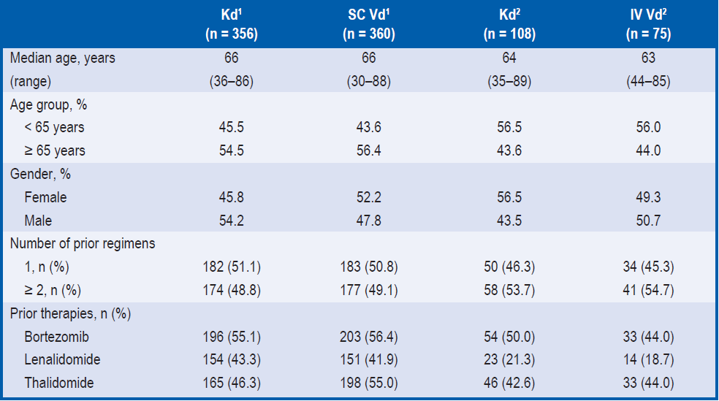
Patient Characteristics
Substudy Kd vs SC Vd and Kd vs IV Vd
ENDEAVOR TOC
Patient Characteristics at Baseline
¹SC Vd and ²IV Vd were based on the actual treatment route of administration in the Vd arm patients, whereas Kd¹ and Kd² were based on
stratification factor of SC and IV routes of BTZ administration assigned before randomisation, respectively.
IV, intravenous; Kd, carfilzomib and dexamethasone; SC, subcutaneous; Vd, bortezomib and dexamethasone.
Goldschmidt H et al. EHA 2016, Copenhagen, Denmark, P659.

Slide 29
History of Peripheral Neuropathy at Baseline (ITT Population)
ENDEAVOR TOC
 | Kd (n = 464) | Vd (n = 465)
History of neuropathy, n (%) | 215 (46.3) | 244 (52.5)
Worst grade at any time, n (%)
Grade 1 | 140 (30.2) | 159 (34.2)
Grade 2 | 56 (12.1) | 66 (14.2)
Grade 3 | 14 (3.0) | 15 (3.2)
Grade 4 | 1 (0.2) | 0
Unknown | 4 (0.9) | 4 (0.9)
Ongoing at screening, n (%)
Grade 1 | 133 (28.7) | 159 (34.2)
Grade 2 | 10 (2.2) | 10 (2.2)
Kd, carfilzomib and dexamethasone; Vd, bortezomib and dexamethasone.
Niesvizky R et al. EHA 2017, Madrid, Spain (abstract and poster E1244).

Slide 30
ENDEAVOR
Primary Endpoint: Progression-free Survival
ENDEAVOR TOC
All studies
Intent-to-treat Population
Intent-to-treat Population: Updated results
Cytogenetic Status
Age
Prior Lines of Therapy
Prior Bortezomib Exposure
Prior Lenalidomide Exposure
Route of BTZ Administration
History of Peripheral Neuropathy
Prior ASCT
Early and Late Relapse Patients
Renal Deficiency
Summary

Slide 31
Kaplan-Meier Curve and Median Progression-free Survival in the Intent-to-treat Population
ENDEAVOR TOC
Median follow-up: 11.9 months in the Kd arm, 11.1 months in the Vd arm
Median follow-up: 11.9 months in the Kd arm, 11.1 months in the Vd arm
 | Kd (N = 464) n (%) | Vd (N = 465) n (%)
Progression/Death | 171 (36.9) | 243 (52.3)
Median PFS, mo | 18.7 | 9.4
HR (Kd/Vd) 95% CI | 0.53 (0.44-0.65)
P value | <0.0001
100
80
60
Survival (%)
Progression-free
40
20
Kd
Vd
0
0
6
12
18
24
30
Months
No. at risk:
Kd 464 331 144 41 4 0
Vd 465 252 81 12 1 0
PFS benefit of Kd was consistent across all pre-specified patient subgroups, including age, cytogenetic risk, prior lenalidomide, and prior bortezomib
CI, confidence interval; HR, hazard ratio; Kd, carfilzomib and dexamethasone; PFS, progression-free survival; Vd, bortezomib and dexamethasone.
Dimopoulos et al., Lancet Oncol 2016;17:27-38.
Notes:
The cutoff date for the interim analysis was November 10, 2014.
43% of patients in the carfilzomib group and 23% of patients in the bortezomib group were still receiving treatment.
In the intent-to-treat population, 414 events had occurred based on outcomes assessed by the independent review committee (carfilzomib group, n=171 events; bortezomib group, n=243 events).
Based on this number of events, the O’Brien-Fleming stopping boundary for efficacy (two-sided p value) was 0.023.
Median follow-up for progression-free survival was 11.9 months in the carfilzomib group and 11.1 months in the bortezomib group.
Reference:
Dimopoulos et al., Carfilzomib and dexamethasone versus bortezomib and dexamethasone for patients with relapsed or refractory multiple myeloma (ENDEAVOR): a randomised, phase 3, open-label, multicentre study. Lancet Oncol. 2015; doi: http://dx.doi.org/10.1016/S1470-2045(15)00464-7.

Slide 32
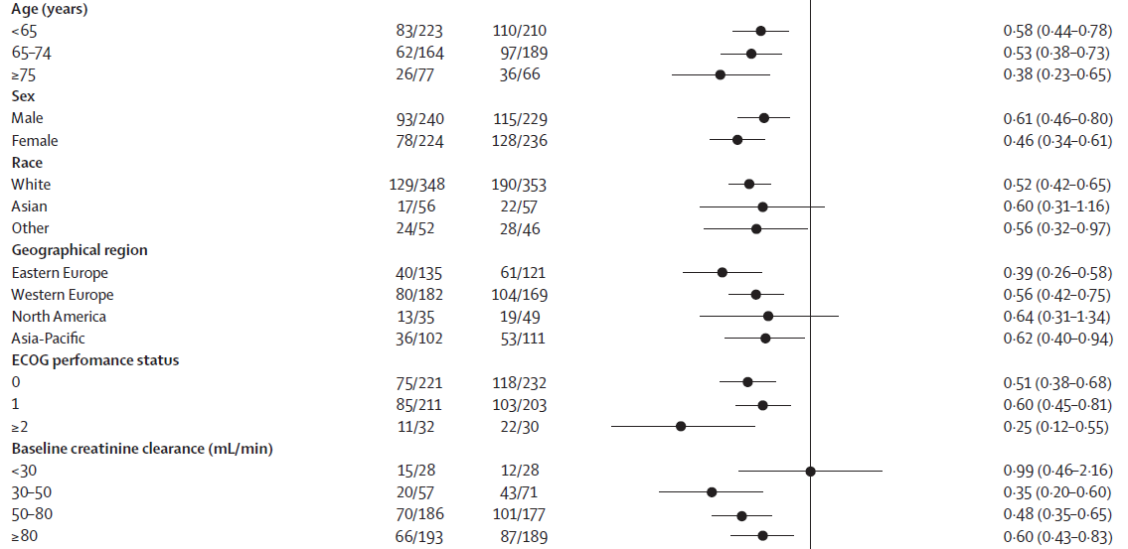
Progression-free Survival by Subgroup (1)
ENDEAVOR TOC
Median follow-up: 11.9 months in the Kd arm, 11.1 months in the Vd arm
CI, confidence interval; ECOG, Eastern Cooperative Oncology Group; HR, hazard ratio.
Dimopoulos et al., Lancet Oncol 2016;17:27-38.

Slide 33
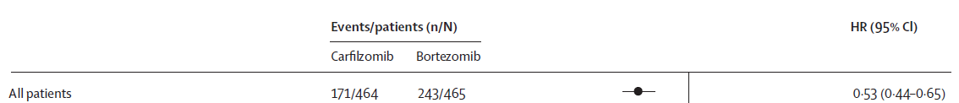
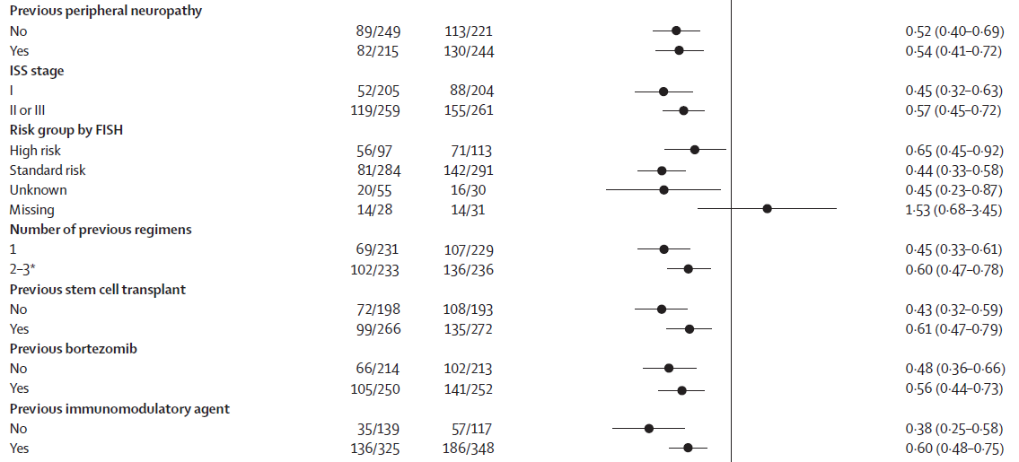
Progression-free Survival by Subgroup (2)
ENDEAVOR TOC
Median follow-up: 11.9 months in the Kd arm, 11.1 months in the Vd arm
* One patient in the bortezomib group received four previous regimens
CI, confidence interval; FISH, fluorescence in situ hybridisation; HR, hazard ratio; ISS, International Staging System.
Dimopoulos et al., Lancet Oncol 2016;17:27-38.

Slide 34
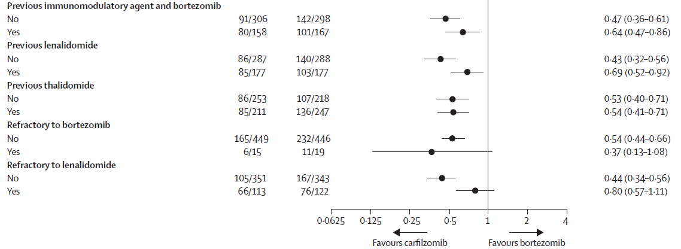
Progression-free Survival by Subgroup (3)
ENDEAVOR TOC
Median follow-up: 11.9 months in the Kd arm, 11.1 months in the Vd arm
CI, confidence interval; HR, hazard ratio; Kd, carfilzomib and dexamethasone; Vd, bortezomib and dexamethasone.
Dimopoulos et al., Lancet Oncol 2016;17:27-38.

Slide 35
Updated Results After an
Additional 6-7 Months of Follow-up
ENDEAVOR TOC
Median follow-up of 19.4 months (Kd) and 17.7 months (Vd)
 | Kd (n=464) | Vd (n=465)
Progression/Death, n (%)* | 245 (52.8) | 298 (64.1)
Median PFS, months (95% CI) | 17.6 (15.4 – 19.5)* | 9.4 (8.4 – 10.4)*
HR (95% CI) p value | 0.53 (0.44 – 0.63) < 0.0001
18-months PFS, % (95% CI) | 48.7 (43.7 – 53.5)* | 23.9 (19.4 – 28.6)*
Median time to progression, months | 19.4 | 10.2
HR (95% CI) P-value | 0.50 (0.42 – 0.60) < 0.0001
Median time to next treatment, months | 26.1 | 14.5
HR (95% CI) p value | 0.49 (0.40 – 0.60) < 0.0001
* Siegel et al. EHA 2017 (abstract P333 and poster).
HR, hazard ratio; Kd, carfilzomib and dexamethasone; PFS, progression-free survival; Vd, bortezomib and dexamethasone.
Dimopoulos et al., Lancet Oncol 2016;17:27-38. Supplementary appendix.

Slide 36
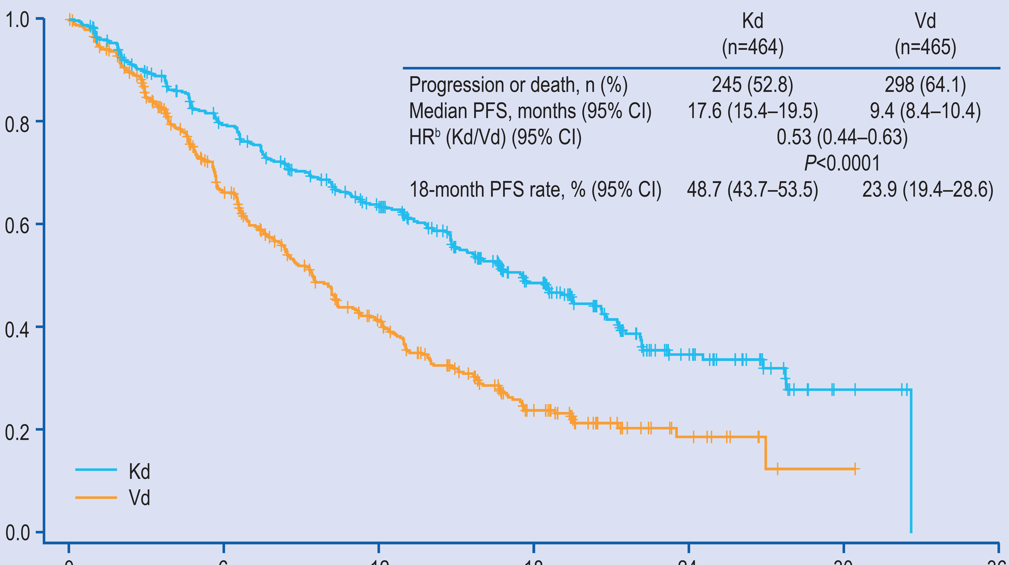
PFS – Updated Results (ITT Population)
ENDEAVOR TOC
Median follow-up of 19.4 months (Kd) and 17.7 months (Vd)
 | Kd (N = 464) n (%) | Vd (N = 465) n (%)
Progression/Death | 245 (52.8) | 298 (64.1)
Median PFS, mo | 17.6 | 9.4
HRª (Kd/Vd) (95% CI) | 0.53 (0.44 – 0.63)
P value | <0.0001
100
80
60
Survival (%)
Progression-free
40
20
Kd
0
Vd
0
6
12
18
24
30
36
Months
No. at risk:
Kd 464 346 260 137 40 4 0
Vd 465 265 147 51 11 1 0
ª Stratified by prior proteasome inhibitor therapy, lines of prior treatment, International Staging System (ISS) stage, and route of bortezomib administration.
CI, confidence interval; HR, hazard ratio; ITT, intent to treat; Kd, carfilzomib and dexamethasone; PFS, progression-free survival;
Vd, bortezomib and dexamethasone.
Siegel et al., EHA 2017 (abstract P333 and poster)

Slide 37
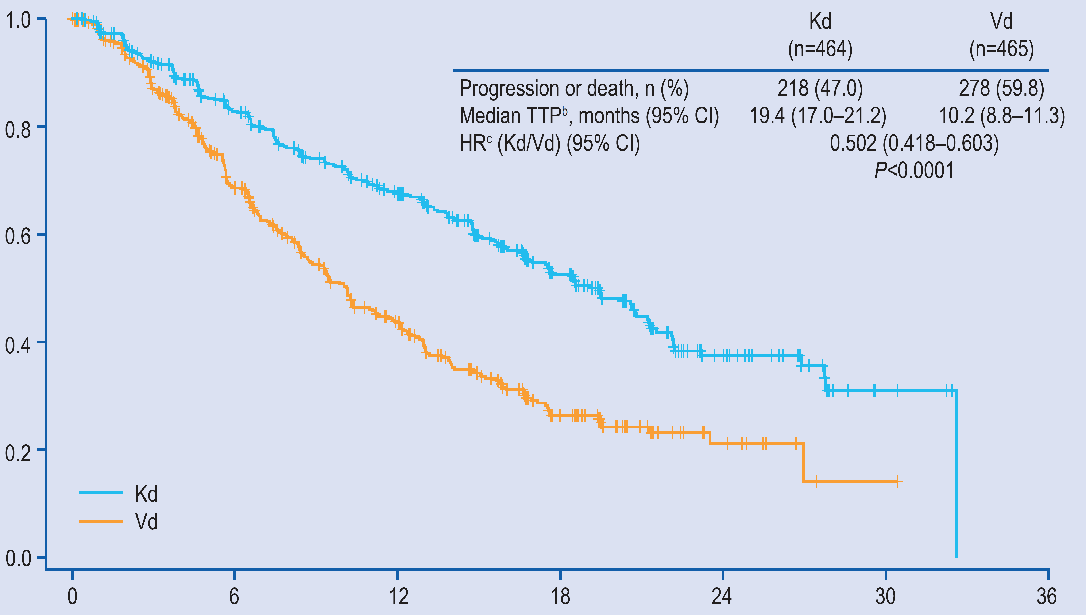
TTP (ITT Population)
ENDEAVOR TOC
Median follow-up of 19.4 months (Kd) and 17.7 months (Vd)
 | Kd (N = 464) n (%) | Vd (N = 465) n (%)
Progression/Death | 218 (47.0) | 278 (59.8)
Median TTP, mo (95% CI) | 19.4 (17.0 – 21.2) | 10.2 (8.8 – 11.3)
HR* (Kd/Vd) (95% CI) | 0.502 (0.418 – 0.603)
P value | <0.0001
1.0
0.8
0.6
Proportion surviving without progression
0.4
0.2
Kd
0
Vd
0
6
12
18
24
30
36
Months
No. at risk:
Kd 464 347 261 137 40 4 0
Vd 465 268 151 52 11 1 0
*Stratified by prior proteasome inhibitor therapy, lines of prior treatment, International Staging System (ISS) stage, and route of bortezomib administration.
CI, confidence interval; HR, hazard ratio; ITT, intent to treat; Kd, carfilzomib and dexamethasone; TTP, time to progression;
Vd, bortezomib and dexamethasone.
Siegel et al., EHA 2017 (abstract P333 and poster)

Slide 38
PFS by Cytogenetic Risk Status at Baseline (1)
ENDEAVOR TOC
Median follow-up: 11.9 months in the Kd arm, 11.1 months in the Vd arm
Kd
Kd
Vd
Vd
 | Kd (n = 97) | Vd (n = 113)
Progression/Death, n (%) | 56 (57.7) | 71 (62.8)
Median PFS, months | 8.8 | 6.0
HR (95% CI) p value | 0.646 (0.453–0.921) <0.0075
 | Kd (n = 284) | Vd (n = 291)
Progression/Death, n (%) | 81 (28.5) | 142 (48.8)
Median PFS, months | NE | 10.2
HR (95% CI) p value | 0.439 (0.333–0.578) <0.0001
CI, confidence interval; HR, hazard ratio; Kd, carfilzomib and dexamethasone; NE, not estimable; PFS, progression-free survival; Vd, bortezomib and dexamethasone.
Chng et al., Leukemia 2017;31:1368-74.

Slide 39
Progression-free Survival by Specific Cytogenetic Abnormalities (2)
ENDEAVOR TOC
Median follow-up: 11.9 months in the Kd arm, 11.1 months in the Vd arm
 | High Risk
 | del(17p) |  | t(4;14)
 | Kd (n = 40) | Vd (n = 52) | Kd (n = 50) | Vd (n = 61)
PFS, median months (95% CI) | 7.6 (5.6–11.2) | 4.9 (3.9–7.5) | 10.1 (6.9–NE) | 6.8 (5.6–9.4)
HR (95% CI) p value | 0.73 (0.42–1.27) 0.13 |  | 0.63 (0.38–1.02) 0.03
CI, confidence interval; HR, hazard ratio; Kd, carfilzomib and dexamethasone; NE, not estimable; PFS, progression-free survival; Vd, bortezomib and dexamethasone.
Chng et al., Leukemia 2017;31:1368-74.

Slide 40
Progression-free Survival by Cytogenetic Risk Status and Lines of Therapy (3)
ENDEAVOR TOC
Median follow-up: 11.9 months in the Kd arm, 11.1 months in the Vd arm
 | High Risk |  |  |  | Standard Risk
 | 1 Prior Line |  | ≥ 2 Prior Lines |  | 1 Prior Line |  | ≥ 2 Prior Lines
 | Kd (n = 42) | Vd (n = 53) | Kd (n = 55) | Vd (n = 60) | Kd (n = 149) | Vd (n = 141) | Kd (n = 135) | Vd (n = 150)
PFS, median months, (95% CI) | 11.1 (7.4–NE) | 7.4 (5.2–10.3) | 7.6 (5.7–10.2) | 5.6 (4.6–6.6) | NE (18.7–NE) | 12.1 (9.5–15.9) | NE (14.5–NE) | 9.3 (6.7–11.3)
HR (95% CI) | 0.59 (0.33–1.05) |  | 0.66 (0.42–1.04) |  | 0.38 (0.25–0.58) |  | 0.51 (0.36–0.74)
CI, confidence interval; HR, hazard ratio; Kd, carfilzomib and dexamethasone; NE, not estimable; PFS, progression-free survival; Vd, bortezomib and dexamethasone.
Chng et al., Leukemia 2017;31:1368-74.

Slide 41
Kaplan-Meier PFS Curves by Age Subgroup
ENDEAVOR TOC
Median follow-up (Kd vs Vd):
11.9 months vs 10.4 months
Median follow-up (Kd vs Vd):
12.0 months vs 11.1 months
Median follow-up (Kd vs Vd):
11.5 months vs 10.4 months
Kd
Kd
Kd
Vd
Vd
Vd
Number at Risk
Kd 223 154 67 22 0 0
Vd 210 118 36 9 1 0
Number at Risk
Kd 164 120 54 12 3 0
Vd 189 101 36 3 0 0
Number at Risk
Kd 77 57 23 7 1 0
Vd 66 33 9 0 0 0
 | Kd (n = 223) | Vd (n = 210)
Progression/ Death, n (%) | 83 (37.2) | 110 (52.4)
Median PFS, months | NE | 9.5
HR for Kd vs Vd (95% CI) | 0.581 (0.436–0.774)
 | Kd (n = 164) | Vd (n = 189)
Progression/ Death, n (%) | 62 (37.8) | 97 (51.3)
Median PFS, months | 15.6 | 9.5
HR for Kd vs Vd (95% CI) | 0.528 (0.382–0.728)
 | Kd (n = 77) | Vd (n = 66)
Progression/ Death, n (%) | 26 (33.8) | 36 (54.5)
Median PFS, months | 18.7 | 8.9
HR for Kd vs Vd (95% CI) | 0.383 (0.227–0.647)
CI, confidence interval; HR, hazard ratio; Kd, carfilzomib and dexamethasone; NE, not estimable;
PFS, progression-free survival; Vd, bortezomib and dexamethasone.
Niesvizky et al, presented at ASH 2017, poster (abstract 1885); Ludwig et al., Leuk Lymphoma 2017; 58:2501-2504.
Notes:
The average dose received (after cycle 1) of carfilzomib was 54.3 mg/m² for patients <65; 54.3 mg/m² ^{for} those 65-74; and 51.7 mg/m² for those ≥ 75.
The average dose of bortezomib was 1.2 mg/m² for all three age subgroups.
In all 3 age subgroups, PFS was better for patients treated with Kd vs Vd.
There was a trend for the largest PFS improvement in the eldest subgroup (≥75 years), where the HR for progression or death was 0.383
Reference:
Palumbo et al., Carfilzomib and dexamethasone vs bortezomib and dexamethasone in patients with relapsed multiple myeloma: results of the Phase 3 study of ENDEAVOR (NCT01568866) according to age subgroup. ASH. 2015 (abstract 1844).

Slide 42
Progression-free Survival by Prior Lines of Therapy (Intent-to-treat Population) (N = 929)
ENDEAVOR TOC
Median follow-up: 11.9 months in the Kd arm, 11.1 months in the Vd arm
Kd
Kd
Vd
Vd
 | Kd (n = 232) | Vd (n = 232)
Progression/Death, n (%) | 70 (30.2) | 109 (47.0)
Median PFS, months | 22.2 | 10.1
HR (95% CI) p value | 0.447 (0.330–0.606) <0.0001
 | Kd (n = 232) | Vd (n = 233)
Progression/Death, n (%) | 101 (43.5) | 134 (57.5)
Median PFS, months | 14.9 | 8.4
HR (95% CI) p value | 0.604 (0.466–0.783) <0.0001
CI, confidence interval; HR, hazard ratio; Kd, carfilzomib and dexamethasone; PFS, progression-free survival;
Vd, bortezomib and dexamethasone.
Moreau et al., Leukemia 2017;31:115-22.

Slide 43
Progression-free Survival by Prior Bortezomib Exposure (Intent-to-treat Population) (N = 929) (1)
ENDEAVOR TOC
Median follow-up: 11.9 months in the Kd arm, 11.1 months in the Vd arm
Kd
Kd
Vd
Vd
 | Kd (n = 214) | Vd (n = 213)
Progression/Death, n (%) | 66 (30.8) | 102 (47.9)
Median PFS, mos | NE | 11.2
HR (95% CI) p value | 0.484 (0.354–0.660) <0.0001
 | Kd (n = 250) | Vd (n = 252)
Progression/Death, n (%) | 105 (42.0) | 141 (56.0)
Median PFS, mos | 15.6 | 8.1
HR (95% CI) p value | 0.562 (0.435–0.726) <0.0001
CI, confidence interval; HR, hazard ratio; Kd, carfilzomib and dexamethasone; NE, not estimable; PFS, progression-free survival;
Vd, bortezomib and dexamethasone.
Moreau et al., Leukemia 2017;31:115-22.

Slide 44
Progression-free Survival by Prior Bortezomib Exposure and Prior Lines of Therapy (Intent-to-treat Population) (N = 929) (2)
ENDEAVOR TOC
Median follow-up: 11.9 months in the Kd arm, 11.1 months in the Vd arm
Prior Lines | No Prior Bortezomib Exposure |  | Prior Bortezomib Exposure
 | Kd (n = 214) | Vd (n = 213) | Kd (n = 250) | Vd (n = 252)
1 prior line, n | 134 | 131 | 97 | 98
Median PFS, mos | NE | 11.2 | 18.7 | 8.7
HR for progression (Kd vs Vd) (95% CI) | 0.43 (0.28–0.66) |  | 0.48 (0.31–0.76)
2-3 prior lines, n (%) | 80 | 82 | 153 | 154
Median PFS, mos | 15.7 | 9.4 | 13.1 | 7.4
HR for progression (Kd vs Vd) (95% CI) | 0.56 (0.36–0.89) |  | 0.62 (0.45–0.85)
CI, confidence interval; HR, hazard ratio; Kd, carfilzomib and dexamethasone; NE, not estimable; PFS, progression-free survival; Vd, bortezomib and dexamethasone.
Moreau et al., Leukemia 2017;31:115-22.

Slide 45
PFS of Patients Treated with 2nd-Line Carfilzomib by Prior Bortezomib
ENDEAVOR TOC
Median follow-up: 11.9 months in the Kd arm, 11.1 months in the Vd arm
1.0
Progression-free survival
0.8
Proportion surviving without progression
0.6
0.4
Kd
Vd
0.2
0.0
0
6
12
18
24
30
Number at risk:
Kd
Vd
Months from randomisation
96
101
68
50
35
14
10
3
2
0
0
0
Kd (n = 96)
33 (34.4%)
18.7
Vd (n = 101)
53 (52.5%)
8.7
Progression/Death, n (%)
Median PFS, mo
HR (Kd/Vd) (95% CI)
p-value (1-sided)
0.464 (0.298, 0.723)
0.0003
CI, confidence interval; HR, hazard ratio; Kd, carfilzomib and dexamethasone;, progression-free survival; Vd, bortezomib and dexamethasone.
Mateos MV, et al. Presented at ASH 2017, poster (abstract 1840).

Slide 46
Progression-free Survival by Prior Lenalidomide Exposure (Intent-to-treat Population) (N = 929) (1)
ENDEAVOR TOC
Median follow-up: 11.9 months in the Kd arm, 11.1 months in the Vd arm
Kd
Kd
Vd
Vd
 | Kd (n = 287) | Vd (n = 288)
Progression/Death, n (%) | 86 (30.0) | 140 (48.6)
Median PFS, mos | 22.2 | 10.2
HR (95% CI) p value | 0.43 (0.32–0.56) <0.0001
 | Kd (n = 177) | Vd (n = 177)
Progression/Death, n (%) | 85 (48.0) | 103 (58.2)
Median PFS, mos | 12.9 | 7.3
HR (95% CI) p value | 0.688 (0.515–0.917) 0.0052
CI, confidence interval; HR, hazard ratio; Kd, carfilzomib and dexamethasone; PFS, progression-free survival; Vd, bortezomib and dexamethasone.
Moreau et al., Leukemia 2017;31:115-22.

Slide 47
Progression-free Survival by Prior
Lenalidomide Exposure and Prior Lines of Therapy (Intent-to-treat Population) (N = 929) (2)
ENDEAVOR TOC
Median follow-up: 11.9 months in the Kd arm, 11.1 months in the Vd arm
Prior Lines | No Prior Lenalidomide Exposure |  | Prior Lenalidomide Exposure
 | Kd (n = 287) | Vd (n = 288) | Kd (n = 177) | Vd (n = 177)
1 prior line, n | 180 | 184 | 51 | 45
Median PFS, mos | 22.2 | 10.1 | 15.6 | 10.3
HR for progression (Kd vs Vd) (95% CI) | 0.41 (0.29–0.58) |  | 0.62 (0.33–1.17)
2-3 prior lines, n | 107 | 104 | 126 | 132
Median PFS, mos | NE | 10.4 | 9.7 | 6.6
HR for progression (Kd vs Vd) (95% CI) | 0.45 (0.29–0.70) |  | 0.73 (0.53–1.01)
CI, confidence interval; HR, hazard ratio; Kd, carfilzomib and dexamethasone; NE, not estimable; PFS, progression-free survival; Vd, bortezomib and dexamethasone.
Moreau et al., Leukemia 2017;31:115-22.

Slide 48
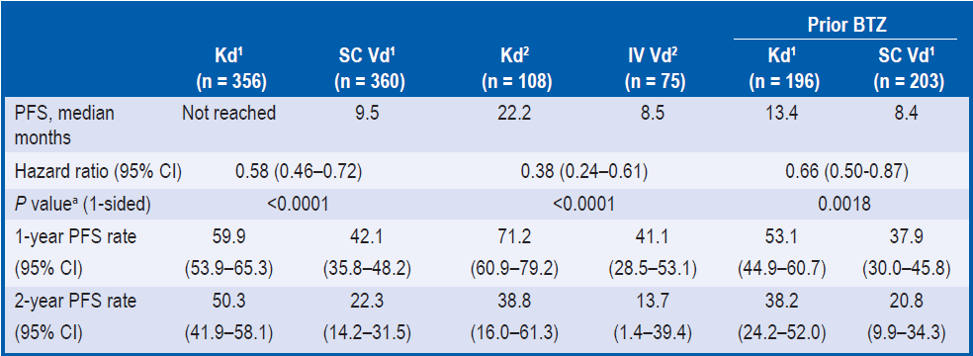
PFS by Route of BTZ Administration
ENDEAVOR TOC
Median follow-up: 11.9 months in the Kd arm, 11.1 months in the Vd arm
Treatment with Kd led to clinically meaningful improvements in PFS compared with SC or IV Vd
1- and 2-year PFS rates were higher in the Kd arm than in the SC and IV Vd arms
PFS rates were also higher in the Kd arm vs SC Vd arm for patients with prior BTZ treatment
ªAll P values were unadjusted for multiplicity. SC Vd¹ and IV Vd² were based on the actual treatment route of administration in the Vd arm patients,
whereas Kd¹ and Kd² were based on stratification factor of SC and IV routes of BTZ administration assigned before randomisation, respectively.
CI, confidence interval; IV, intravenous; Kd, carfilzomib and dexamethasone; PFS, progression-free survival; SC, subcutaneous;
Vd, bortezomib and dexamethasone.
Goldschmidt H et al. EHA 2016, Copenhagen, Denmark, P659.

Slide 49
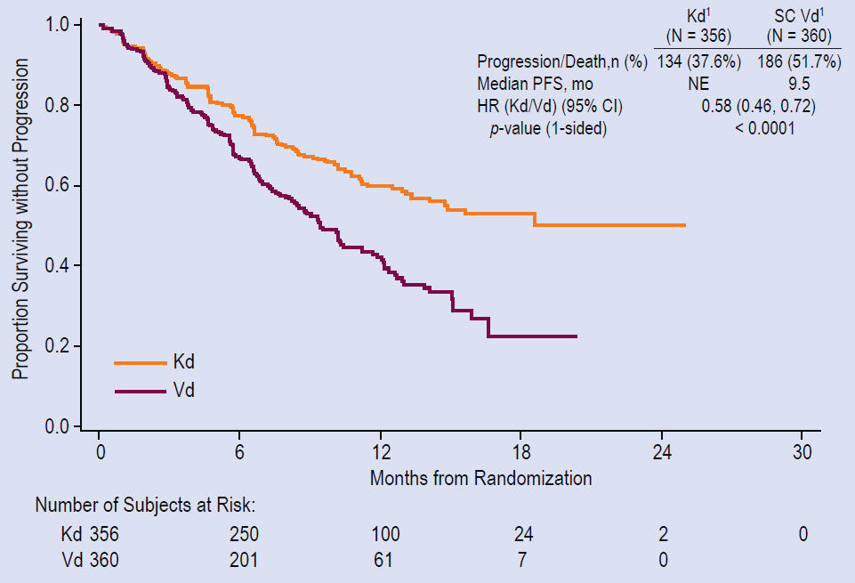
PFS by Route of BTZ Administration
ENDEAVOR TOC
Median follow-up: 11.9 months in the Kd arm, 11.1 months in the Vd arm
Kaplan-Meier PFS curves - Kd vs SC Vd
SC Vd¹ and IV Vd² were based on the actual treatment route of administration in the Vd arm patients, whereas Kd¹ and Kd² were based on
stratification factor of SC and IV routes of BTZ administration assigned before randomisation, respectively.
CI, confidence interval; HR, hazard ratio; Kd, carfilzomib and dexamethasone; NE, not estimable; PFS, progression-free survival; Vd, bortezomib
and dexamethasone
Goldschmidt H et al. EHA 2016, Copenhagen, Denmark, P659.

Slide 50
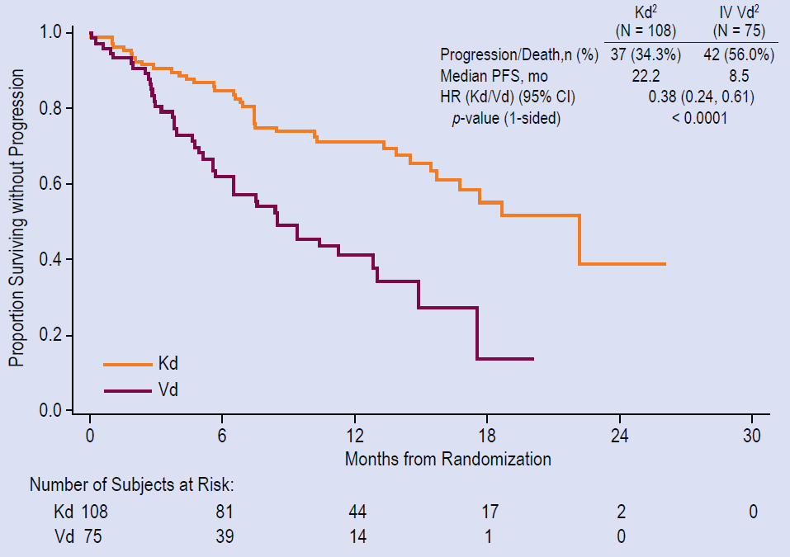
PFS by Route of BTZ Administration
ENDEAVOR TOC
Median follow-up: 11.9 months in the Kd arm, 11.1 months in the Vd arm
Kaplan-Meier PFS curves - Kd vs IV Vd
SC Vd¹ and IV Vd² were based on the actual treatment route of administration in the Vd arm patients, whereas Kd¹ and Kd² were based on
stratification factor of SC and IV routes of BTZ administration assigned before randomisation, respectively.
CI, confidence interval; HR, hazard ratio; Kd, carfilzomib and dexamethasone; NE, not estimable; PFS, progression-free survival; Vd, bortezomib
and dexamethasone
Goldschmidt H et al. EHA 2016, Copenhagen, Denmark, P659.

Slide 51
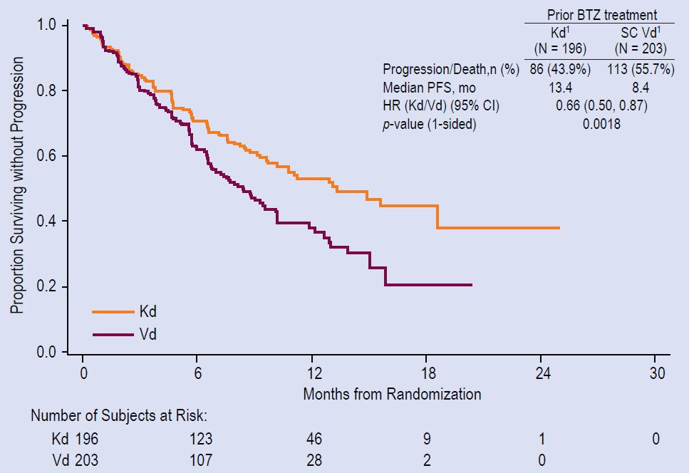
PFS by Route of BTZ Administration
ENDEAVOR TOC
Median follow-up: 11.9 months in the Kd arm, 11.1 months in the Vd arm
Kaplan-Meier PFS curves –
Kd vs SC Vd in patients with prior BTZ use
Treatment with Kd also reduced the risk of progression or death vs SC Vd in patients with prior BTZ exposure
SC Vd¹ and IV Vd² were based on the actual treatment route of administration in the Vd arm patients, whereas Kd¹ and Kd² were based on
stratification factor of SC and IV routes of BTZ administration assigned before randomisation, respectively.
CI, confidence interval; HR, hazard ratio; Kd, carfilzomib and dexamethasone; NE, not estimable; PFS, progression-free survival; Vd, bortezomib
and dexamethasone
Goldschmidt H et al. EHA 2016, Copenhagen, Denmark, P659.

Slide 52
PFS by History of Peripheral
Neuropathy at Baseline (ITT Population)
ENDEAVOR TOC
Median follow-up: 37.5 months in the Kd arm, 36.9 months in the Vd arm
 | Kd | Vd
No PN, n | 249 | 221
Median PFS, months (95% CI) | 17.7 (18.9–NE) | 9.5 (8.0–12.1)
HR (95% CI) | 0.52 (0.395–0.693)
Any-grade PN, n | 215 | 244
Median PFS, months (95% CI) | 18.7 (13.9–NE) | 9.4 (7.5–10.4)
HR (95% CI) | 0.54 (0.410–0.715)
Grade ≥ 2 PN, n | 71 | 81
Median PFS, months (95% CI) | 18.6 (10.2–NE) | 5.6 (4.5–7.4)
HR (95% CI) | 0.42 (0.266–0.677)
PFS was improved with Kd vs Vd irrespective of PN status at baseline
CI, confidence interval; HR, hazard ratio; ITT, intention-to-treat; Kd, carfilzomib and dexamethasone; PFS, progression-free survival; PN, peripheral neuropathy; Vd, bortezomib and dexamethasone.
Niesvizky et al., EHA 2017 (abstract E1244 and poster)

Slide 53
PFS by Prior ASCT (ITT Population)
ENDEAVOR TOC
Median follow-up: 11.9 months in the Kd arm, 11.1 months in the Vd arm
 | Prior ASCT |  | 1R1T |  | No prior ASCT
 | Kd (n = 266) | Vd (n = 272) | Kd (n = 123) | Vd (n = 141) | Kd (n = 198) | Vd (n = 193)
Median PFS, months (95% CI) | NE (15.6–NE) | 10.2 (8.5–12.2) | NE (16.8–NE) | 11.2 (8.5–15.1) | 17.7 (14.1–NE) | 8.5 (6.5–10.2)
HR (95% CI) P-value | 0.61 (0.47–0.79) < 0.0001 |  | 0.46 (0.30–0.69) < 0.0001 |  | 0.43 (0.32–0.59) < 0.0001
1-year PFS rate (95% CI) | 61.8 (55.1–67.8) | 46.0 (38.9–52.9) | 70.7 (60.6–78.6) | 48.4 (38.2–57.8) | 63.9 (55.9–70.9) | 35.4 (27.4–43.6)
2-year PFS rate (95% CI) | 53.0 (44.2–61.0) | 25.9 (16.7–36.0) | 59.3 (44.8–71.1) | NE (NE–NE) | 32.0 (13.2–52.7) | 17.1 (8.1–29.0)
Treatment with Kd led to improvements in PFS regardless of transplant status
Hari et al., Leukemia 2017; 31:2630-2641.
1R1T, first relapse after frontline ASCT; ASCT, autologous stem cell transplantation; CI, confidence interval; HR, hazard ratio; Kd, carfilzomib and dexamethasone; NE, not estimable; PFS, progression-free survival; Vd, bortezomib and dexamethasone;.

Slide 54
PFS in Early and Late Relapse Patients
ENDEAVOR TOC
1.0
Progression-free survival:
early relapse patients
Kd (n=123)
58 (47.2%)
13.9
Vd (n=116)
73 (62.9%)
5.7
0.8
Progression/Death, n (%)
Median PFS, mo
HR (Kd/Vd) (95% CI)
p-value (1-sided)
0.6
0.598 (0.423, 0.846)
0.0017
Proportion surviving without progression
0.4
Kd
0.2
Median follow-up: 11.9 months in the Kd arm,
11.1 months in the Vd arm
Vd
0.0
0
6
12
18
24
30
Number at risk:
Kd
Vd
Months from randomisation
123
116
69
45
31
14
7
3
0
1
0
0
1.0
Progression-free survival:
late relapse patients
Kd (n=335)
111 (33.1%)
22.2
Vd (n=340)
167 (49.1%)
10.2
0.8
Progression/Death, n (%)
Median PFS, mo
HR (Kd/Vd) (95% CI)
p-value (1-sided)
0.6
0.486 (0.382, 0.620)
<0.0001
Proportion surviving without progression
0.4
Kd
0.2
Vd
0.0
0
6
12
18
24
30
Number at risk:
Kd
Vd
Months from randomisation
CI, confidence interval; HR, hazard ratio; Kd, carfilzomib and dexamethasone; PFS, progression-free survival;
Vd, bortezomib and dexamethasone.
Mateos MV et al. Presented at ASH 2017; Poster (Abstract 3120).
335
340
258
201
111
66
33
9
3
0
0
0

Slide 55
PFS in Renal Deficient Subgroups
ENDEAVOR TOC
CrCL ≥15 to ≤50 mL/min
 | Kd56 (n=85) | Vd (n=99)
Progression/death, n (%) | 35 (41.2%) | 55 (55.6%)
Median PFS, mo | 14.9 | 6.5
HR (Kd56/Vd, 95% CI) | 0.492 (0.320, 0.757)
CrCL >50 to <80 mL/min
 | Kd56 (n=186) | Vd (n=177)
Progression/death, n (%) | 70 (37.6%) | 101 (57.1%)
Median PFS, mo | 18.6 | 9.4
HR (Kd56/Vd, 95% CI) | 0.478 (0.351, 0.652)
1.0
1.0
0.8
0.8
0.6
0.6
Proportion surviving without progression
Proportion surviving without progression
0.4
Kd56
Vd
0.4
Kd56
Vd
0.2
0.2
0.0
0.0
0
6
12
18
0
6
12
18
Months from randomisation
Months from randomisation
Number of subjects at risk:
Number of subjects at risk:
Kd56
Vd
85
99
55
41
22
16
Kd56
Vd
186
177
136
97
54
27
14
1
CrCL ≥80 mL/min
 | Kd56 (n=193) | Vd (n=189)
Progression/death, n (%) | 66 (34.2%) | 87 (46.0%)
Median PFS, mo | NE | 12.2
HR (Kd56/Vd, 95% CI) | 0.599 (0.434, 0.827)
1.0
0.8
Median follow-up:
11.9 months in the Kd arm, 11.1 months in the Vd arm
0.6
Proportion surviving without progression
0.4
Kd56
Vd
0.2
0.0
0
6
12
18
Months from randomisation
Number of subjects at risk:
Kd56
Vd
193
189
140
114
68
38
21
8
CI, confidence interval; CrCL, creatinine clearance; HR, hazard ratio; Kd56, carfilzomib and dexamethasone, with 56 mg/m² carfilzomib dose;
NE, not estimable; PFS, progression-free survival; Vd, bortezomib and dexamethasone.
Dimopoulos M et al. Presented at ASH 2017; Poster (Abstract 1845).

Slide 56
Progression-free Survival: Summary (1)
ENDEAVOR TOC
Intent-to-treat Population:
With median follow-up of 19.4 months in the Kd group, and 17.7 months in the Vd group, median PFS was 17.6 months in the Kd treatment group compared to 9.4 months in the Vd treatment group (HR = 0.53; p-value < 0.0001)
The effect of Kd on progression-free survival in the overall population was similar to that in all other subgroups analysed
Results after an additional follow-up were consistent (HR = 0.53; p-value < 0.0001)
Cytogenetic Status:
As expected, median PFS for patients with high-risk cytogenetics was lower compared with the overall population
However, Kd-treated patients had a clinically meaningful improvement in PFS compared with Vd-treated patients with high- or standard-risk cytogenetics
Age:
Patients in the Kd treatment arm had clinically meaningful improvements in PFS compared with the Vd treatment arm, irrespective of age group
HR, hazard ratio; Kd, carfilzomib and dexamethasone; PFS, progression-free survival; Vd, bortezomib and dexamethasone.

Slide 57
Progression-free Survival: Summary (2)
ENDEAVOR TOC
Prior Lines of Therapy:
There was a clinically meaningful improvement in PFS for patients with relapsed MM who were treated with Kd compared to Vd, regardless of the number of prior lines of therapy
  In patients who had received one prior line of therapy, median PFS was 22.2 months in the Kd treatment group versus 10.1 months in the Vd treatment group (HR 0.447, p<0.0001)
There was a trend for greatest improvement in median PFS in patients who received just one prior line of therapy, supporting early use of carfilzomib-based regimens
Prior Bortezomib Exposure:
A PFS benefit was observed for Kd compared to Vd based on prior exposure to bortezomib, and similar trends were observed when patients were categorised by prior bortezomib exposure and number of prior lines of therapy
  Second Line Carfilzomib by Prior Exposure to Bortezomib
  Carfilzomib-based regimens were effective at first relapse compared to standard of care, regardless of prior exposure to bortezomib
    Kd improved PFS vs Vd at first relapse after bortezomib-based frontline therapy, providing 10.0 additional months without disease progression (18.7 months vs 8.7 months)
HR, hazard ratio; Kd, carfilzomib and dexamethasone; PFS, progression-free survival; Vd, bortezomib and dexamethasone.

Slide 58
Progression-free Survival: Summary (3)
ENDEAVOR TOC
Prior Lenalidomide Exposure:
A PFS benefit was observed for Kd compared to Vd based on prior exposure to lenalidomide, and similar trends were observed when patients were categorised by prior lenalidomide exposure and number of prior lines of therapy
History of Peripheral Neuropathy:
Patients in the Kd treatment arm had clinically meaningful improvements in PFS compared with the Vd treatment arm, irrespective of their history of peripheral neuropathy at baseline
Transplant Status:
A PFS benefit was observed for Kd compared to Vd, regardless of transplant status
Early and late relapse:
Patients benefitted from Kd vs Vd treatment regardless of whether they had early or late relapse
Renal deficient patients:
Clinically meaningful improvements in PFS were observed with Kd56 vs Vd in all CrCL subgroups, including patients with severe renal impairment
Kd, carfilzomib and dexamethasone; PFS, progression-free survival; Vd, bortezomib and dexamethasone.

Slide 59
ENDEAVOR
Secondary Endpoint:
Overall Survival
ENDEAVOR TOC
All studies
Intent-to-treat Population
Updated OS Analysis
Subgroup Analysis
Age
Prior Lines
Prior Bortezomib
Prior Lenalidomide
Cytogenetic Risk
Renal Deficiency
Time to Next Treatment
Subsequent Anti-myeloma Therapy
Survival from Time of Progressive Disease
Summary

Slide 60
Secondary Endpoint:
Final Overall Survival Analysis*
ENDEAVOR TOC
Preplanned interim analysis for OS at 79% of targeted survival events
  Stratified log-rank test for inferential comparison
  Significance level was determined by the O’Brien-Fleming type alpha spending function based on the actual number of events (alpha = 0.0123)
The cutoff date for this pre-specified interim analysis was Jan 3, 2017
At the time of this analysis, a total of 398 deaths had been recorded (189 in the carfilzomib group and 209 in the bortezomib group), with a median OS follow up of approximately 37.5 months (IQR, 34.4-41.9) in the carfilzomib group and 36.9 months (IQR, 33.4-40.6) in the bortezomib group
*This was the second planned interim OS analysis which became the final OS analysis as the OS endpoint was met.
IQR, interquartile range; OS, overall survival.
Dimopoulos et al., Lancet Oncol 2017; 18:1327-1337.

Slide 61
Secondary Endpoint:
Final Overall Survival Analysis* (ITT)
ENDEAVOR TOC
Median follow-up: 37.5 months in the Kd arm, 36.9 months in the Vd arm
 | Kd (N = 464) | Vd (N = 465)
Death, n (%) | 189 (40.7) | 209 (44.9)
Median OS, mo | 47.6 | 40.0
HR (Kd/Vd) 95% CI | 0.791 (0.648-0.964)
p value | 0.01
1.0
0.8
0.6
Proportion Surviving
0.4
0.2
Kd
Median follow-up: 37.5 months for Kd and 36.9 months for Vd
0
Vd
0
6
12
18
24
30
36
42
48
Months Since Randomisation
No. at risk:
(no. censored)
Kd 464 (0) 423 (7) 373 (16) 335 (21) 308 (25) 270 (35) 162 (121) 66 (215) 10 (266)
Vd 465 (0) 402 (28) 351 (40) 293 (50) 256 (56) 228 (58) 140 (130) 39 (221) 5 (251)
Pre-planned interim analysis* of overall survival at 79% of targeted survival events
In the ITT population, the OS rate at 24 months (Kd56 vs Vd) was 70.9% vs 63.9%
*This was the second planned interim OS analysis which became the final OS analysis as the OS endpoint was met.
CI, confidence interval; HR, hazard ratio; ITT, intent-to-treat; Kd, carfilzomib and dexamethasone; OS, overall survival; Vd, bortezomib and dexamethasone.
Dimopoulos et al., Lancet Oncol 2017; 18:1327-1337; Weisel K et al. Presented at ASH 2017; Poster (Abstract 1850).

Slide 62
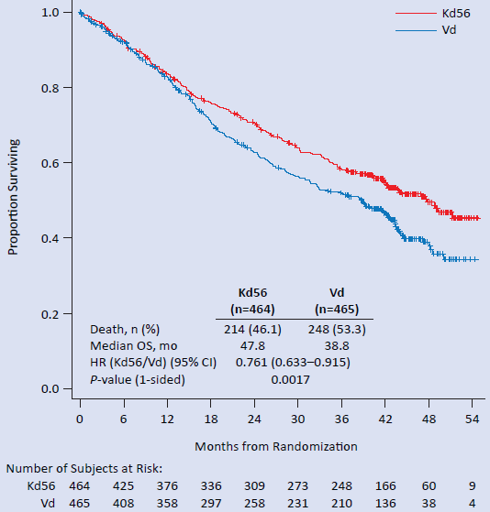
Secondary Endpoint:
Updated Overall Survival Analysis
ENDEAVOR TOC
Median follow-up in the Kd56 group was 44.3 months, compared to 43.7 months in the Vd group
In the ITT population, the median OS was 47.8 months in the Kd56 group and 38.8 months in the Vd group (HR 0.76; 95% CI 0.63-0.92; one-sided p=0.0017)
CI, confidence interval; HR, hazard ratio; ITT, intent-to-treat; Kd, carfilzomib and dexamethasone; OS, overall survival;
Vd, bortezomib and dexamethasone.
Orlowski K et al. Presented at EHA 2018; Poster (Abstract PF561).

Slide 63
Overall Survival by Subgroups
ENDEAVOR TOC
Median follow-up: 37.5 months in the Kd arm, 36.9 months in the Vd arm
Events (n)/Patients (n)
Kd
Vd
HR (95% CI)
Age (years)
< 65
91/223
92/210
0.85 (0.63–1.13)
65–74
61/164
85/189
0.71 (0.51–0.98)
≥ 75
37/77
32/66
0.84 (0.52–1.36)
Baseline ECOG PS
0.81 (0.59–1.12)
0
71/221
81/232
0.80 (0.61–1.05)
1
103/210
107/203
≥ 2
15/33
21/30
0.50 (0.26–0.98)
Baseline creatinine clearance (mL/min)
0.69 (0.33–1.44)
< 30
14/28
15/28
0.63 (0.38–1.06)
30 to < 50
24/57
37/71
0.84 (0.62–1.14)
50 to < 80
81/186
85/177
0.84 (0.60–1.17)
≥ 80
70/193
72/189
ISS stage
0.70 (0.49–1.00)
I
54/205
68/204
II or III
135/259
141/261
0.83 (0.66–1.05)
Risk group by FISH*
0.83 (0.58–1.19)
High†
55/97
65/113
Standard‡
106/284
116/291
0.85 (0.65–1.10)
Lines of prior treatment
1
79/231
83/229
0.83 (0.61–1.14)
2-3
110/233
126/236
0.76 (0.59–0.99)
Prior bortezomib
113/250
0.84 (0.65–1.08)
Yes
124/252
0.75 (0.55–1.02)
No
76/214
85/213
Previous immunomodulatory drugs
Yes
143/326
160/350
0.86 (0.68–1.07)
No
46/138
49/115
1
0.66 (0.44–0.99)
Favours Kd
Favours Vd
*Excludes patients with missing or unknown results. †High-risk FISH is defined as detection of ≥ 10% t(4;14) or t(14;16) genetic subtypes in screened plasma cells, or ≥ 20% 17p deletions in screened plasma cells at study entry. ‡Standard-risk patients were those in whom chromosomal abnormalities were not detected.
CI, confidence interval; ECOG PS, Eastern Cooperative Oncology Group performance status; FISH, fluorescence in situ hybridization; HR, hazard ratio; ISS, International Staging System; Kd, carfilzomib and dexamethasone; Vd, bortezomib and dexamethasone.
Dimopoulos et al., Lancet Oncol 2017; 18:1327-1337.
Notes:
OS in other subgroups of interest (ENDEAVOR trial)
Baseline Creatinine Clearance (mL/min) HR Kd vs Vd (95% CI)
<30 0.69 (0.326, 1.443)
30 - <50 0.63 (0.377, 1.059)
50 - <80 0.84 (0.619, 1.138)
>=80 0.84 (0.604, 1.168
Prior lenalidomide
Yes 0.95 (0.707, 1.271)
No 0.69 (0.524, 0.897)
LDH (U/L)
<300 0.75 (0.606, 0.934)
>=300 0.75 (0.457, 1.233)

Slide 64
Overall Survival by Age
ENDEAVOR TOC
1.0
OS*: <65 years
0.8
Kd56 (N=223)
91 (40.8%)
47.6
Vd (N=210)
92 (43.4%)
41.9
Proportion surviving
Kd56
Death, n (%)
Median OS, mo
HR (Kd56/Vd) (95% CI)
0.6
0.847 (0.634, 1.132)
0.4
0.2
Vd
0.0
0
6
12
18
24
30
36
42
Number at risk:
Kd56
Vd
Months from randomisation
223
210
205
187
182
170
170
147
158
130
139
116
82
69
32
21
1.0
OS*: 65 – 74 years
Kd56 (N=164)
61 (37.2%)
NE
Vd (N=189)
85 (45.0%)
37.0
0.8
Death, n (%)
Median OS, mo
HR (Kd56/Vd) (95% CI)
Proportion surviving
Kd56
0.706 (0.508, 0.981)
0.6
0.4
Vd
0.2
0.0
0
6
12
18
24
30
36
42
Number at risk:
Kd56
Vd
Months from randomisation
164
189
149
163
132
131
114
109
105
97
93
84
57
53
23
13
1.0
OS*: ≥75 years
Kd56 (N=77)
37 (48.1%)
42.4
Vd (N=66)
32 (48.5%)
25.9
0.8
Death, n (%)
Median OS, mo
HR (Kd56/Vd) (95% CI)
Proportion
surviving
Kd56
0.841 (0.522, 1.355)
0.6
0.4
Vd
The median duration of treatment was longer with Kd56 than Vd within all age subgroups:
  <65 years: 49.0 vs 27.0 weeks
  65–74 years: 49.9 vs 27.6 weeks
  ≥75 years: 43.3 vs 20.6 weeks
0.2
0.0
0
6
12
18
24
30
36
42
Number at risk:
Months from randomization
Kd56
Vd
77
66
69
52
59
50
51
37
45
29
38
28
23
18
11
5
*Curves were truncated at time points with ≤10 subjects (Kd56 and Vd combined) at risk.
CI, confidence interval; HR, hazard ratio; Kd56, 56 mg/m² carfilzomib and dexamethasone; OS, overall survival; Vd, bortezomib+dexamethasone.
Niesvizky et al, presented at ASH 2017, poster (abstract 1885).

Slide 65
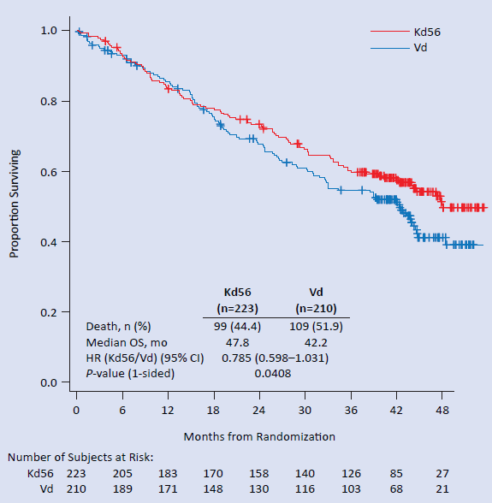
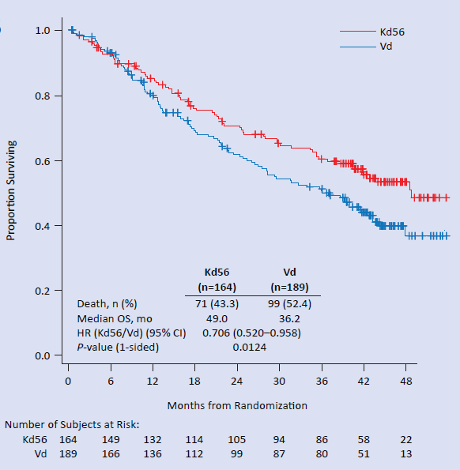
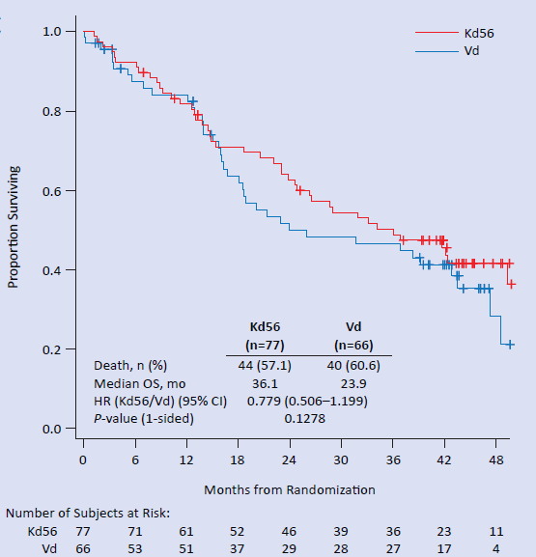
Updated Overall Survival by Age
ENDEAVOR TOC
Median follow-up: 44.3 months in the Kd56 group, and 43.7 months in the Vd group
Patients aged <65 years
Patients aged 65-74 years
Patients aged ≥75 years
CI, confidence interval; HR, hazard ratio; Kd, carfilzomib and dexamethasone; OS, overall survival; Vd, bortezomib and dexamethasone.
Orlowski K et al. Presented at EHA 2018; Poster (Abstract PF561).

Slide 66
Overall Survival by Prior Treatment –
1 or 2–3 Prior Lines of Therapy
ENDEAVOR TOC
OS follow-up of approximately 37 months
Overall survival: 1 prior line
1.0
HR=0.76 (0.59–0.99)
p=0.02
0.8
Kd56
0.6
Median OS (months)
Proportion surviving
0.4
Kd56 (n=231)
79 (34.2%)
–
Vd (n=229)
83 (36.2%)
–
Vd
Death, n (%)
Median OS, mo
HR (Kd56/Vd) (95% CI)
p-value (1-sided)
0.2
0.833 (0.611, 1.136)
0.1246
0.0
0
6
12
18
24
30
36
42
Number at risk:
Months from randomisation
Kd56
Vd
231
229
214
199
192
180
175
158
162
142
142
128
89
76
37
19
It was not possible to reliably estimate median OS for the Kd56 and Vd arms in the 1 prior line subgroup
The HR of 0.83 (95% CI: 0.61, 1.14) suggested a survival advantage for Kd56 vs Vd in patients at first relapse
Kd56 improved survival by 11.8 months vs Vd (median OS for Kd56 vs Vd, 40.5 vs 28.7 months; HR = 0.76; 95% CI: 0.59, 0.99) for patients with 2–3 prior lines of therapy
CI, confidence interval; HR, hazard ratio; Kd56, carfilzomib and dexamethasone, with 56 mg/m² carfilzomib dose;
OS, overall survival; RRMM, relapsed/refractory multiple myeloma; Vd, bortezomib and dexamethasone.
Weisel K et al. Presented at ASH 2017; Poster (Abstract 1850).

Slide 67
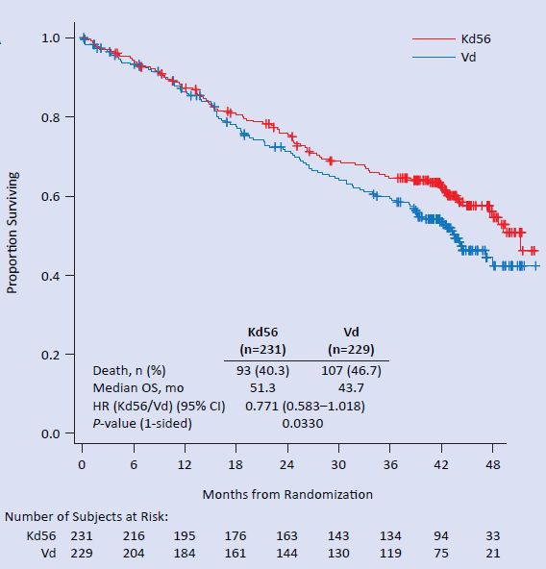
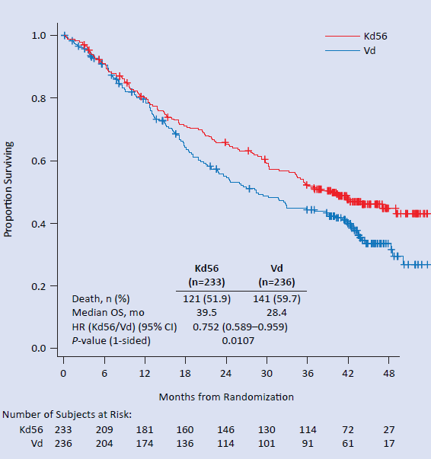
Updated Overall Survival by Prior
Treatment – 1 or 2-3 Prior Lines of Therapy
ENDEAVOR TOC
Median follow-up: 44.3 months in the Kd56 group, and 43.7 months in the Vd group
1 prior line
2-3 prior lines
CI, confidence interval; HR, hazard ratio; Kd, carfilzomib and dexamethasone; OS, overall survival; Vd, bortezomib and dexamethasone.
Orlowski K et al. Presented at EHA 2018; Poster (Abstract PF561).

Slide 68
Overall Survival by Prior Treatment –
Prior Exposure to Bortezomib
ENDEAVOR TOC
Median follow-up: 37.5 months in the Kd arm, 36.9 months in the Vd arm
1.0
Overall survival: prior bortezomib
0.8
0.6
Kd56
Proportion surviving
0.4
Kd56 (n=250)
113 (45.2%)
47.6
Vd (n=252)
124 (49.2%)
32.8
Death, n (%)
Median OS, mo
HR (Kd56/Vd) (95% CI)
p-value (1-sided)
Vd
0.2
0.837 (0.648, 1.080)
0.0857
0.0
0
6
12
18
24
30
36
42
Number at risk:
Months from randomisation
Kd56
Vd
250
252
219
220
188
189
165
152
155
132
133
116
79
71
29
20
Kd56 improved survival by 14.8 months compared with Vd (median OS for Kd56 vs Vd, 47.6 months vs 32.8 months; HR = 0.84; 95% CI: 0.65, 1.08) for patients with prior bortezomib exposure
CI, confidence interval; HR, hazard ratio; Kd56, carfilzomib and dexamethasone, with 56 mg/m² carfilzomib dose;
OS, overall survival; Vd, bortezomib and dexamethasone.
Weisel K et al. Presented at ASH 2017; Poster (Abstract 1850).

Slide 69
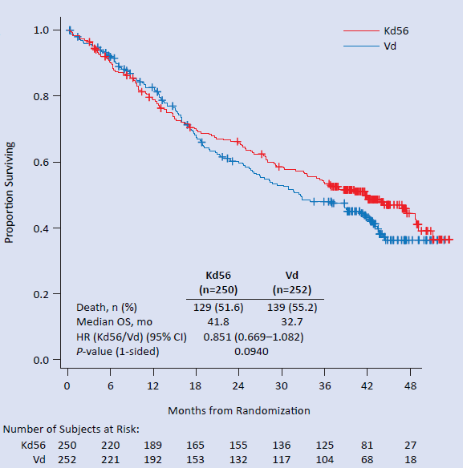
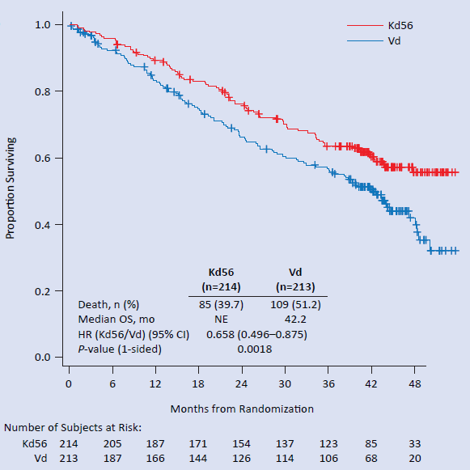
Updated Overall Survival by Prior
Treatment –Prior Exposure to Bortezomib
ENDEAVOR TOC
Median follow-up: 44.3 months in the Kd56 group, and 43.7 months in the Vd group
With prior bortezomib treatment
Without prior bortezomib treatment
CI, confidence interval; HR, hazard ratio; Kd, carfilzomib and dexamethasone; OS, overall survival; Vd, bortezomib and dexamethasone.
Orlowski K et al. Presented at EHA 2018; Poster (Abstract PF561).

Slide 70
Overall Survival by Prior Treatment –
No Prior Exposure to Bortezomib
ENDEAVOR TOC
Median follow-up: 37.5 months in the Kd arm, 36.9 months in the Vd arm
Overall survival: No prior bortezomib
1.0
Kd56
0.8
Vd
0.6
Proportion surviving
0.4
 | Kd56 (N=214) | Vd (N=213)
Death, n (%) | 76 (35.5) | 85 (39.9)
Median OS, months | – | 42.2
HR (Kd56/Vd) 95% CI) | 0.750 (0.550, 1.022)
P-value (1-sided) | 0.0337
0.2
0
0
6
12
18
24
30
36
42
Number of subjects at risk:
Months from randomization
Kd56
Vd
214
213
204
182
185
162
170
141
153
124
137
112
83
69
37
19
For patients without prior bortezomib exposure, the median OS was not reached in the Kd56 arm and was 42.2 months in the Vd arm (HR = 0.75; 95% CI: 0.55, 1.02)
CI, confidence interval; HR, hazard ratio; Kd56, carfilzomib and dexamethasone, with 56 mg/m² carfilzomib dose;
OS, overall survival; Vd, bortezomib and dexamethasone.
Weisel K et al. Presented at ASH 2017; Poster (Abstract 1850).

Slide 71
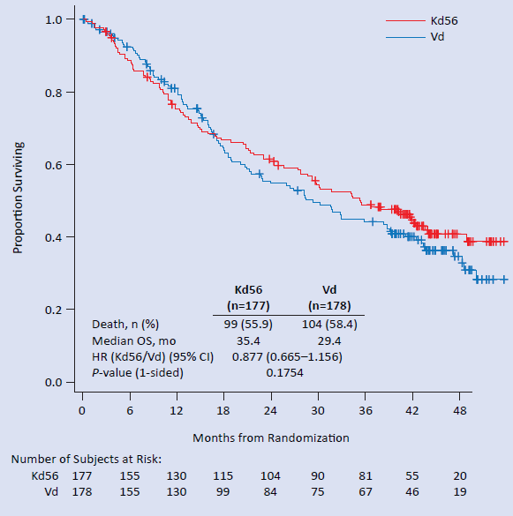
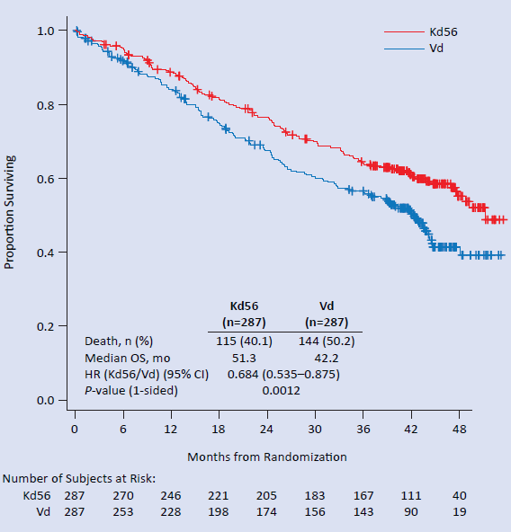
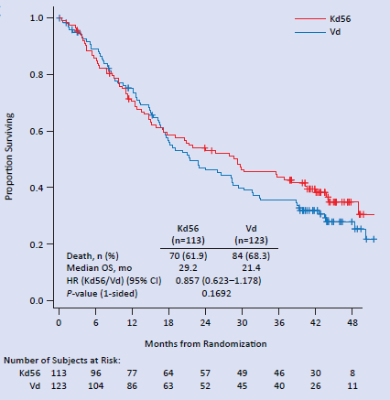
Updated Overall Survival by Prior
Treatment – Prior Exposure to Lenalidomide
ENDEAVOR TOC
Median follow-up: 44.3 months in the Kd56 group, and 43.7 months in the Vd group
With prior lenalidomide
Without prior lenalidomide
Lenalidomide-refractory
CI, confidence interval; HR, hazard ratio; Kd, carfilzomib and dexamethasone; OS, overall survival; Vd, bortezomib and dexamethasone.
Orlowski K et al. Presented at EHA 2018; Poster (Abstract PF561).

Slide 72
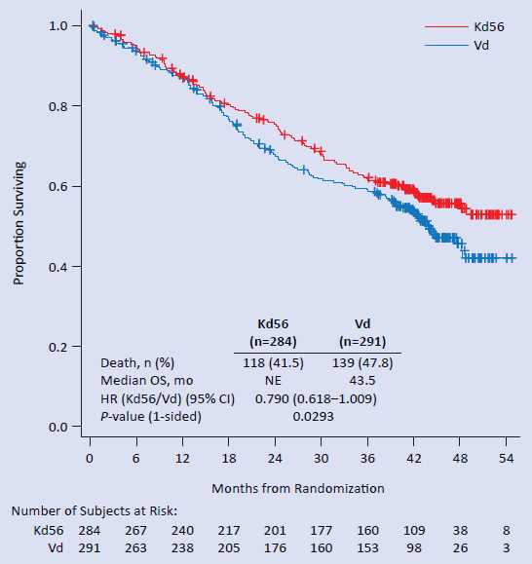
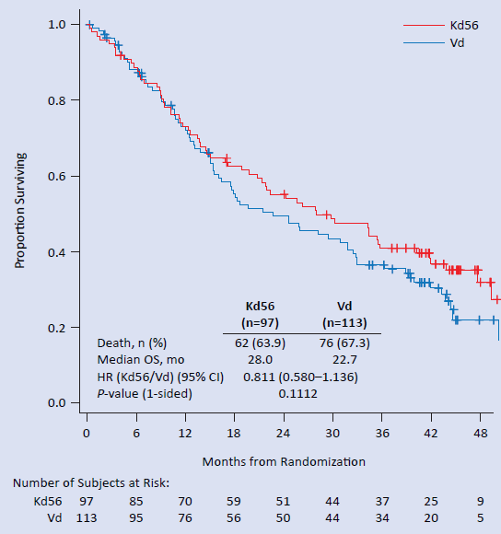
Updated Overall Survival by
Cytogenetic Risk Status
ENDEAVOR TOC
Median follow-up: 44.3 months in the Kd56 group, and 43.7 months in the Vd group
Standard risk
High risk
CI, confidence interval; HR, hazard ratio; Kd, carfilzomib and dexamethasone; OS, overall survival; Vd, bortezomib and dexamethasone.
Orlowski K et al. Presented at EHA 2018; Poster (Abstract PF561).

Slide 73
Overall Survival in Renal Deficient Subgroups
ENDEAVOR TOC
CrCL ≥15 to ≤50 mL/min
CrCL >50 to <80 mL/min
1.0
Kd56
Vd
1.0
Kd56
Vd
0.8
0.8
0.6
0.6
Proportion surviving
Proportion surviving
0.4
 | Kd56 (n=85) | Vd (n=99)
Death, n (%) | 38 (44.7%) | 52 (52.5%)
Median OS, mo | 40.5 | 23.9
HR (Kd56/Vd, 95% CI) | 0.67 (0.439, 1.020)
0.4
 | Kd56 (n=186) | Vd (n=177)
Death, n (%) | 81 (43.5%) | 85 (48.0%)
Median OS, mo | NE | 35.9
HR (Kd56/Vd, 95% CI) | 0.84 (0.619, 1.137)
0.2
0.2
0.0
0.0
0
60
12
18
24
30
36
42
0
6
12
18
24
30
36
42
Months from randomization
Months from randomization
Number of subjects at risk:
Number of subjects at risk:
Kd56
Vd
85
99
80
78
67
63
55
51
48
40
40
37
25
24
11
7
Kd56
Vd
186
177
167
155
144
135
130
109
117
99
103
85
56
52
25
13
CrCL ≥80 mL/min
1.0
Kd56
Vd
0.8
Median follow-up:
37.5 months in the Kd arm, 36.9 months in the Vd arm
0.6
Proportion surviving
0.4
 | Kd56 (n=193) | Vd (n=189)
Death, n (%) | 70 (36.3%) | 72 (38.1%)
Median OS, mo | 47.6 | 42.2
HR (Kd56/Vd, 95% CI) | 0.84 (0.604, 1.168)
0.2
0.0
0
6
12
18
24
30
36
42
Months from randomization
Number of subjects at risk:
Kd56
Vd
193
176
162
150
143
127
81
30
189
169
153
133
117
106
64
19
CI, confidence interval; CrCL, creatinine clearance; HR, hazard ratio; Kd56, carfilzomib and dexamethasone, with 56 mg/m² carfilzomib dose;
NE, not estimable; Vd, bortezomib and dexamethasone.
Dimopoulos M et al. Presented at ASH 2017; Poster (Abstract 1845).

Slide 74
Time to Next Treatment
ENDEAVOR TOC
Median follow-up: 37.5 months (Kd arm), and 36.9 months (Vd arm)
 | Kd (N = 464) | Vd (N = 465)
With next treatment, n (%) | 253 (54.5) | 286 (61.5)
Median TTNT, months | 26.3 | 14.4
HR (Kd/Vd) 95% CI | 0.552 (0.464–0.658)
p value | < 0.0001
1.0
0.8
0.6
Proportion Without Next Treatment
0.4
0.2
Kd
Vd
0.0
0
6
12
18
24
30
36
42
48
54
Months Since Randomization
No. at risk
(no censored):
Kd
464 (0)
380 (36)
307 (54)
252 (66)
208 (74)
164 (85)
82 (138)
29 (184)
7 (205)
0 (211)
Vd
465 (0)
339 (59)
214 (81)
139 (102)
93 (115)
75 (116)
39 (145)
6 (174)
0 (179)
0 (179)
CI, confidence interval; HR, hazard ratio; Kd, carfilzomib and dexamethasone; TTNT, time to next treatment;
Vd, bortezomib and dexamethasone.
Dimopoulos et al., Lancet Oncol 2017; 18:1327-1337; Supplementary Appendix.

Slide 75
Subsequent Antimyeloma Therapies (1)
ENDEAVOR TOC
Median follow-up: 37.5 months in the Kd group, and 36.9 months in the Vd group
 | Kd (n = 391) | Vd (n = 413)
Number of patients treated with at least one therapy | 262 (67%) | 291 (70%)
Systemic corticosteroids
Dexamethasone | 189 (48%) | 220 (53%)
Prednisone | 20 (5%) | 32 (8%)
Prednisolone | 19 (5%) | 15 (4%)
Proteasome inhibitors
Bortezomib | 98 (25%) | 51 (12%)
Carfilzomib | 3 (1%) | 33 (8%)
Immunomodulatory drugs
Lenalidomide | 125 (32%) | 152 (37%)
Pomalidomide | 64 (16%) | 99 (24%)
Thalidomide | 36 (9%) | 55 (13%)
Monoclonal antibodies
Daratumumab | 14 (4%) | 18 (4%)
Data are n (%) of patients for therapies for which 2% or more of patients were given subsequent therapies. On completion of Kd or Vd therapy, 391 patients in the Kd group (of 397 completing therapy) and 413 patients in the Vd group (of 418 completing therapy) entered long-term follow-up.
Kd, carfilzomib and dexamethasone; Vd, bortezomib and dexamethasone.
Dimopoulos et al., Lancet Oncol 2017; 18:1327-1337.

Slide 76
Subsequent Antimyeloma Therapies (2)
ENDEAVOR TOC
Median follow-up: 37.5 months in the Kd group, and 36.9 months in the Vd group
 | Kd (n = 391) | Vd (n = 413)
Antineoplastic agents
Cyclophosphamide | 85 (22%) | 102 (25%)
Melphalan | 50 (13%) | 53 (13%)
Bendamustine | 20 (5%) | 35 (8%)
Doxorubicin | 25 (6%) | 21 (5%)
Etoposide | 14 (4%) | 15 (4%)
Cisplatin | 12 (3%) | 15 (4%)
Vincristine | 11 (3%) | 7 (2%)
Other therapeutic products
Investigational drug | 7 (2%) | 11 (3%)
Data are n (%) of patients for therapies for which 2% or more of patients were given subsequent therapies. On completion of Kd or Vd therapy, 391 patients in the Kd group (of 397 completing therapy) and 413 patients in the Vd group (of 418 completing therapy) entered long-term follow-up.
Data on response were not collected for subsequent treatment and thus are not available
Kd, carfilzomib and dexamethasone; Vd, bortezomib and dexamethasone.
Dimopoulos et al., Lancet Oncol 2017; 18:1327-1337.

Slide 77
Survival from Time of Progressive Disease (Among Patients with Disease Progression Based on Investigator Assessment)
ENDEAVOR TOC
Median follow-up: 37.5 months (Kd arm), and 36.9 months (Vd arm)
 | Kd (N = 258) | Vd (N = 301)
Death, n (%) | 133 (51.6) | 168 (55.8)
Median SBP, months | 21.5 | 21.5
HR (Kd/Vd) 95% CI | 1.032 (0.822–1.297)
p value | 0.61
1.0
0.8
0.6
Proportion Surviving
0.4
0.2
Kd
0
Vd
0
6
12
18
24
30
36
42
48
Months from PD
No. at risk:
(no. censored)
Kd
Vd
258 (0)
211 (6)
155 (24)
99 (49)
56 (80)
26 (103)
9 (117)
4 (122)
0 (125)
301 (0)
240 (8)
191 (18)
149 (29)
100 (54)
42 (98)
11 (122)
1 (132)
0 (133)
CI, confidence interval; HR, hazard ratio; Kd, carfilzomib and dexamethasone; PD, progressive disease; SBP, survival beyond progression; Vd, bortezomib and dexamethasone.
Dimopoulos et al., Lancet Oncol 2017; 18:1327-1337, Supplementary Appendix.

Slide 78
Overall Survival: Summary
ENDEAVOR TOC
In the final OS analysis (which was initially the second planned interim analysis), median overall survival was significantly longer in the Kd treatment group compared with the Vd treatment group (47.6 months vs 40.0 months; HR = 0.791; p-value = 0.01)
Updated OS analysis with extended follow-up shows longer median overall survival in the Kd56 group compared to the Vd group (47.8 months vs 38.8 months; HR = 0.76; 95% CI, 0.63-0.92; one-sided p-value = 0.0017)
Improvements in OS were observed in all patients, regardless of age, performance status, ISS stage, cytogenetic risk and extent of prior treatment
Kd56 improved survival by 7.6 months vs Vd (median OS for Kd56 vs Vd, 51.3 vs 43.7 months; HR = 0.77; 95% CI: 0.58, 1.02) for patients with 1 prior line of therapy
Kd56 improved survival by 11.1 months vs Vd (median OS for Kd56 vs Vd, 39.5 vs 28.4 months; HR = 0.75; 95% CI: 0.59, 0.96) for patients with 2–3 prior lines of therapy
Kd56 improved survival by 9.1 months compared with Vd (median OS for Kd56 vs Vd, 41.8 months vs 32.7 months; HR = 0.85; 95% CI: 0.67, 1.08) for patients with prior bortezomib exposure
HR, hazard ratio; Kd, carfilzomib and dexamethasone; Kd56, carfilzomib and dexamethasone, with 56 mg/m² carfilzomib dose;
OS, overall survival; Vd, bortezomib and dexamethasone.

Slide 79
Overall Survival: Summary
ENDEAVOR TOC
Kd56 improved survival by 6 months vs Vd (median OS for Kd56 vs Vd, 35.4 vs 29.4 months; HR = 0.88; 95% CI: 0.67, 1.16) for patients with prior lenalidomide exposure
Kd56 improved survival by 9.1 months vs Vd (median OS for Kd56 vs Vd, 51.3 vs 42.2 months; HR = 0.68; 95% CI: 0.54, 0.88) for patients with no prior lenalidomide exposure
Kd56 improved survival by 7.8 months vs Vd (median OS for Kd56 vs Vd, 29.2 vs 21.4 months; HR = 0.86; 95% CI: 0.62, 1.18) for lenalidomide-refractory patients
Clinically meaningful improvements in OS were observed with Kd56 vs Vd in all CrCL subgroups, including patients with severe renal impairment
CrCl, creatinine clearance; HR, hazard ratio; Kd, carfilzomib and dexamethasone;
Kd56, carfilzomib and dexamethasone, with 56 mg/m² carfilzomib dose; OS, overall survival; Vd, bortezomib and dexamethasone.

Slide 80
ENDEAVOR
Secondary Endpoint:
Grade ≥ 2 Peripheral Neuropathy
ENDEAVOR TOC
All studies
Safety Population
Summary

Slide 81
Secondary Endpoint: Grade ≥ 2 Peripheral Neuropathy*
ENDEAVOR TOC
Median follow-up: 11.9 months in the Kd group, and 11.1 months in the Vd group
p<0.0001
Significantly more patients receiving bortezomib than carfilzomib experienced grade 2 or higher PN, irrespective of PN status at baseline
*Grouped term.
Kd, carfilzomib and dexamethasone; PN, peripheral neuropathy; Vd, bortezomib and dexamethasone.
Dimopoulos et al., Lancet Oncol 2016;17:27-38.

Slide 82
Grade ≥ 2 Peripheral Neuropathy: Summary
ENDEAVOR TOC
The number of patients who had grade ≥ 2 peripheral neuropathy* was significantly higher in the Vd group than in the Kd group (32% vs 6%; p < 0.0001)
This result was irrespective of peripheral neuropathy status at baseline
*Grouped term.
Kd = carfilzomib and dexamethasone; PN = peripheral neuropathy; Vd = bortezomib and dexamethasone.

Slide 83
ENDEAVOR
Adverse Events
ENDEAVOR TOC
All studies
Intent-to-treat Population
Safety Population
Cytogenetic Status
Age
Prior Lines of Therapy
Prior Bortezomib
Prior ASCT
Substudy Kd vs SC Vd and Kd vs IV Vd
Early and Late Relapse Patients
Renal Deficiency
Final OS analysis: Safety
Summary

Slide 84
Treatment Discontinuations and Deaths
Intent-to-Treat Population (N = 929)¹
ENDEAVOR TOC
Median follow-up: 19.7 months in the Kd group, and 17.7 months in the Vd group
 | Kd (N = 464) n (%) | Vd (N = 465) n (%)
Treatment discontinuations² | 263 (56.7) | 351 (75.5)
Discontinuation due to disease progression² | 117 (25.2) | 168 (36.1)
Discontinuation due to AEs² Updated results*³, % | 65 (14.0) 15.8 | 73 (15.7) 14.9
On-study deaths during treatment or within 30 days of receiving last dose of study treatment | 22 (5) | 21 (5)
Deaths due to disease progression | 4 (0.9) | 4 (0.9)
* At a median follow-up of 19.4 months (Kd) and 17.7 months (Vd).
AE, adverse event; Kd, carfilzomib and dexamethasone; Vd, bortezomib and dexamethasone.
1. Dimopoulos et al., Lancet Oncol 2016;17:27-38; 2. Dimopoulos et al., Lancet Oncol 2016;17:27-38. Supplementary appendix; 3. Siegel DS, et al. Presented at IMW 2017.

Slide 85
Adverse Events, Treatment
Discontinuations, and Dose Reductions
Safety Population (N = 919)¹ (1)
ENDEAVOR TOC
Median follow-up: 11.9 months in the Kd group, and 11.1 months in the Vd group
 | Kd (N = 463) n (%) | Vd (N = 456) n (%)
Median treatment duration, wks | 39.9 | 26.8
Serious AEs | 224 (48) | 162 (36)
Dose reduction due to AEs | 106 (23) | 218 (48)
Dose reductions due to neuropathy-related AEs | 7 (7) | 135 (62)
Adverse events leading to treatment discontinuation
Peripheral neuropathy | 0 (0) | 10 (2.2)
Peripheral sensory neuropathy² | 0 (0) | 7 (1.5)
AE, adverse event; Kd, carfilzomib and dexamethasone; Vd, bortezomib and dexamethasone.
1. Dimopoulos et al., Lancet Oncol 2016;17:27-38; 2. Dimopoulos et al., Lancet Oncol 2016;17:27-38. Supplementary appendix.

Slide 86
Common Adverse Events (≥ 10% of Patients in Either Treatment Group) (2)
ENDEAVOR TOC
 | Kd (N = 463) n (%) |  |  |  | Vd (N = 456) n (%)
 | Grade 1-2 | Grade 3 | Grade 4 | Grade 5 | Grade 1-2 | Grade 3 | Grade 4 | Grade 5
Common haematologic AEs (preferred terms)
Anaemia | 115 (25) | 66 (14) | 1 (< 1) | 0 (0) | 78 (17) | 44 (10) | 1 (< 1) | 0 (0)
Thrombocytopaenia | 56 (12) | 21 (5) | 18 (4) | 0 (0) | 35 (8) | 20 (4) | 23 (5) | 0 (0)
Common non-haematologic AEs (preferred terms)
Diarrhoea | 127 (27) | 16 (3) | 0 (0) | 0 (0) | 141 (31) | 33 (7) | 1 (< 1) | 0 (0)
Fatigue | 111 (24) | 25 (5) | 0 (0) | 0 (0) | 98 (21) | 32 (7) | 0 (0) | 0 (0)
Dyspnoea | 107 (23) | 25 (5) | 0 (0) | 0 (0) | 50 (11) | 10 (2) | 0 (0) | 0 (0)
Pyrexia | 119 (26) | 9 (2) | 2 (< 1) | 0 (0) | 59 (13) | 3 (< 1) | 0 (0) | 0 (0)
Insomnia | 110 (24) | 7 (2) | 0 (0) | 0 (0) | 108 (24) | 11 (2) | 0 (0) | 0 (0)
Cough | 115 (25) | 0 (0) | 0 (0) | 0 (0) | 63 (14) | 1 (< 1) | 0 (0) | 0 (0)
Hypertension | 74 (16) | 41 (9) | 0 (0) | 0 (0) | 28 (6) | 12 (3) | 0 (0) | 0 (0)
Peripheral oedema | 97 (21) | 4 (< 1) | 0 (0) | 0 (0) | 75 (16) | 3 (< 1) | 0 (0) | 0 (0)
Asthenia | 78 (17) | 16 (3) | 0 (0) | 0 (0) | 61 (13) | 13 (3) | 1 (< 1) | 0 (0)
Upper respiratory tract infection | 85 (18) | 9 (2) | 0 (0) | 0 (0) | 64 (14) | 3 (< 1) | 0 (0) | 0 (0)
Nausea | 84 (18) | 6 (1) | 0 (0) | 0 (0) | 79 (17) | 3 (< 1) | 0 (0) | 0 (0)
Back pain | 78 (17) | 7 (2) | 1 (< 1) | 0 (0) | 59 (13) | 12 (3) | 0 (0) | 0 (0)
AE, adverse event; Kd, carfilzomib and dexamethasone; Vd, bortezomib and dexamethasone.
Dimopoulos et al., Lancet Oncol 2016;17:27-38.

Slide 87
Common Adverse Events
(≥ 10% of Patients in Either Treatment Group) (3)
ENDEAVOR TOC
 | Kd (N = 463) n (%) |  |  |  | Vd (N = 456) n (%)
 | Grade 1-2 | Grade 3 | Grade 4 | Grade 5 | Grade 1-2 | Grade 3 | Grade 4 | Grade 5
Common non-haematologic AEs (preferred terms)
Muscle spasms | 85 (18) | 1 (< 1) | 0 (0) | 0 (0) | 24 (5) | 3 (< 1) | 0 (0) | 0 (0)
Headache | 75 (16) | 4 (< 1) | 0 (0) | 0 (0) | 43 (9) | 3 (< 1) | 0 (0) | 0 (0)
Bronchitis | 66 (14) | 10 (2) | 0 (0) | 0 (0) | 37 (8) | 4 (< 1) | 0 (0) | 0 (0)
Constipation | 66 (14) | 2 (< 1) | 0 (0) | 0 (0) | 114 (25) | 9 (2) | 0 (0) | 0 (0)
Nasopharyngitis | 66 (14) | 0 (0) | 0 (0) | 0 (0) | 50 (11) | 1 (< 1) | 0 (0) | 0 (0)
Vomiting | 59 (13) | 6 (1) | 0 (0) | 0 (0) | 34 (7) | 6 (1) | 0 (0) | 0 (0)
Pain in extremity | 45 (10) | 2 (< 1) | 0 (0) | 0 (0) | 46 (10) | 3 (< 1) | 0 (0) | 0 (0)
Peripheral neuropathy | 37 (8) | 6 (1) | 0 (0) | 0 (0) | 97 (21) | 23 (5) | 1 (< 1) | 0 (0)
Decreased appetite | 36 (8) | 4 (< 1) | 0 (0) | 0 (0) | 52 (11) | 5 (1) | 0 (0) | 0 (0)
Dizziness | 36 (8) | 1 (< 1) | 0 (0) | 0 (0) | 64 (14) | 3 (< 1) | 0 (0) | 0 (0)
Paraesthesia | 35 (8) | 1 (< 1) | 0 (0) | 0 (0) | 72 (16) | 2 (< 1) | 0 (0) | 0 (0)
Peripheral sensory neuropathy | 26 (6) | 1 (< 1) | 0 (0) | 0 (0) | 61 (13) | 6 (1) | 0 (0) | 0 (0)
Neuralgia | 6 (1) | 3 (< 1) | 0 (0) | 0 (0) | 63 (14) | 7 (2) | 0 (0) | 0 (0)
AE, adverse event; Kd, carfilzomib and dexamethasone; Vd, bortezomib and dexamethasone.
Dimopoulos et al., Lancet Oncol 2016;17:27-38.

Slide 88
Adverse Events of Interest (4)
ENDEAVOR TOC
 | Kd (N = 463) n (%) |  |  |  | Vd (N = 456) n (%)
 | Grade 1-2 | Grade 3 | Grade 4 | Grade 5 | Grade 1-2 | Grade 3 | Grade 4 | Grade 5
Adverse events of interest (grouped terms)
Peripheral neuropathy* | 77 (17) | 10 (2) | 0 (0) | 0 (0) | 198 (43) | 36 (8) | 1 (< 1) | 0 (0)
Acute renal failure^{Ɨ} | 19 (4) | 15 (3) | 3 (< 1) | 1 (< 1) | 10 (2) | 11 (2) | 1 (< 1) | 0 (0)
Cardiac failure^{ǂ} | 16 (3) | 17 (4) | 3 (< 1) | 2 (< 1) | 5 (1) | 5 (1) | 1 (< 1) | 2 (< 1)
Pneumonia | 9 (2) | 30 (6) | 1 (< 1) | 1 (< 1) | 12 (3) | 33 (7) | 1 (< 1) | 2 (< 1)
Ischaemic heart disease§ | 4 (< 1) | 5 (1) | 3 (< 1) | 0 (0) | 2 (< 1) | 3 (< 1) | 1 (< 1) | 3 (< 1)
Pulmonary hypertension** | 3 (< 1) | 3 (< 1) | 0 (0) | 0 (0) | 0 (0) | 1 (< 1) | 0 (0) | 0 (0)
*The category of peripheral neuropathy included (in descending order of frequency) peripheral neuropathy, peripheral sensory neuropathy, neuralgia, decreased vibratory sense, polyneuropathy, sensory loss, amyotrophy, peripheral motor neuropathy, peripheral sensorimotor neuropathy, sensory disturbance, and toxic neuropathy †The category of acute renal failure included (in descending order of frequency) acute renal failure, renal failure, renal impairment, acute prerenal failure, anuria, oliguria, and prerenal failure ‡The category of cardiac failure included (in descending order of frequency) cardiac failure, ejection fraction decreased, pulmonary oedema, acute cardiac failure, congestive cardiac failure, acute pulmonary oedema, acute left ventricular failure, chronic cardiac failure, cardiopulmonary failure, hepatojugular reflex, right ventricular failure, and left ventricular failure §The category of ischaemic heart disease included (in descending order of frequency) angina pectoris, acute coronary syndrome, myocardial infarction, increased troponin T, coronary artery disease, increased troponin I, acute myocardial infarction, myocardial ischaemia, and cardiomyopathy stress **The category of pulmonary hypertension included (in decreasing order of frequency) pulmonary hypertension, right ventricular failure, and pulmonary arterial hypertension.
AE, adverse event; Gr, grade; Kd, carfilzomib and dexamethasone; Vd, bortezomib and dexamethasone.
Dimopoulos et al., Lancet Oncol 2016;17:27-38.

Slide 89
Peripheral Neuropathy
(Safety Population)
ENDEAVOR TOC
Median follow-up: 37.5 months in the Kd arm, 36.9 months in the Vd arm
 | Kd (n = 463) |  | Vd (n = 456)
 | All Grades | Grade ≥ 3 | All Grades | Grade ≥ 3
Peripheral neuropathy (SMQN), n (%) | 87 (18.8) | 10 (2.2) | 235 (51.5) | 37 (8.1)
Peripheral neuropathy* | 43 (9.3) | 6 (1.3) | 121 (26.5) | 24 (5.3)
Peripheral sensory neuropathy* | 27 (5.8) | 1 (0.2) | 67 (14.7) | 6 (1.3)
Polyneuropathy* | 5 (1.1) | 0 | 24 (5.3) | 3 (0.7)
Neuralgia* | 9 (1.9) | 3 (0.6) | 70 (15.4) | 7 (1.5)
Peripheral motor neuropathy* | 1 (0.2) | 0 | 2 (0.4) | 0
Sensorimotor disorder* | 0 | 0 | 0 | 0
Toxic neuropathy* | 0 | 0 | 1 (0.2) | 0
Sensory loss* | 2 (0.4) | 0 | 0 | 0
Peripheral sensorimotor neuropathy* | 1 (0.2) | 0 | 2 (0.4) | 0
Decreased vibratory sense* | 5 (1.1) | 0 | 6 (1.3) | 0
Amyotrophy* | 1 (0.2) | 0 | 0 | 0
Sensory disturbance* | 1 (0.2) | 0 | 0 | 0
*Preferred term.
Kd, carfilzomib and dexamethasone; SMQN, Standard MedDRA Query Narrow; Vd, bortezomib and dexamethasone.
Niesvizky et al., EHA 2017 (abstract and poster E1244)

Slide 90
Adverse Events, Treatment Discontinuations, and Death by Cytogenetic Risk Status (1)
ENDEAVOR TOC
Median follow-up: 11.9 months in the Kd arm, 11.1 months in the Vd arm
Category | High Risk |  | Standard Risk |  | Unknown / Missing
 | Kd (n = 97) | Vd (n = 111) | Kd (n = 283) | Vd (n = 287) | Kd (n = 83) | Vd (n = 58)
Treatment duration, median weeks (range) | 30.3 (1.0–93.1) | 22.0 (1.0–85) | 40.9 (2.0–108.1) | 28.0 (1.0–106.1) | 36.9 (1.0–104.0) | 21.3 (1.0–70.0)
Grade ≥ 3 treatment-emergent AE, n (%) | 68 (70.1) | 70 (63.1) | 209 (73.9) | 196 (68.3) | 62 (74.7) | 39 (67.2)
Treatment discontinuation of any study drug due to treatment-emergent AE, n (%) | 18 (18.6) | 22 (19.8) | 56 (19.8) | 62 (21.6) | 18 (21.7) | 11 (19.0)
Deaths within 30 days of last dose, n (%)* | 8 (8.2) | 5 (4.4) | 9 (3.2) | 14 (4.8) | 5 (6.0) | 2 (3.3)
*Percentage based on the intent-to-treat population of 97 (Kd) and 113 (Vd) high-risk patients, 284 (Kd) and 291 (Vd) standard-risk patients; and 83 (Kd) and 61 (Vd) unknown/missing cytogenetics patients.
AE, adverse event; Kd, carfilzomib and dexamethasone; Vd, bortezomib and dexamethasone.
Chng et al., Leukemia 2017;31:1368-74.

Slide 91
Grade ≥ 3 Adverse Events Reported in
≥ 5% of Patients in Any Subgroup by Cytogenetic Risk Status (2)
ENDEAVOR TOC
Median follow-up: 11.9 months in the Kd arm, 11.1 months in the Vd arm
Preferred Term | High Risk |  | Standard Risk |  | Unknown / Missing
 | Kd (n = 97) | Vd (n = 111) | Kd (n = 283) | Vd (n = 287) | Kd (n = 83) | Vd (n = 58)
Haematologic grade ≥ 3 AEs, n (%)
Anaemia | 14 (14.4) | 14 (12.6) | 44 (15.5) | 23 (8.0) | 9 (10.8) | 8 (13.8)
Thrombocytopaenia | 7 (7.2) | 14 (12.6) | 23 (8.1) | 21 (7.3) | 9 (10.8) | 8 (13.8)
Decreased platelet count | 2 (2.1) | 6 (5.4) | 11 (3.9) | 16 (5.6) | 4 (4.8) | 2 (3.4)
Decreased lymphocyte count | 3 (3.1) | 2 (1.8) | 21 (7.4) | 6 (2.1) | 2 (2.4) | 0
Lymphopaenia | 5 (5.2) | 1 (0.9) | 10 (3.5) | 6 (2.1) | 5 (6.0) | 5 (8.6)
Non-haematologic grade ≥ 3 AEs, n (%)
Pneumonia | 8 (8.2) | 10 (9.0) | 19 (6.7) | 18 (6.3) | 5 (6.0) | 8 (13.8)
Fatigue | 5 (5.2) | 7 (6.3) | 18 (6.4) | 20 (7.0) | 2 (2.4) | 5 (8.6)
Asthenia | 4 (4.1) | 3 (2.7) | 11 (3.9) | 8 (2.8) | 1 (1.2) | 3 (5.2)
Hypertension | 6 (6.2) | 4 (3.6) | 30 (10.6) | 8 (2.8) | 5 (6.0) | 0
Diarrhoea | 4 (4.1) | 9 (8.1) | 10 (3.5) | 23 (8.0) | 2 (2.4) | 2 (3.4)
Peripheral neuropathy | 1 (1.0) | 4 (3.6) | 4 (1.4) | 20 (7.0) | 1 (1.2) | 0
Dyspnoea | 5 (5.2) | 1 (0.9) | 16 (5.7) | 6 (2.1) | 4 (4.8) | 3 (5.2)
Back pain | 1 (1.0) | 0 | 4 (1.4) | 9 (3.1) | 3 (3.6) | 3 (5.2)
Bone pain | 1 (1.0) | 0 | 4 (1.4) | 4 (1.4) | 5 (6.0) | 2 (3.4)
Syncope | 0 | 1 (0.9) | 0 | 8 (2.8) | 0 | 3 (5.2)
AE, adverse event; Kd, carfilzomib and dexamethasone; Vd, bortezomib and dexamethasone.
Chng et al., Leukemia 2017;31:1368-74.

Slide 92
Select Adverse Events of Interest by Cytogenetic Risk Status (3)
ENDEAVOR TOC
Median follow-up: 11.9 months in the Kd arm, 11.1 months in the Vd arm
 | High Risk |  | Standard Risk
 | Kd (n = 97) | Vd (n = 111) | Kd (n = 283) | Vd (n = 287)
Grade ≥ 3 AEs of interest, n (%)
Cardiac failure (preferred term) | 3 (3.1) | 2 (1.8) | 7 (2.5) | 1 (0.3)
Acute renal failure (preferred term) | 3 (3.1) | 0 (0) | 6 (2.1) | 3 (1.0)
Peripheral neuropathy (grouped term), n (%)
Grade ≥ 2 | 3 (3.1) | 39 (35.1) | 18 (6.4) | 96 (33.4)
Odds ratio (95% CI) | 0.059 (0.018–0.198) |  | 0.135 (0.079–0.231)
Grade ≥ 3 | 1 (1.0) | 4 (3.6) | 4 (1.4) | 20 (7.0)
AE, adverse event; CI, confidence interval; Kd, carfilzomib and dexamethasone; Vd, bortezomib and dexamethasone.
Chng et al., ASH 2015 (abstract 30, oral presentation); Chng et al., Leukemia 2017;31:1368-74.
Notes:
The category of cardiac failure included (in descending order of frequency) cardiac failure, congestive cardiac failure, pulmonary oedema, hepatic congestion, cardiopulmonary failure, acute pulmonary oedema, acute cardiac failure, and right ventricular failure.
The category of ischemic heart disease included (in descending order of frequency) angina pectoris, myocardial infarction, acute myocardial infarction, increased blood creatinine phosphokinase, coronary artery disease, myocardial ischemia, coronary artery occlusion, increased troponin, increased troponin T, acute coronary syndrome, abnormal cardiac stress test, cardiomyopathy stress, unstable angina, coronary artery stenosis, abnormal electrocardiogram ST-T segment, and abnormal electrocardiogram T wave.
The category of acute renal failure included (in descending order of frequency) acute renal failure, renal failure, renal impairment, azotemia, oliguria, anuria, toxic nephropathy, and prerenal failure.

Slide 93
Safety Profile by Patient Age (1)
ENDEAVOR TOC
Median follow-up (Kd vs Vd):
11.9 months vs 10.4 months
Median follow-up (Kd vs Vd):
12.0 months vs 11.1 months
Median follow-up (Kd vs Vd):
11.5 months vs 10.4 months
 | < 65 Years |  | 65 – 74 Years |  | ≥ 75 Years
 | Kd (n = 223) | Vd (n = 208) | Kd (n = 163) | Vd (n = 183) | Kd (n = 77) | Vd (n = 65)
Grade ≥ 3 adverse event, n (%) | 152 (68.2) | 131 (63.0) | 124 (76.1) | 128 (69.9) | 63 (81.8) | 46 (70.8)
Adverse event leading to treatment discontinuation, n (%) | 37 (16.6) | 31 (14.9) | 35 (21.5) | 41 (22.4) | 20 (26.0) | 23 (35.4)
Adverse event leading to death, n (%) | 11 (4.9) | 10 (4.8) | 10 (6.1) | 8 (4.4) | 4 (5.2) | 3 (4.6)
Treatment-emergent AEs, n (%) | 220 (98.7) | 207 (99.5) | 160 (98.2) | 180 (98.4) | 77 (100.0) | 64 (98.5)
In the safety population (n=919), the median duration of treatment was longer with Kd56 than with Vd within each age subgroup
  <65 years: median, 49.0 weeks vs 27.0 weeks
  65–74 years: 49.9 weeks vs 27.6 weeks
  ≥75 years: 43.3 weeks vs 20.6 weeks
  Adverse events were not adjusted for exposure
Kd, carfilzomib and dexamethasone; Kd56, carfilzomib and dexamethasone, with 56 mg/m² carfilzomib dose;
Vd, bortezomib and dexamethasone.
Ludwig et al., Leuk Lymphoma 2017; 58:2501-2504; Niesvizky et al, presented at ASH 2017, poster (abstract 1885).
Notes:
Frequency of grade ≥ 2 peripheral neuropathy was lower for Kd than Vd across all age subgroups
Frequencies of grade ≥ 3 hypertension, dyspnoea, and cardiac failure were higher for Kd than Vd across all age subgroups
Rates of adverse events leading to treatment discontinuation were lower for Kd vs Vd in the ≥ 75 years age subgroup but were similar between treatment arms in the 2 younger subgroups
Rates of adverse events leading to death were similar between treatment arms in all subgroups

Slide 94
Safety Profile by Patient Age (2)
ENDEAVOR TOC
 | < 65 Years |  | 65 – 74 Years |  | ≥ 75 Years
 | Kd (n = 223) | Vd (n = 208) | Kd (n = 163) | Vd (n = 183) | Kd (n = 77) | Vd (n = 65)
Select grade ≥ 3 adverse events of interest*, n (%)
Hypertension | 31 (13.9) | 7 (3.4) | 23 (14.1) | 6 (3.3) | 13 (16.9) | 2 (3.1)
Dyspnoea | 9 (4.0) | 3 (1.4) | 14 (8.6) | 6 (3.3) | 6 (7.8) | 1 (1.5)
Peripheral neuropathy | 2 (0.9) | 7 (3.4) | 4 (2.5) | 17 (9.3) | 0 | 4 (6.2)
Cardiac failure | 3 (1.3) | 1 (0.5) | 6 (3.7) | 1 (0.5) | 4 (5.2) | 1 (1.5)
Acute renal failure | 8 (3.6) | 6 (2.9) | 1 (0.6) | 1 (0.5) | 3 (3.9) | 0
Select grade ≥ 3 haematologic related AEs, n (%)
Anaemia | 36 (16.1) | 23 (11.1) | 22 (13.5) | 20 (10.9) | 18 (23.4) | 3 (4.6)
Thrombocytopenia | 17 (7.6) | 19 (9.1) | 17 (10.4) | 19 (10.4) | 7 (9.1) | 5 (7.7)
Neutropenia | 7 (3.1) | 4 (1.9) | 4 (2.5) | 5 (2.7) | 0 | 1 (1.5)
Leukopenia | 2 (0.9) | 1 (0.5) | 3 (1.8) | 1 (0.5) | 0 | 0
The incidence of grade ≥3 peripheral neuropathy was lower for Kd56 than Vd across all age subgroups
The incidence of grade ≥3 hypertension, dyspnoea, cardiac failure, acute renal failure, and cardiac ischaemia were greater with Kd56 vs Vd across all age subgroups
Treatment discontinuation due to hypertension was rare, with only one patient in the Kd arm stopping treatment
* Preferred term, and incidence of adverse events was not adjusted for exposure.
Kd, carfilzomib and dexamethasone; Vd, bortezomib and dexamethasone.
Ludwig et al., Leuk Lymphoma 2017; 58:2501-2504; Niesvizky et al, presented at ASH 2017, poster (abstract 1885).

Slide 95
Adverse Events Summary by Prior Lines
ENDEAVOR TOC
Median follow-up: 37.5 months in the Kd arm, 36.9 months in the Vd arm
 | 1 prior line |  | 2-3 prior lines
 | Kd56 (n=231) | Vd (n=229) | Kd56 (n=233) | Vd (n=236)
Treatment duration, weeks, median | 52 | 28 | 42 | 25
≥ Grade 3 AEs, % | 78.4 | 68.3 | 84.5 | 73.7
AEs leading to treatment discontinuation, % | 25.1 | 20.5 | 25.0 | 22.8
Grade 5 AEs, % | 6.5 | 3.1 | 7.3 | 6.0
Rate of any grade AEs
  1 prior line: 97.4% vs 98.7% for Kd vs Vd
  ≥2 prior lines: 99.1% vs 97.4% for Kd vs Vd
Rates of AEs leading to treatment discontinuation and death were similar between the Kd56 and Vd treatment arms for subgroups
AE, adverse event; Kd56, carfilzomib and dexamethasone, with 56 mg/m² carfilzomib dose; Vd, bortezomib and dexamethasone.
Weisel et al. Presented at ASH 2017; Poster (Abstract 1850); Moreau et al., Leukemia 2017;31:115-22.

Slide 96
≥ Grade 3 Adverse Events by Prior Lines
ENDEAVOR TOC
 | 1 prior line |  | 2-3 prior lines
 | Kd56 (n=231) | Vd (n=229) | Kd56 (n=233) | Vd (n=236)
≥ Grade 3 haematologic AEs, %
Anaemia | 15.2 | 8.5 | 17.7 | 11.6
Thrombocytopenia | 6.5 | 8.5 | 11.2 | 10.3
Neutropenia | 0.9 | 1.8 | 3.9 | 2.6
≥ Grade 3 non-haematologic AEs, %
Pneumonia | 8.7 | 7.1 | 9.5 | 9.9
Fatigue | 7.4 | 8.5 | 6.0 | 6.9
Diarrhoea | 2.2 | 5.8 | 5.6 | 11.2
≥ Grade 3 AEs of interest, %
Hypertension | 15.2 | 4.0 | 13.8 | 2.6
Cardiac failure | 3.0 | 0.4 | 2.6 | 0.9
Dyspnoea | 5.6 | 2.2 | 6.9 | 2.2
Peripheral neuropathy | 2.2 | 6.3 | 0.4 | 6.0
Acute renal failure | 1.3 | 2.2 | 3.9 | 0.9
Median follow-up:
37.5 months in the Kd arm,
36.9 months in the Vd arm
AE, adverse event; Kd56, carfilzomib and dexamethasone, with 56 mg/m² carfilzomib dose; Vd, bortezomib and dexamethasone.
Weisel K et al. Presented at ASH 2017; Poster (Abstract 1850).

Slide 97
Adverse Events in Patients with ≥ 2 Prior Lines
ENDEAVOR TOC
Median follow-up: 11.9 months in the Kd arm, 11.1 months in the Vd arm
Adverse Events, n (%) | ≥ 2 Prior Lines
 | Kd (n = 231) | Vd (n = 229)
Any grade adverse event | 229 (99.1) | 223 (97.4)
Grade ≥ 3 adverse event | 177 (76.6) | 160 (69.9)
Adverse event leading to treatment discontinuation | 52 (22.5) | 53 (23.1)
Adverse event leading to death | 15 (6.5) | 14 (6.1)
Grade ≥ 3 adverse events of interest, n (%)
Hypertension | 17 (7.4) | 4 (1.7)
Dyspnoea | 13 (5.6) | 5 (2.2)
Peripheral neuropathy | 1 (0.4) | 14 (6.1)
Cardiac failure | 5 (2.2) | 1 (0.4)
Renal failure | 1 (0.4) | 0
Kd, carfilzomib and dexamethasone; Vd, bortezomib and dexamethasone.
Moreau et al., Leukemia 2017;31:115-22.

Slide 98
Adverse Events Summary by Prior Bortezomib
ENDEAVOR TOC
Median follow-up: 37.5 months in the Kd arm, 36.9 months in the Vd arm
 | No prior bortezomib |  | Prior bortezomib
 | Kd56 (n=214) | Vd (n=213) | Kd56 (n=250) | Vd (n=252)
Treatment duration, weeks, median | 54 | 26 | 44 | 27
≥ Grade 3 AEs, % | 83.2 | 77.3 | 79.9 | 65.7
AEs leading to treatment discontinuation, % | 26.6 | 23.7 | 23.7 | 20.0
Grade 5 AEs, % | 4.7 | 4.3 | 8.8 | 4.9
Rates of AEs leading to treatment discontinuation and death were similar between the Kd56 and Vd treatment arms for subgroups
AE, adverse event; Kd56, carfilzomib and dexamethasone, with 56 mg/m² carfilzomib dose; Vd, bortezomib and dexamethasone.
Weisel et al. Presented at ASH 2017; Poster (Abstract 1850); Moreau et al., Leukemia 2017;31:115-22.

Slide 99
≥ Grade 3 Adverse Events by Prior Bortezomib
ENDEAVOR TOC
Median follow-up:
37.5 months in the Kd arm,
36.9 months in the Vd arm
 | No prior bortezomib |  | Prior bortezomib
 | Kd56 (n=214) | Vd (n=213) | Kd56 (n=250) | Vd (n=252)
≥ Grade 3 haematologic AEs, %
Anaemia | 14.0 | 11.4 | 18.5 | 9.0
Thrombocytopenia | 6.5 | 10.9 | 10.8 | 8.2
Neutropenia | 1.4 | 1.9 | 3.2 | 2.4
≥ Grade 3 non-haematologic AEs, %
Pneumonia | 7.9 | 9.0 | 10.0 | 8.2
Fatigue | 9.3 | 9.5 | 4.4 | 6.1
Diarrhoea | 3.7 | 10.9 | 4.0 | 6.5
≥ Grade 3 AEs of interest, %
Hypertension | 19.2 | 5.2 | 10.4 | 1.6
Cardiac failure | 3.3 | 0.5 | 2.4 | 0.8
Dyspnoea | 5.1 | 1.9 | 7.2 | 2.4
Peripheral neuropathy | 1.9 | 8.5 | 0.8 | 4.1
Acute renal failure | 2.3 | 2.8 | 2.8 | 0.4
AE, adverse event; Kd56, carfilzomib and dexamethasone, with 56 mg/m² carfilzomib dose; Vd, bortezomib and dexamethasone.
Weisel K et al. Presented at ASH 2017; Poster (Abstract 1850).

Slide 100
Adverse Events of 2nd-Line Carfilzomib by Prior Exposure to Bortezomib
ENDEAVOR TOC
Median follow-up: 11.9 months in the Kd arm, 11.1 months in the Vd arm
 | Prior Bortezomib |  | No Prior Bortezomib
 | Kd (n=96) | Vd (n=98) | Kd (n=136) | Vd (n=129)
Any-grade adverse event, n (%) | 94 (97.9) | 97 (99.0) | 132 (97.1) | 127 (98.4)
Grade ≥ 3 adverse event, n (%) | 62 (64.6) | 56 (57.1) | 100 (73.5) | 89 (69.0)
Adverse event leading to treatment discontinuation, n (%) | 14 (14.6) | 17 (17.3) | 26 (19.1) | 25 (19.4)
Fatal adverse event, n (%) | 5 (5.2) | 3 (3.1) | 5 (3.7) | 4 (3.1)
Kd, carfilzomib and dexamethasone; Vd, bortezomib and dexamethasone.
Mateos MV, et al. Presented at ASH 2017, poster (abstract 1840).

Slide 101
Select Adverse Events, Treatment Discontinuations, and Deaths by Prior ASCT
ENDEAVOR TOC
Median follow-up: 37.5 months in the Kd group, and 36.9 months in the Vd group
 | Prior ASCT |  | 1R1T |  | No prior ASCT
 | Kd (n = 266) | Vd (n = 268) | Kd (n = 123) | Vd (n = 139) | Kd (n = 197) | Vd (n = 188)
Patients with any-grade adverse events, % | 98.9 | 99.6 | 98.4 | 100.0 | 98.5 | 97.9
Select any-grade adverse events of interest, %
Anaemia | 44.4 | 26.5 | 42.3 | 23.7 | 40.1 | 30.9
Thrombocytopenia | 22.6 | 22.0 | 22.0 | 18.7 | 20.3 | 13.3
Neutropenia | 6.8 | 5.6 | 4.9 | 5.0 | 5.1 | 5.9
Hypertension | 30.8 | 10.8 | 32.5 | 9.4 | 34.0 | 8.5
Upper respiratory tract infection | 28.6 | 23.9 | 31.7 | 24.5 | 21.8 | 10.1
Peripheral neuropathy (SMQN) | 22.9 | 56.0 | 23.6 | 54.0 | 18.3 | 52.7
Cardiac failure (SMQN) | 6.4 | 1.9 | 4.9 | 2.9 | 16.8 | 5.3
Acute renal failure (SMQN) | 10.5 | 6.3 | 11.4 | 7.9 | 10.2 | 5.9
Patients discontinuing due to adverse events, % | 28.6 | 25.4 | 26.0 | 26.6 | 28.9 | 26.6
Adverse events leading to death, n (%) | 6 | 3 | 4 | 3 | 5 | 6
1R1T, first relapse after frontline ASCT; ASCT, autologous stem cell transplantation; Kd, carfilzomib and dexamethasone; SMQN, Standard MedDRA Query Narrow; Vd, bortezomib and dexamethasone.
Hari et al., Leukemia 2017; 31:2630-2641; Goldschmidt et al. Presented at EHA 2018; Poster Abstract PS1309.
Notes:
Frequency of grade ≥ 2 peripheral neuropathy was lower for Kd than Vd across all age subgroups
Frequencies of grade ≥ 3 hypertension, dyspnoea, and cardiac failure were higher for Kd than Vd across all age subgroups
Rates of adverse events leading to treatment discontinuation were lower for Kd vs Vd in the ≥ 75 years age subgroup but were similar between treatment arms in the 2 younger subgroups
Rates of adverse events leading to death were similar between treatment arms in all subgroups

Slide 102
Select Grade ≥3 Adverse Events by
Prior ASCT
ENDEAVOR TOC
Median follow-up: 37.5 months in the Kd group, and 36.9 months in the Vd group
 | Prior ASCT |  | 1R1T |  | No prior ASCT
 | Kd (n = 266) | Vd (n = 268) | Kd (n = 123) | Vd (n = 139) | Kd (n = 197) | Vd (n = 188)
Patients with grade ≥ 3 adverse events, % | 81.6 | 68.3 | 78.0 | 64.7 | 81.2 | 75.0
Select grade ≥ 3 adverse events of interest, %
Anaemia | 16.9 | 8.2 | 13.0 | 5.8 | 15.7 | 12.8
Thrombocytopenia | 10.2 | 11.6 | 4.9 | 10.8 | 7.1 | 6.4
Neutropenia | 3.4 | 2.6 | 1.6 | 1.4 | 1.0 | 1.6
Hypertension | 13.9 | 3.0 | 12.2 | 3.6 | 15.2 | 3.7
Upper respiratory tract infection | 1.9 | 1.5 | 1.6 | 1.4 | 1.5 | 0
Peripheral neuropathy (SMQN) | 2.6 | 9.7 | 2.4 | 9.4 | 2.0 | 9.6
Cardiac failure (SMQN) | 3.8 | 0.7 | 3.3 | 1.4 | 8.6 | 3.7
Acute renal failure (SMQN) | 5.6 | 3.0 | 6.5 | 4.3 | 5.6 | 3.7
1R1T, first relapse after frontline ASCT; ASCT, autologous stem cell transplantation; Kd, carfilzomib and dexamethasone; SMQN, Standard MedDRA Query Narrow; Vd, bortezomib and dexamethasone.
Goldschmidt et al. Presented at EHA 2018; Poster Abstract PS1309.
Notes:
Frequency of grade ≥ 2 peripheral neuropathy was lower for Kd than Vd across all age subgroups
Frequencies of grade ≥ 3 hypertension, dyspnoea, and cardiac failure were higher for Kd than Vd across all age subgroups
Rates of adverse events leading to treatment discontinuation were lower for Kd vs Vd in the ≥ 75 years age subgroup but were similar between treatment arms in the 2 younger subgroups
Rates of adverse events leading to death were similar between treatment arms in all subgroups

Slide 103
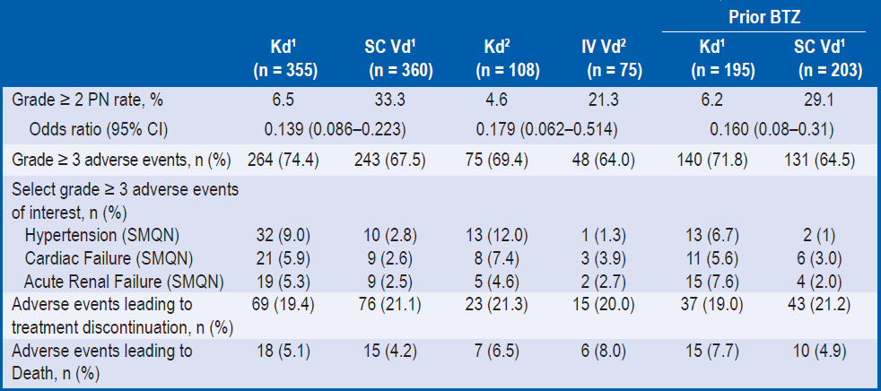
Substudy Kd vs SC Vd and Kd vs IV Vd
Adverse Events, Treatment Discontinuation, and Deaths
ENDEAVOR TOC
Median follow-up: 11.9 months in the Kd arm, 11.1 months in the Vd arm
Lower rates of grade ≥ 2 PN were reported in Kd-treated patients vs Vd patients who were administered SC or IV BTZ
Grade ≥ 2 PN rate was lower for IV Vd vs SC Vd (21.3% vs 33.3%) possibly because investigators were less likely to place patients expected to be at risk for PN on the IV cohort prior to randomisation
Grade ≥ 3 AEs were reported at similar rates between Kd-treated patients and Vd patients administered SC or IV BTZ
ªAll P values were unadjusted for multiplicity. SC Vd¹ and IV Vd² were based on the actual route of administration in the Vd arm patients, whereas Kd¹ and Kd² were based on stratification factor of SC and IV routes of BTZ administration assigned before randomisation, respectively.
CI, confidence interval; CR, complete response; IV, intravenous; Kd, carfilzomib and dexamethasone; PR, partial response; SC, subcutaneous; Vd, bortezomib and dexamethasone; VGPR, very good partial response.
Goldschmidt H et al. EHA 2016, Copenhagen, Denmark, P659.

Slide 104
Adverse Events Summary in Early and Late Relapse Patients
ENDEAVOR TOC
Median follow-up: 11.9 months in the Kd arm, 11.1 months in the Vd arm
 | Early Relapsers |  | Late Relapsers
 | Kd (n = 122) | Vd (n = 114) | Kd (n = 335) | Vd (n = 333)
Any-grade adverse event, n (%) | 119 (97.5) | 112 (98.2) | 330 (98.5) | 326 (97.9)
≥ Grade 3 adverse event, n (%) | 84 (68.9) | 85 (74.6) | 250 (74.6) | 215 (64.6)
Adverse event leading to treatment discontinuation, n (%) | 25 (20.5) | 20 (17.5) | 65 (19.4) | 74 (22.2)
Fatal adverse event, n (%) | 9 (7.4) | 9 (7.9) | 15 (4.5) | 12 (3.6)
Kd, carfilzomib and dexamethasone Vd, bortezomib and dexamethasone.
Mateos et al. Presented at ASH 2017; Poster (Abstract 3120).

Slide 105
Adverse Events in Renal Deficiency Subgroups
ENDEAVOR TOC
Safety outcomes | CrCL ≥15 to <50 mL/min |  | CrCL 50 <80 mL/min |  | CrCL ≥80 mL/min
 | Kd56 (n=85) | Vd (n=97) | Kd56 (n=186) | Vd (n=174) | Kd56 (n=192) | Vd (n=185)
Median duration of treatment, weeks | 36 | 21 | 50 | 27 | 52 | 31
Median number of cycles received, n | 9 | 7 | 12 | 8 | 13 | 10
AEs leading to carfilzomib or bortezomib discontinuation, n (%) | 27 (31.8) | 23 (23.7) | 45 (24.2) | 40 (23.0) | 44 (22.9) | 36 (19.5)
Grade ≥3 AE rates (%) | 87.1 | 79.4 | 83.9 | 71.8 | 76.6 | 65.9
Treatment-emergent grade ≥3 AEs of interest, n (%)*
Hypertension | 12 (14.1) | 3 (3.1) | 25 (13.4) | 7 (4.0) | 30 (15.6) | 5 (2.7)
Peripheral neuropathy | 0 | 4 (4.1) | 5 (2.7) | 16 (9.2) | 1 (0.5) | 8 (4.3)
Dyspnoea | 8 (9.4) | 2 (2.1) | 12 (6.5) | 2 (1.1) | 9 (4.7) | 6 (3.2)
Cardiac failure | 4 (4.7) | 0 | 7 (3.8) | 1 (0.6) | 2 (1.0) | 2 (1.1)
Acute renal failure | 3 (3.5) | 2 (2.1) | 4 (2.2) | 2 (1.1) | 5 (2.6) | 3 (1.6)
The median duration of treatment was longer with Kd56 vs Vd across all CrCL subgroups
*Preferred term.
AE, adverse event; CrCL, creatinine clearance; Kd56, carfilzomib and dexamethasone, with 56 mg/m² carfilzomib dose;
Vd, bortezomib and dexamethasone.
Dimopoulos M et al. Presented at ASH 2017; Poster (Abstract 1845);

Slide 106
Adverse Events Summary
Final OS Analysis
ENDEAVOR TOC
Median follow-up: 37.5 months in the Kd group, and 36.9 months in the Vd group
Category | Kd (n = 463) | Vd (n = 456)
Median (IQR) duration of PI treatment, weeks Median (IQR) dose intensity of PI, % | 48 (24.1-88.7) 91 (81-98) | 27 (15.0-50.0) 85 (70-96)
AE, % Any grade AE Grade ≥3 AE Serious AE Leading to treatment discontinuation Grade 5 | 99 81 59 25 7 | 99 71 40 22 5
The most frequently reported AEs leading to discontinuation (>1%; preferred term):
Carfilzomib: cardiac failure (2%), ejection fraction decreased (1%), asthenia (1%), acute renal failure (1%)
Bortezomib: peripheral neuropathy (5%), sensory peripheral neuropathy (2%), fatigue (1%), dyspnoea (1%), diarrhoea (1%)
AE, adverse event; IQR, interquartile range; Kd, carfilzomib and dexamethasone; PI, proteasome inhibitor; Vd, bortezomib and dexamethasone.
Dimopoulos et al., Lancet Oncol 2017; 18:1327-1337.

Slide 107
Exposure-Adjusted Adverse Events
Final OS Analysis
ENDEAVOR TOC
Median follow-up: 37.5 months in the Kd group, and 36.9 months in the Vd group
Category | Kd (n = 463) | Vd (n = 456)
AE, r (95% CI) Any grade AE Grade ≥3 AE Serious AE Grade 5 | 1377 (1256-1509) 164 (148-181) 67.9 (60.3-76.5) 5.83 (4.12-8.25) | 1755 (1600-1925) 178 (160-199) 65.8 (56.9-76.0) 5.98 (3.90-9.17)
r, exposure-adjusted subject incidence per 100 subject years.
AE, adverse event; CI, confidence interval; Kd, carfilzomib and dexamethasone; Vd, bortezomib and dexamethasone.
Dimopoulos et al., Lancet Oncol 2017; 18:1327-1337; Supplementary Appendix.

Slide 108
Most Common Haematological and
Non-hematological Adverse Events
Final OS Analysis
ENDEAVOR TOC
Median follow-up: 37.5 months in the Kd group, and 36.9 months in the Vd group
Haematological AE %, preferred term | Kd (n = 463) |  | Vd (n = 456)
 | All grades | Grade ≥3 | All grades | Grade ≥3
Anaemia | 42.5 | 16.4 | 28.3 | 10.1
Non-haematological AE % (≥30% in either arm), preferred term | Kd (n = 463) |  | Vd (n = 456)
 | All grades | Grade ≥3 | All grades | Grade ≥3
Pyrexia | 32.4 | 3.0 | 15.4 | 0.7
Diarrhea | 36.3 | 3.9 | 40.6 | 8.6
Dyspnoea | 32.2 | 6.3 | 13.6 | 2.2
Fatigue | 32.2 | 6.7 | 30.7 | 7.7
Hypertension | 32.2 | 14.5 | 9.9 | 3.3
AE, adverse event; Kd, carfilzomib and dexamethasone; Vd, bortezomib and dexamethasone.
Dimopoulos et al., Lancet Oncol 2017; 18:1327-1337; Dimopoulos et al., Lancet Oncol 2017; 18:1327-1337, Supplementary Appendix.
Notes:
Peripheral Neuropathy Preferred Term (Kd vs Vd); All grade, 10.6% vs 28.5%; Grade 3+ 1.3% vs 6.1%
Peripheral Sensory Neuropathy Preferred Term (Kd vs Vd), All grade, 6.3% vs 15.4%; Grade 3+ 0.2% vs 1.3%

Slide 109
Exposure-Adjusted Grade ≥ 3 Adverse Events with Higher Incidence in the Carfilzomib Group vs the Bortezomib Group (Safety Population)
ENDEAVOR TOC
Median follow-up: 37.5 months in the Kd group, and 36.9 months in the Vd group
 | Kd (n = 463) | Vd (n = 456)
AE, r (95% CI)
Hypertension | 13.8 (10.9-17.6) | 4.4 (2.7-7.3)
Decreased lymphocyte count | 5.6 (3.9-8.1) | 2.6 (1.4-5.0)
Pyrexia | 2.6 (1.5-4.4) | 0.9 (0.3-2.7)
Bronchitis | 2.4 (1.4-4.2) | 1.1 (0.4-3.1)
Cardiac failure | 2.4 (1.4-4.1) | 0.9 (0.3-2.7)
Urinary tract infection | 2.0 (1.1-3.7) | 0.9 (0.3-2.7)
r = exposure-adjusted incidence (adverse event incidence rate per 100 person-years of exposure). Adverse events included in this table had a frequency of ≥ 2 per 100 person-years in either arm and had a value for r that was at least two times higher in the carfilzomib arm than the bortezomib arm.
AE, adverse event; CI, confidence interval; Kd, carfilzomib and dexamethasone; Vd, bortezomib and dexamethasone.
Dimopoulos et al., Lancet Oncol 2017; 18:1327-1337, Supplementary Appendix.

Slide 110
Adverse Events of Interest
Final OS Analysis
ENDEAVOR TOC
Median follow-up: 44.3 months in the Kd group, and 43.7 months in the Vd group
Safety Population (n = 919)
AE, % | Kd (n = 463) |  | Vd (n = 456)
 | All grades | Grade ≥ 3 | All grades | Grade ≥ 3
Acute renal failure* | 10.8 | 5.8 | 6.4 | 3.5
Hypertension | 32.4 | 14.9 | 10.1 | 3.3
Dyspnoea | 32.2 | 6.3 | 13.6 | 2.2
Cardiac failure* | 11.0 | 6.0 | 3.5 | 2.0
Peripheral neuropathy* | 21.0 | 2.4 | 54.6 | 9.6
Ischaemic heart disease* | 3.9 | 2.6 | 2.0 | 1.5
Safety data are consistent with the previously reported profile
* Grouped term.
AE, adverse event; Kd, carfilzomib and dexamethasone; Vd, bortezomib and dexamethasone.
Dimopoulos et al., Lancet Oncol 2017; 18:1327-1337, Supplementary Appendix; Orlowski et al. Presented at ASCO 2018; Poster Abstract 8032.
Notes:
1. The category of acute renal failure included (in descending order of frequency) acute renal failure, renal failure, renal impairment, acute prerenal failure, anuria, oliguria, and prerenal failure.
2. The category of cardiac failure included (in descending order of frequency) cardiac failure, ejection fraction decreased, pulmonary edema, acute cardiac failure, congestive cardiac failure, acute pulmonary edema, acute left ventricular failure, chronic cardiac failure, cardiopulmonary failure, hepatojugular reflex, right ventricular failure, and left ventricular failure
3. The category of hypertension included (in descending order of frequency) blood pressure increased, hypertensive crisis, blood pressure systolic increased, diastolic hypertension, essential hypertension, hypertensive emergency, malignant hypertension, hypertensive encephalopathy
4.The category of ischemic heart disease included (in descending order of frequency) angina pectoris, acute coronary syndrome, myocardial infarction, increased troponin t, coronary artery disease, increased troponin i, acute myocardial infarction, myocardial ischemia, and cardiomyopathy stress.

Slide 111
Frequency and Time to Onset for Adverse Events of Interest (Safety Population)
ENDEAVOR TOC
Median follow-up: 37.5 months in the Kd group, and 36.9 months in the Vd group
 | All Grade |  | Grade ≥ 3
 | Carfilzomib group (n = 463) | Bortezomib group (n = 456) | Carfilzomib group (n = 463) | Bortezomib group (n = 456)
Dyspnea n (%) Average (days) SD Median (days) IQR | 149 (32.2) 144.8 212.0 66.0 15.0-148.0 | 62 (13.6) 99.0 133.2 59.5 25.0-109.0 | 29 (6.3) 137.2 145.9 100.0 13.0-182.0 | 10 (2.2) 100.6 87.5 83.0 27.0-144.0
Hypertension n (%) Average (days) SD Median (days) IQR | 149 (32.2) 201.9 184.6 147.0 52.0-325.0 | 45 (9.9) 168.4 227.0 92.0 28.0-183.0 | 67 (14.5) 277.7 247.6 267.0 50.0-393.0 | 15 (3.3) 156.6 187.6 92.0 28.0-157.0
Acute renal failure* n (%) Average (days) SD Median (days) IQR | 48 (10.4) 240.9 255.9 197.5 35.0-339.0 | 28 (6.1) 161.3 200.9 64.5 24.5-217.5 | 26 (5.6) 264.7 252.5 219.5 57.0-387.0 | 15 (3.3) 172.4 221.0 49.0 5.0-421.0
Cardiac failure* n (%) Average (days) SD Median (days) IQR | 50 (10.8) 291.6 241.2 246.0 100.0-423.0 | 15 (3.3) 167.3 134.4 169.0 29.0-259.0 | 27 (5.8) 253.3 182.1 230.0 87.0-407.0 | 9 (2.0) 161.2 136.9 141.0 29.0-259.0
Ischemic heart disease* n (%) Average (days) SD Median (days) IQR | 18 (3.9) 248.9 330.1 92.5 9.0-328.0 | 9 (2.0) 56.0 69.8 26.0 13.0-50.0 | 12 (2.6) 222.2 346.7 43.5 9.0-337.5 | 7 (1.5) 36.3 50.6 24.0 8.0-29.0
Peripheral neuropathy* n (%) Average (days) SD Median (days) IQR | 97 (21.0) 158.8 187.0 85.0 30.0-225.0 | 249 (54.6) 101.0 134.5 64.0 35.0-106.0 | 11 (2.4) 146.1 95.3 121.0 78.0-182.0 | 44 (9.6) 207.6 239.7 99.5 71.5-211.5
* Grouped Term Standardized Medical Dictionary for Regulatory Activities Query Narrow
IQR, interquartile range; SD, standard deviation
Dimopoulos et al., Lancet Oncol 2017; 18:1327-1337, Supplementary Appendix.

Slide 112
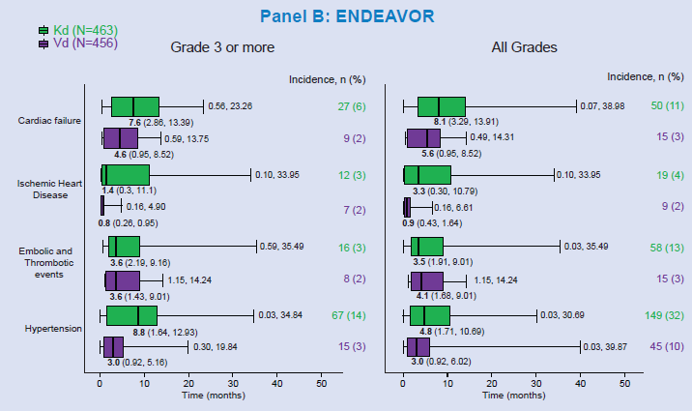
Time to First Onset of Cardiac or Vascular Events
ENDEAVOR TOC
Median follow-up: 37.5 months in the Kd group, and 36.9 months in the Vd group
Kd, carfilzomib and dexamethasone; Vd, bortezomib and dexamethasone.
Mateos MV, et al. Presented at EHA 2018, Poster Abstract PF574.

Slide 113
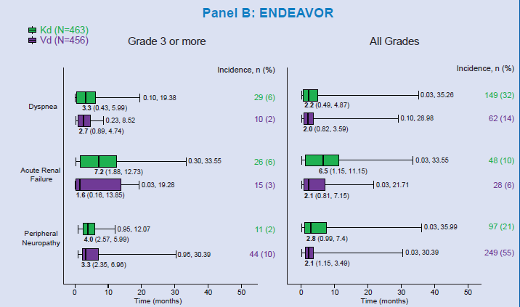
Time to First Onset of Non-haematological Events
ENDEAVOR TOC
Median follow-up: 37.5 months in the Kd group, and 36.9 months in the Vd group
Kd, carfilzomib and dexamethasone; Vd, bortezomib and dexamethasone.
Mateos MV, et al. Presented at EHA 2018, Poster Abstract PF574.

Slide 114
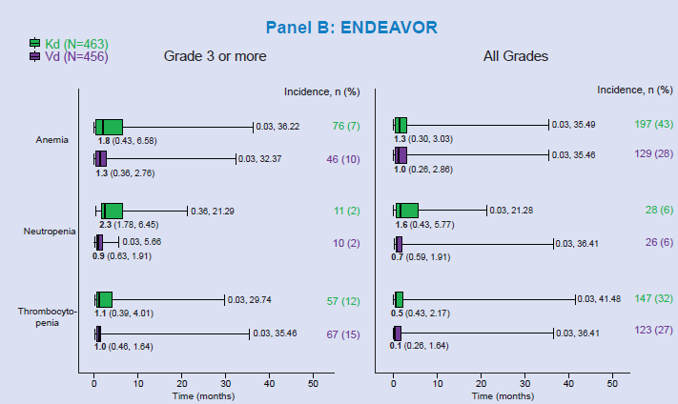
Time to First Onset of
Haematological Events
ENDEAVOR TOC
Median follow-up: 37.5 months in the Kd group, and 36.9 months in the Vd group
Kd, carfilzomib and dexamethasone; Vd, bortezomib and dexamethasone.
Mateos MV, et al. Presented at EHA 2018, Poster Abstract PF574.

Slide 115
Adverse Events Summary
Part 1: Safety at the first (PFS) interim analysis‡
ENDEAVOR TOC
Intent-to-treat Population (Interim Analysis):
Treatment discontinuations due to AEs and treatment-related deaths due to AEs were comparable between the Kd and Vd treatment groups
Safety Population (Interim Analysis):
Duration of treatment was longer in the Kd treatment group than in the Vd treatment group; this may have contributed to a higher frequency of grade ≥ 3 AEs and SAEs
Adverse drug reactions reported more frequently in the Kd group than in the Vd group included any-grade dyspnoea*, hypertension*, pyrexia*, and cough*, any-grade cardiac failure^{Ɨ}, and acute renal failure^{Ɨ}
  A higher frequency of grade ≥ 3 hypertension*, dyspnoea*, cardiac failure^{Ɨ}, acute renal failure^{Ɨ}, and pulmonary hypertension^{Ɨ} were also noted in the Kd treatment group compared with the Vd treatment group
Grade ≥ 3 or higher ischaemic heart disease^{Ɨ} was comparable between treatment groups
*Preferred term; ^{Ɨ}Grouped term; ‡ Median follow-up 11.2 months.
AE, adverse event; Kd, carfilzomib and dexamethasone; SAE, serious adverse event; Vd, bortezomib and dexamethasone.
Dimopoulos et al., Lancet Oncol 2016;17:27-38; Dimopoulos et al., Lancet Oncol 2016;17:27-38. Supplementary appendix; Siegel DS, et al. Presented at IMW 2017.
.

Slide 116
Adverse Events: Summary
Part 2: Safety at the final OS analysis* (1)
ENDEAVOR TOC
Cytogenetic Status:
Median treatment duration and incidence of grade ≥ 3 adverse events were greater in the Kd arm versus the Vd arm, regardless of cytogenetic status
Treatment discontinuations were comparable between treatment groups irrespective of cytogenetic status
Age:
Rates of grade ≥ 2 peripheral neuropathy were lower in the Kd arm than in the Vd arm across all age groups, while rates of grade ≥ 3 hypertension, dyspnoea, and cardiac failure were higher in the Kd arm than in the Vd arm across all age subgroups
Rates of treatment discontinuation due to an adverse event were similar between arms for the < 65 years and 65 – 74 years age groups, but were higher in the Vd arm than the Kd arm (35% vs 26%) for the ≥ 75 years age group
* Initially the second planned interim analysis; median follow-up 37.5 months for Kd and 36.9 months for Vd.
Kd, carfilzomib and dexamethasone; Vd, bortezomib and dexamethasone.
Chng et al., Leukemia 2017;31:1368-74; Ludwig et al., Leuk Lymphoma 2017; 58:2501-2504.

Slide 117
Adverse Events: Summary
Part 2: Safety at the final OS analysis* (2)
ENDEAVOR TOC
Prior Lines of Therapy:
Some adverse events of interest, including hypertension and cardiac failure, were higher in the Kd arm than the Vd arm in both prior lines of therapy subgroups
Prior ASCT:
The incidences of all-grade and grade ≥ 3 hypertension and cardiac failure were greater in the Kd arm that in the Vd arm in all subgroups, whereas the incidence of all-grade peripheral neuropathy was lower
Rates of adverse events leading to treatment discontinuation or death were similar between treatment arms, irrespective of prior ASCT
Early and late relapse:
Safety profiles for the early and late relapse subgroups were comparable to those previously reported
*Initially the second planned interim analysis; median follow-up 37.5 months for Kd and 36.9 months for Vd.
ASCT, autologous stem cell transplantation; Kd, carfilzomib and dexamethasone; Vd, bortezomib and dexamethasone.
Moreau et al., Leukemia 2017;31:115-22; Hari et al., Leukemia 2017; 31:2630-2641;
Mateos et al. Presented at ASH 2017; Poster (Abstract 3120).

Slide 118
Adverse Events: Summary
Part 2: Safety at the final OS analysis (3)
ENDEAVOR TOC
Prior Bortezomib Treatment:
The rates of AEs in patients with and without prior bortezomib treatment were consistent with that reported in the overall trial population
Renal Deficiency:
A greater percentage of patients in the CrCL ≥15 to <50 mL group reported grade ≥3 AEs compared with the other groups
Final OS Analysis:
Rates of ≥ grade 3 serious AEs were balanced between the two groups, after adjusting for treatment exposure
The rate of any-grade AEs was 98.7% for Kd56 and 98.9% for Vd
  Exposure-adjusted patient incidences per 100 patient-years (95% CI) of grade ≥3 AEs were 1352.07 (1233.62-1481.89) for Kd56 and 1754.86 (1600.15-1924.53) for Vd
Any grade AEs were reported in 81.9% of patients in the Kd56 group and 71.1% of patients in the Vd group
  Exposure-adjusted patient incidences per 100 patient-years (95% CI) of grade ≥3 AEs were 162.31 (146.77-179.50) for Kd56 and 175.90 (157.75-196.13) for Vd
AE, adverse event; CrCL, creatinine clearance; Kd56, carfilzomib (56 mg/m²) and dexamethasone;
OS, overall survival; Vd, bortezomib and dexamethasone.
Weisel et al. Presented at ASH 2017; Poster (Abstract 1850); Dimopoulos et al. Presented at ASH 2017; Poster (Abstract 1845);
Dimopoulos et al., Lancet Oncol 2017; 18:1327-1337; Orlowski et al. Presented at ASCO 2018; Poster Abstract 8032.

Slide 119
Adverse Events: Summary
Part 3: Safety, Post-hoc analysis (1)
ENDEAVOR TOC
Cardiac AEs:
Median TTFOs of cardiac AEs were earlier in Vd vs Kd subjects
  CF, grade ≥3: 7.6 months for Kd (n=27), 4.6 months for Vd (n=9); a similar pattern was seen for all-grade CF AEs, with median TTFOs of 8.1 months for Kd (n=50) and 5.6 months for Vd (n=15)
  IHD, grade ≥3: 1.4 months for Kd (n=12), 0.8 months for Vd (n=7). This trend toward a slightly later median TTFO for Kd vs Vd was also seen for all-grade IHD AEs: 3.3 months for Kd (n=19), 0.9 months for Vd (n=9)
The occurrence of CF and IHD was higher among Kd vs Vd subjects and widely distributed over the course of K treatment. For Vd subjects, they had an early and narrow onset, particularly IHD with a median TTFO of <1 month
Vascular AEs:
Median TTFO of HT grade ≥3 was longer in Kd (n=67) than Vd (n=15) subjects: 8.8 vs 3.0 months, respectively. Compared with grade ≥3, the difference in median TTFO of all-grade HT between Kd (n=149) and Vd (n=45) subjects was less striking: 4.8 vs 3.0 months
HT had a higher incidence in Kd arm vs Vd arm
No major difference between Kd vs Vd for thromboembolic events, regardless of grade
AE, adverse event; CF, cardiac failure; HT, hypertension; IHD, ischaemic heart disease; K, carfilzomib; Kd, carfilzomib and dexamethasone; TTFO, time to first onset; Vd, bortezomib and dexamethasone.
Mateos MV, et al. Presented at EHA 2018, Poster Abstract PF574.

Slide 120
Adverse Events: Summary
Part 3: Safety, Post-hoc analysis (2)
ENDEAVOR TOC
Non-haematological AEs:
Median TTFO of acute renal failure was markedly longer in Kd (n=26) vs Vd (n=15): 7.2 vs 1.6 months
TTFO pattern of all-grade acute renal failure was consistent with the grade ≥3 acute renal failure results: Kd (n=48) vs Vd (n=28): 6.5 vs 2.1 months
Haematological AEs:
Grade ≥3 haematological AEs occurred early, within 1-2.5 months, with much narrower interquartile ranges compared with those of cardiovascular or non-haematological TEAEs
AE, adverse event;, carfilzomib and dexamethasone; TEAE, treatment-emergent adverse event; TTFO, time to first onset;
Vd, bortezomib and dexamethasone.
Mateos MV, et al. Presented at EHA 2018, Poster Abstract PF574.

