Slide 1
Francesca Gay
Not for further reproduction or distribution.

Slide 2
Francesca Gay
Not for further reproduction or distribution.

Slide 3
Francesca Gay
Not for further reproduction or distribution.

Slide 4
Francesca Gay
Not for further reproduction or distribution.

Slide 5
Francesca Gay
Not for further reproduction or distribution.

Slide 6
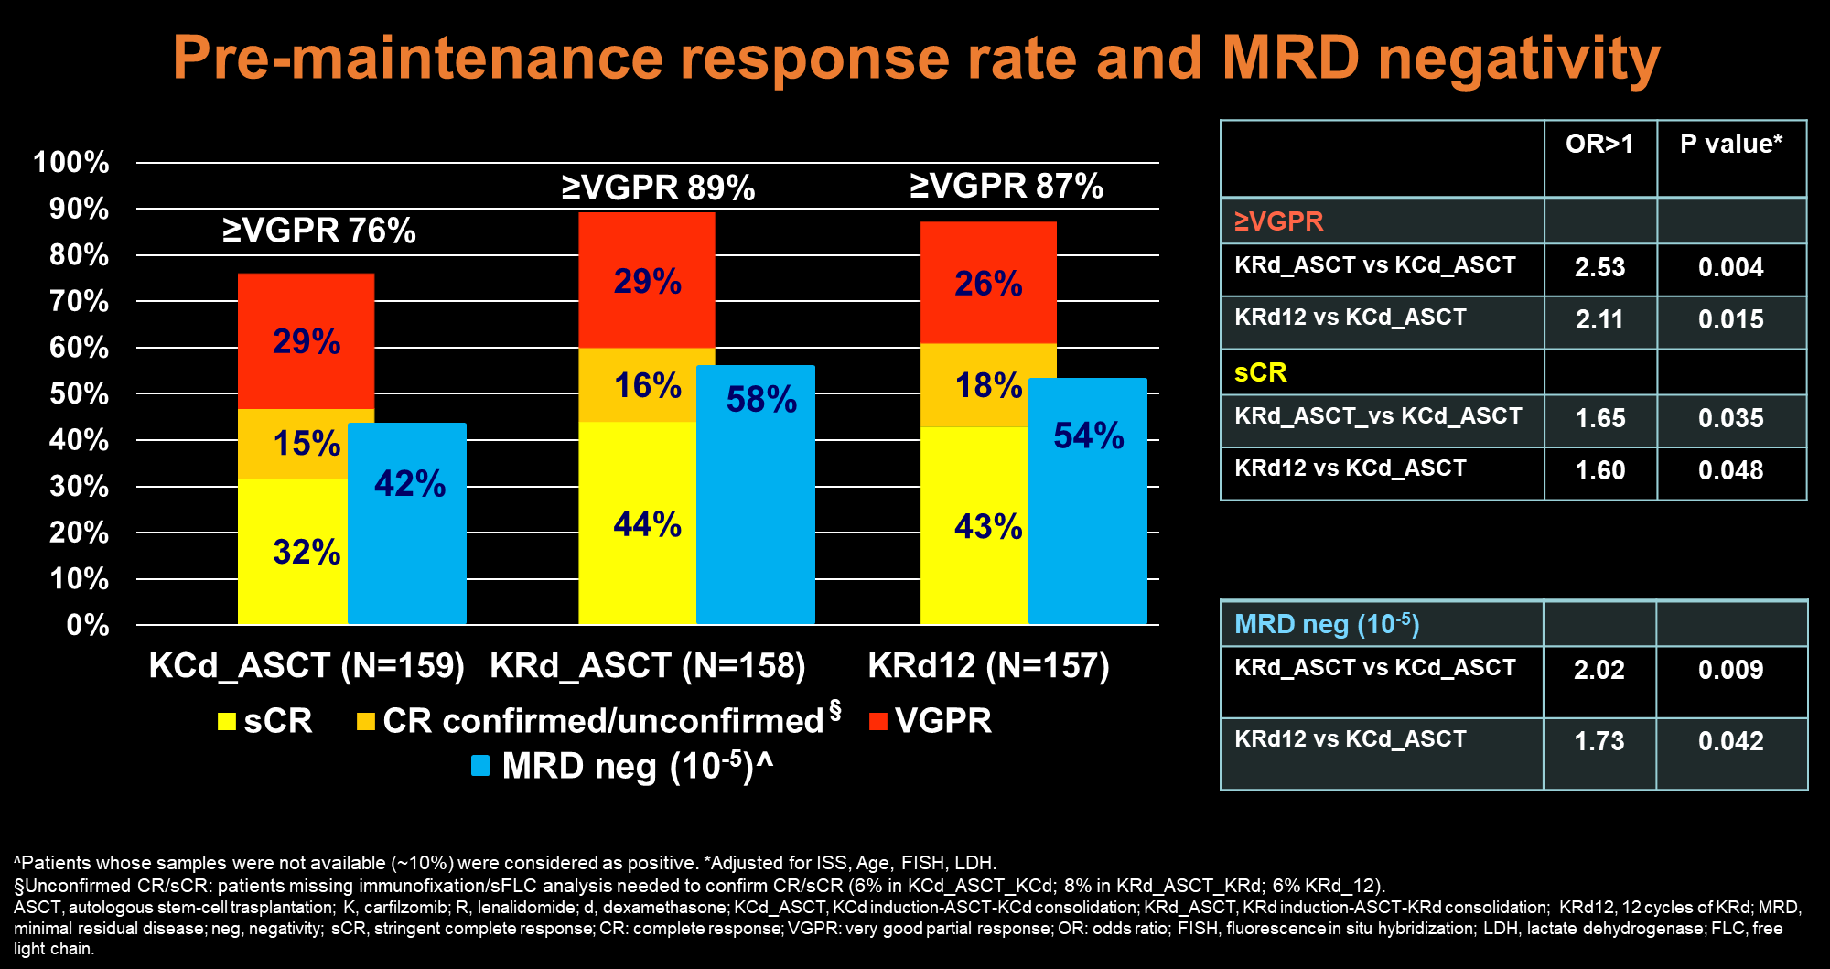
Francesca Gay
Not for further reproduction or distribution.

Slide 7
Francesca Gay
Not for further reproduction or distribution.

Slide 8
Francesca Gay
Not for further reproduction or distribution.

Slide 9
Francesca Gay
Not for further reproduction or distribution.

Slide 10
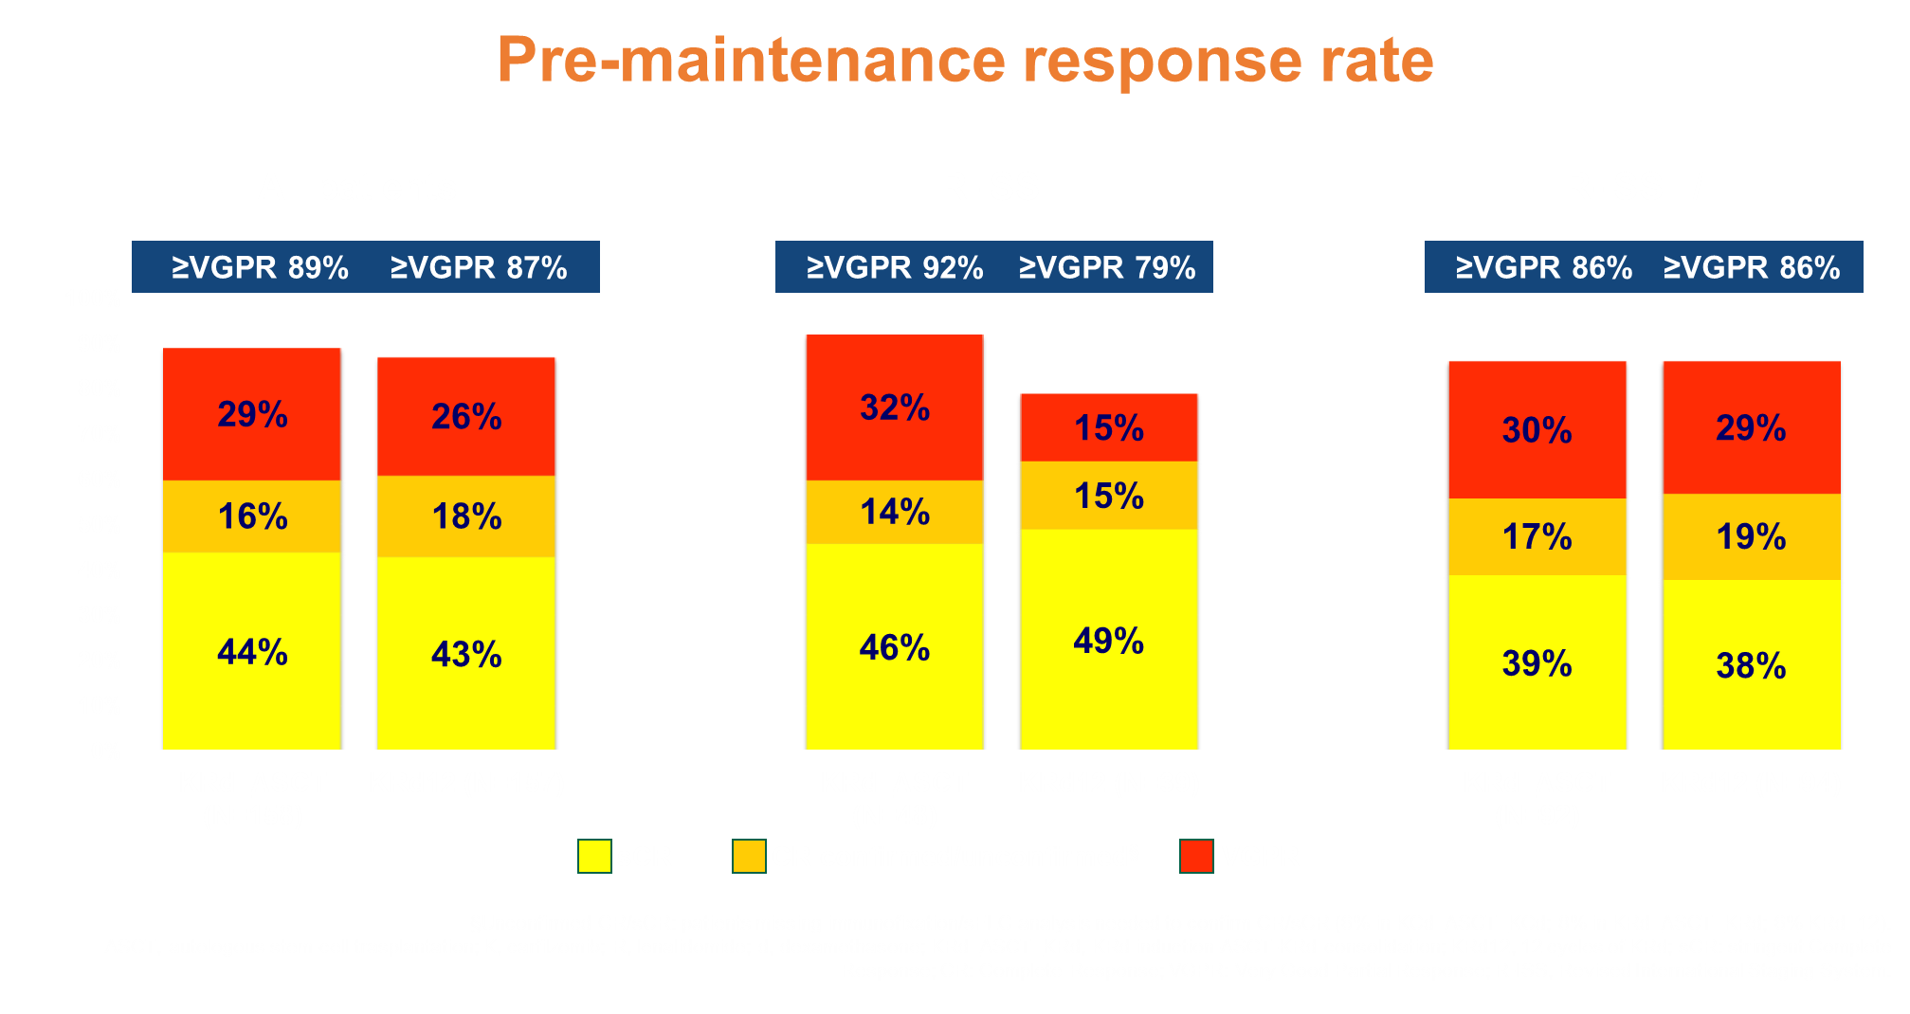
Francesca Gay
Not for further reproduction or distribution.

Slide 11
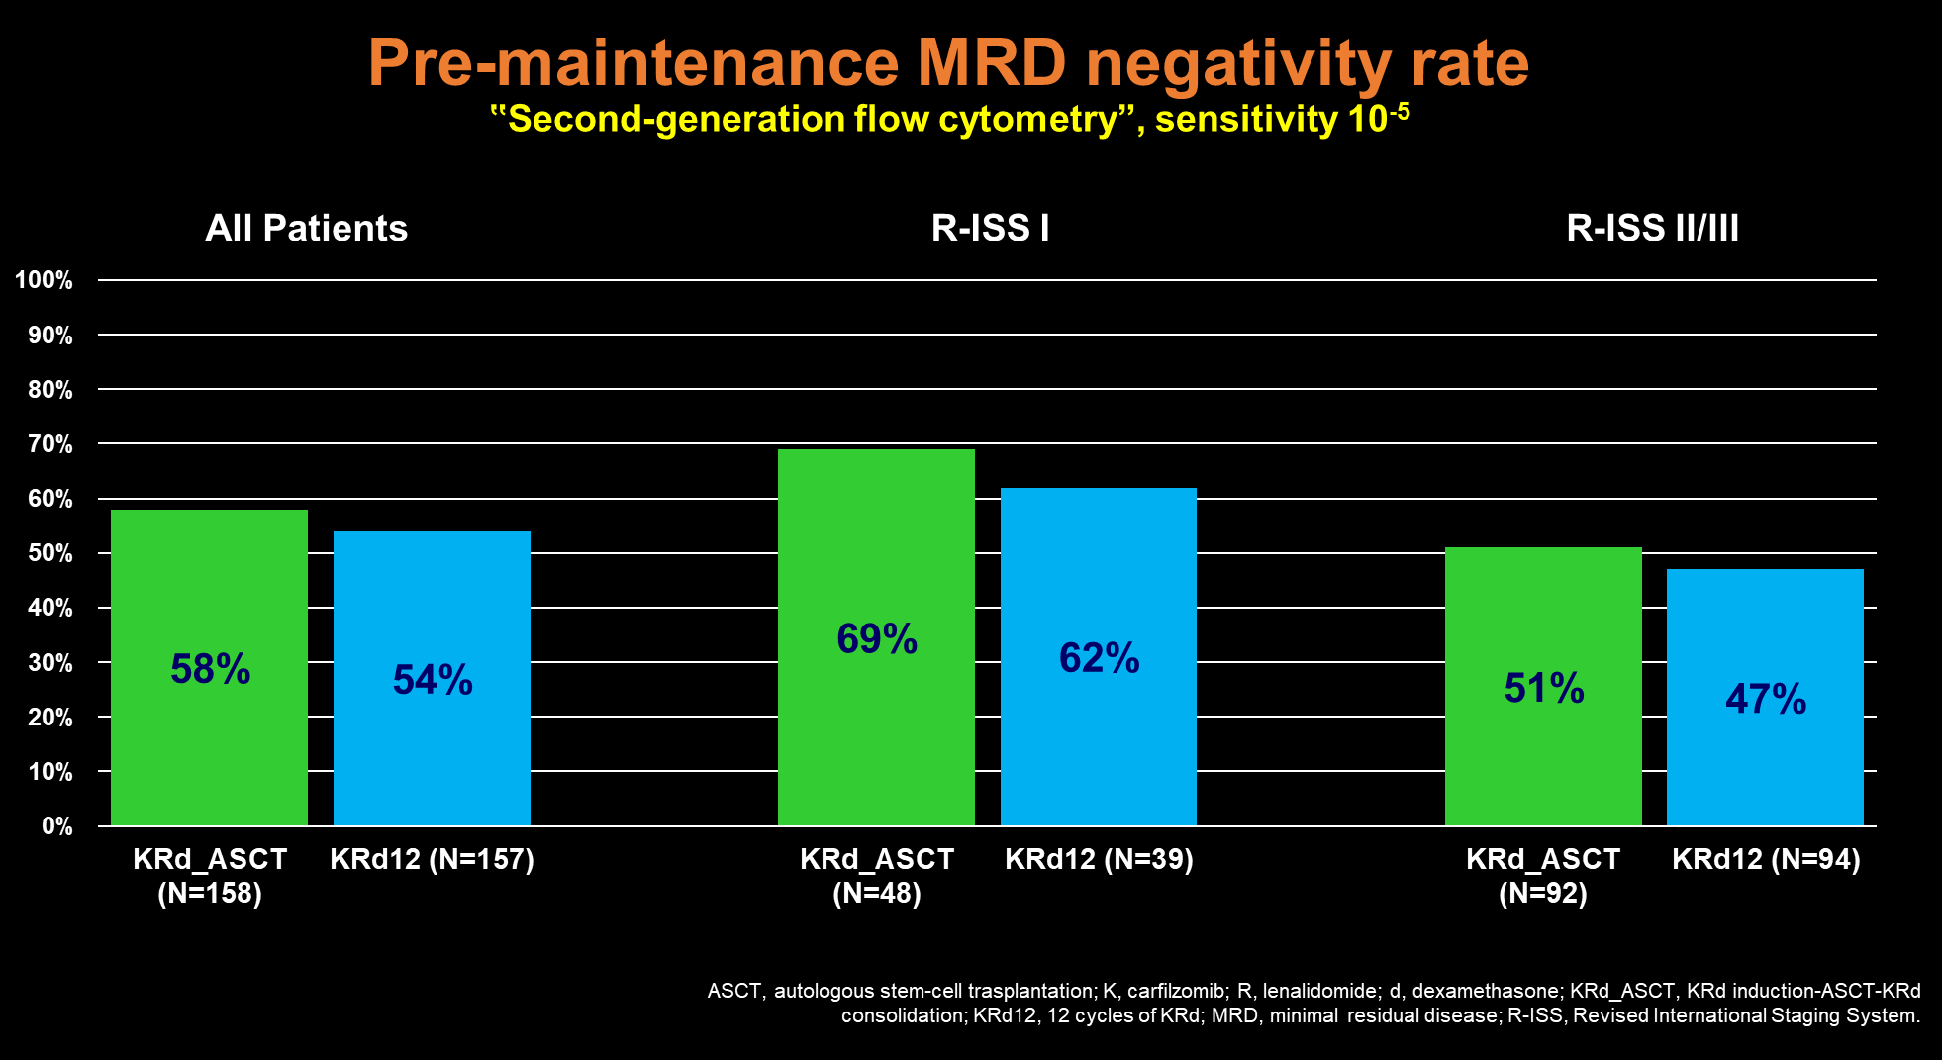
Francesca Gay
Not for further reproduction or distribution.

Slide 12
Francesca Gay
Not for further reproduction or distribution.

Slide 13
Francesca Gay
Not for further reproduction or distribution.

Slide 14
Not for further reproduction or distribution.

Slide 15
Francesca Gay
Not for further reproduction or distribution.

Slide 16
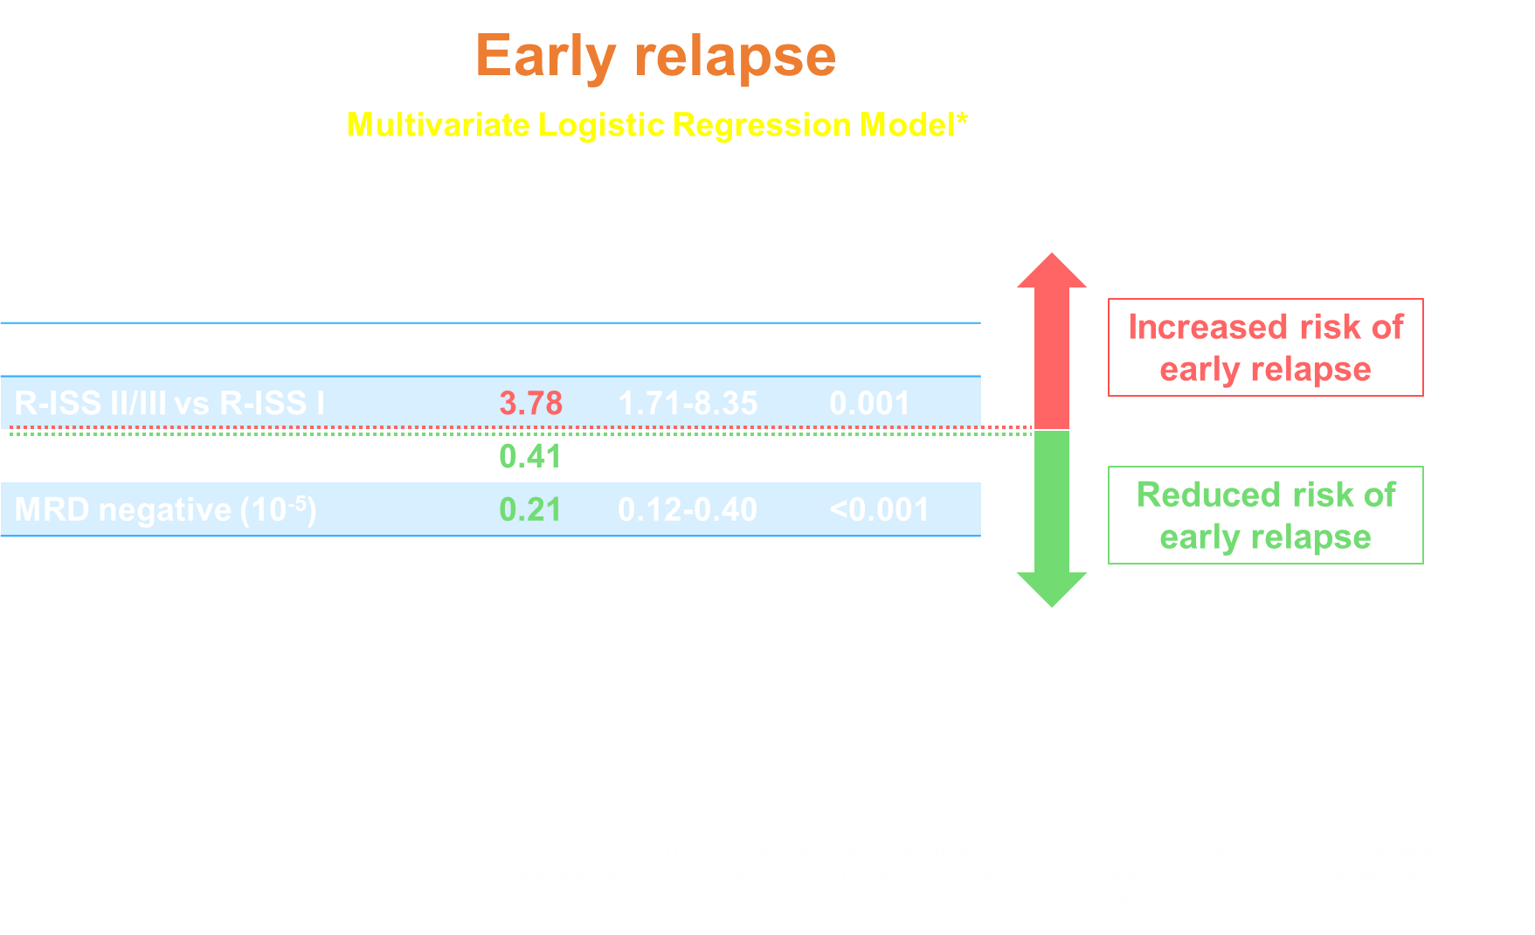
Francesca Gay
Not for further reproduction or distribution.

Slide 17
Francesca Gay
Not for further reproduction or distribution.

Slide 18
Francesca Gay
Not for further reproduction or distribution.

Slide 19
Francesca Gay
Not for further reproduction or distribution.

