Slide 1
European Hematology Association (EHA) 2019
Amgen Sponsored Posters:
Safety and Efficacy of Self-Administered Romiplostim in Patients with Immune Thrombocytopenia (ITP): Results of an Integrated Analysis of Five Clinical Trials
Safety and Efficacy of Romiplostim in Over 200 Children With Persistent or Chronic Immune Thrombocytopenia in an Integrated Database of 5 Clinical Trials
Amgen Investigator-Sponsored Study (ISS) Posters:
Biological and Clinical Factors that Favor the Use of a Specific TPO-RA in ITP Patients. Results from a Spanish Multicenter Study
Prevalence and Risk Factors for Thrombosis in Adult ITP Patients Treated with TPO-RA
Predictors of Therapy Free Responses in ITP Patients Receiving TPO-RA. Results from a Spanish Multicenter Study
Presented at EHA 2019
European Hematology Association (EHA) 2019
June 13–16, 2019; Amsterdam, Netherlands
Amgen (Europe) GmbH, 6343 Risch-Rotkreuz, Switzerland
Date of preparation: June 2019 www.amgen.com © 2019 Amgen Inc. All rights reserved
Slides developed as a post-congress resource and may deviate from Amgen style guidelines
SC-EU-ROMIPLOSTI-00515

Slide 2
Table of Contents
Amgen Sponsored Posters
Kuter DJ, et al. Safety and Efficacy of Self-Administered Romiplostim in Patients with Immune Thrombocytopenia (ITP): Results of an Integrated Analysis of Five Clinical Trials
Tarantino M, et al. Safety and Efficacy of Romiplostim in Over 200 Children With Persistent or Chronic Immune Thrombocytopenia in an Integrated Database of 5 Clinical Trials
Investigator-Sponsored Posters
Lozano ML, et al. Biological and Clinical Factors that Favor the Use of a Specific TPO-RA in ITP Patients. Results from a Spanish Multicenter Study
Lozano ML, et al. Prevalence and Risk Factors for Thrombosis in Adult ITP Patients Treated with TPO-RA
Lozano ML, et al. Predictors of Therapy Free Responses in ITP Patients Receiving TPO-RA. Results from a Spanish Multicenter Study
Click the box to view the associated poster/presentation data

Slide 3
Safety and Efficacy of Self-Administered Romiplostim in Patients with Immune Thrombocytopenia (ITP): Results of an Integrated Analysis of Five Clinical Trials
Kuter DJ, et al. Safety and Efficacy of Self-Administered Romiplostim in Patients with Immune Thrombocytopenia (ITP): Results of an Integrated Analysis of Five Clinical Trials
David J. Kuter,¹ Donald M. Arnold,² Francesco Rodeghiero,³ Ann Janssens,⁴ Dominik Selleslag,⁵ Robert Bird,⁶ Adrian Newland,⁷ Jiri Mayer,⁸ Cheryl Turkington,⁹ Nooshin Hashemi Sadraei¹⁰
¹Hematology Division, Massachusetts General Hospital, Boston, MA, USA; ²Division of Hematology & Thromboembolism, Department of Medicine, Michael G DeGroote School of Medicine, McMaster University, Hamilton, ON; and Canadian Blood Services, Hamilton, ON, Canada; ³Haematology Project Foundation, Department of Cell Therapy and Haematology, S. Bortolo Hospital, Vicenza, Italy; ⁴Department of Hematology, University Hospitals Leuven, Campus Gasthuisberg, Leuven, Belgium; ⁵Department of Hematology, AZ Sint Jan Brugge, Brugge, Belgium; ⁶Division of Cancer Services, Princess Alexandra Hospital, Brisbane, Australia; ⁷The Pathology Clinical Academic Group, The Royal London Hospital, London, UK; ⁸Department of Internal Medicine, Haematology and Oncology, Masaryk University and University Hospital Brno, Brno, Czech Republic; ⁹Amgen Ltd, Cambridge, UK; ¹⁰Amgen Inc, Thousand Oaks, CA, USA
Abstract #PF696
European Hematology Association (EHA) 2019
June 13–16, 2019; Amsterdam, Netherlands

Slide 4
Introduction
Kuter DJ, et al. Safety and Efficacy of Self-Administered Romiplostim in Patients with Immune Thrombocytopenia (ITP): Results of an Integrated Analysis of Five Clinical Trials
Romiplostim is approved for use in adults with chronic ITP who are refractory to other treatments in the EU, the USA and other countries.^{1–3} Romiplostim is also indicated for paediatric patients aged ≥ 1 year with chronic ITP (EU), or ITP for ≥ 6 months (USA), who are refractory to other treatments^{1–3}
Romiplostim is approved for self-administration by patients and caregivers in the EU²
According to the EU label, patients with a stable platelet count ≥ 50 ×10⁹/L for ≥ 4 weeks without dose adjustment may, after training, self-administer romiplostim at the discretion of the supervising physician^{2,4}
The ability to self-administer romiplostim may improve the practicality and convenience of this treatment, e.g., by eliminating the need for weekly treatment visits to the clinic⁵
A previous analysis has demonstrated comparable efficacy and safety with self- vs healthcare provider (HCP)-administered romiplostim⁵
The analysis presented here builds on the existing evidence base to provide a more comprehensive assessment of romiplostim self-administration
NPLATE PI (updated 2018). Available at: www.nplate.com. 2. NPLATE SmPC (updated 2018). Available at: www.ema.europa.eu. 3. Amgen Submits Supplemental Biologics License Application For Nplate® (romiplostim), 2018. Available at https://www.prnewswire.com/news-releases/amgen-submits-supplemental-biologics-license-application-for-nplate-romiplostim-300769133.html. 4. Selecting and training adult patients for home administration of Nplate® (romiplostim), 2018. Available at: www.medicines.org.uk/emc/rmm/272/Document.5. Selleslag D, et al. Eur J Haematol 2015;94:169–76.

Slide 5
Kuter DJ, et al. Safety and Efficacy of Self-Administered Romiplostim in Patients with Immune Thrombocytopenia (ITP): Results of an Integrated Analysis of Five Clinical Trials
Methods
Analysis Participants
This analysis integrates data from 5 clinical trials that assessed the use of romiplostim in individuals with ITP aged ≥ 18 years (Table 1), in which self-administration (defined as administration by the patient or a caregiver) was allowed
Patients were eligible for self-administration after achieving a platelet count of ≥ 50 ×10⁹/L without romiplostim dose adjustment for ≥ 3 consecutive weeks at the discretion of investigators
Patients could continue with self-administration as long as their romiplostim dose remained stable as assessed by platelet counts every 4 weeks. If dose adjustments were needed, patients had to return to weekly clinic visits until the dose stabilised
ITP, immune thrombocytopenia

Slide 6
Kuter DJ, et al. Safety and Efficacy of Self-Administered Romiplostim in Patients with Immune Thrombocytopenia (ITP): Results of an Integrated Analysis of Five Clinical Trials
Methods (cont.)
Analysis Participants (cont.)
Patients who ever self-administered romiplostim in any of these 5 trials comprised the self-administration (SA) group
The index date for the SA group was the first day a subject self-injected romiplostim
The comparator was an HCP-dosed subgroup of patients from the 5 trials (the HCP group)
Patients in the HCP comparator group were required to have received the same stable romiplostim dose for ≥ 5 consecutive weeks (duration selected to provide a conservative comparison) with platelet response and with all doses given by an HCP
The index date for the HCP group was the date of the first instance of the 5th consecutive stable dose across all studies in which the subject was enrolled
HCP, healthcare provider

Slide 7
Kuter DJ, et al. Safety and Efficacy of Self-Administered Romiplostim in Patients with Immune Thrombocytopenia (ITP): Results of an Integrated Analysis of Five Clinical Trials
Methods (cont.)
Table 1. Studies Included in the Integrated Analysis
Study number (NCT number) | Phase | Design | Duration of Treatment (years) | Intervention(s) | Intervention (S) | Total no. Of patients | No. of SA patients
Controlled study
20060131 (NCT00415532)¹ | 3b | Open-label, randomised | 1 |  | Romiplostim SOC | 157 77 | 109* -
Uncontrolled studies
20030213 (NCT00116688)² | 3 | Open-label, extension | ≤5 | Romiplostim | Romiplostim | 292 | 239*
20080009 (NCT00907478)³ | 4 | Open-label, single-arm | ≤3 | Romiplostim | Romiplostim | 169 | 112
20080435 (NCT01143038)⁴ | 2 | Open-label, single-arm | ≤1 | Romiplostim | Romiplostim | 75 | 43
20040209 (NCT00508820)⁵ | 3b | Open-label, single-arm | ≤4 | Romiplostim | Romiplostim | 407 | 215
*Romiplostim-treated patients from Study 20060131 could be rolled over into Study 20030213 (extension study)
NCT, National Clinical Trial; SA, self-administration; SOC, standard of care
1. Kuter DJ, et al. N Engl J Med 2010;363:1889–99. 2. Kuter DJ, et al. Br J Haematol 2013;161:411–23. 3. Cines DB, et al. Haematologica 2017;102:1342–1351.
4. Newland A, et al. Br J Haematol 2016;172:262–73. 5. Janssens A, et al. Acta Haematol 2015;134:215–28

Slide 8
Kuter DJ, et al. Safety and Efficacy of Self-Administered Romiplostim in Patients with Immune Thrombocytopenia (ITP): Results of an Integrated Analysis of Five Clinical Trials
Methods (cont.)
Efficacy Measures
Platelet response was defined as platelet count ≥ 50 ×10⁹L without any use of rescue medication within the 4 weeks preceding platelet measurement and was assessed at 4-weekly intervals. Platelet counts measured after on-study splenectomy were excluded
Analyses of platelet response included incidence of platelet response; % of time with a platelet response; and % of patients by platelet count level < 50 and ≥ 50 ×10⁹/L
The incidence and duration-adjusted event rate of rescue medication use were summarised
Dosing
The number of dose adjustments (defined as observing different stable doses with ≥ 1 dose change in between) within 8 weeks of the index date and within 6 months after the index date, as well as the duration-adjusted rate of dose adjustment (number of dose adjustments per 100 subject-weeks), were determined

Slide 9
Kuter DJ, et al. Safety and Efficacy of Self-Administered Romiplostim in Patients with Immune Thrombocytopenia (ITP): Results of an Integrated Analysis of Five Clinical Trials
Methods (cont.)
Exposure Measures
The total number of romiplostim doses and cumulative doses were analysed for each group
Safety Measures
Treatment-emergent adverse events (TEAEs) were summarised according to group. TEAEs were coded according to Medical Dictionary for Regulatory Activities (MedDRA) version 20.1 by standardised MedDRA query and preferred term
Bleeding events were identified using a pre-defined list of preferred terms from the 'Haemorrhages' (narrow search) standardised MedDRA Query (SMQ; MedDRA vs. 20.1)
Number and percentage of subjects who developed anti-romiplostim and/or anti-thrombopoietin antibodies (binding and neutralising) were summarised

Slide 10
Kuter DJ, et al. Safety and Efficacy of Self-Administered Romiplostim in Patients with Immune Thrombocytopenia (ITP): Results of an Integrated Analysis of Five Clinical Trials
Methods (cont.)
Statistical Methods
Data were analysed using descriptive statistics with no hypothesis testing. Continuous variables were described by number (n), mean, standard deviation (SD), median, interquartile range (Q1, Q3), minimum and maximum
Safety parameters were adjusted for differences in romiplostim treatment duration in the SA and HCP groups (duration-adjusted event rates calculated as: [Total number of events/Total duration in patient-years] x 100)
HCP, healthcare provider; SA, self-administration

Slide 11
Kuter DJ, et al. Safety and Efficacy of Self-Administered Romiplostim in Patients with Immune Thrombocytopenia (ITP): Results of an Integrated Analysis of Five Clinical Trials
Results
Baseline Demographics and Patient Characteristics
The analysis set comprised 621 patients in the SA group and 133 in the HCP group
Table 2 shows baseline demographics and patient characteristics. In the SA versus HCP group at baseline, age was slightly lower, time since primary ITP diagnosis was slightly higher, platelet count was comparable, and fewer patients had undergone splenectomy
HCP, healthcare provider; ITP, immune thrombocytopenia; SA, self-administration

Slide 12
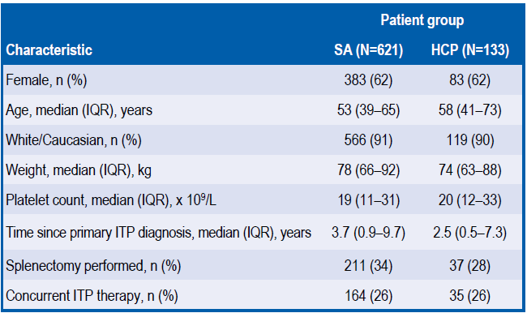
Kuter DJ, et al. Safety and Efficacy of Self-Administered Romiplostim in Patients with Immune Thrombocytopenia (ITP): Results of an Integrated Analysis of Five Clinical Trials
Results (cont.)
Table 2. Demographic and Baseline Characteristics
HCP, healthcare provider; IQR, interquartile range; ITP, immune thrombocytopenia; SA, self-administration

Slide 13
Kuter DJ, et al. Safety and Efficacy of Self-Administered Romiplostim in Patients with Immune Thrombocytopenia (ITP): Results of an Integrated Analysis of Five Clinical Trials
Results (cont.)
Dose Adjustment
Dose adjustment within 8 weeks of the index date was required by 20% (n = 27) of patients in the HCP group and 0.2% (n = 1) of the SA group. Dose adjustment within 6 months of the index date was required by 47% (n = 63) of the HCP group and 24% (n = 149) of the SA group
Duration-adjusted dose adjustment rates during Weeks –4 to –1 (i.e., prior to the index date) were 1.13 in the SA group vs 0.72 in the HCP group and from Week 1 to the end of treatment (EOT) were 1.24 vs 1.60, respectively
Exposure
The SA group had greater exposure to romiplostim compared to the HCP group (Table 3)
HCP, healthcare provider; ITP, immune thrombocytopenia; SA, self-administration

Slide 14
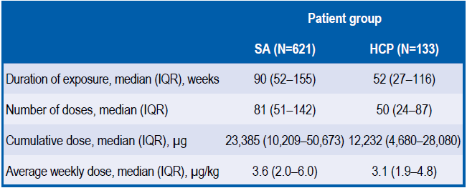
Kuter DJ, et al. Safety and Efficacy of Self-Administered Romiplostim in Patients with Immune Thrombocytopenia (ITP): Results of an Integrated Analysis of Five Clinical Trials
Results (cont.)
Table 3. Romiplostim Exposure
HCP, healthcare provider; IQR, interquartile range; SA, self-administration

Slide 15
Kuter DJ, et al. Safety and Efficacy of Self-Administered Romiplostim in Patients with Immune Thrombocytopenia (ITP): Results of an Integrated Analysis of Five Clinical Trials
Results (cont.)
Efficacy – Platelet Response
During Weeks –4 to –1, 87% (95% exact binomial confidence interval [CI]: 84–89%) of the SA group and all patients in the HCP group (100%; 95% CI: 97–100%) achieved platelet response at least once
From Week 1 to EOT, 95% (95% CI: 93–97%) of the SA group and 100% (95% CI: 97–100%) of patients in the HCP group achieved platelet response at least once
The proportion of patients with platelet counts above 50 × 10⁹/L from Week 1 to EOT ranged between 88–92% in the SA group and 92–100% in the HCP group (Figure 1)
EOT, end of treatment; HCP, healthcare provider; ITP, immune thrombocytopenia; SA, self-administration

Slide 16
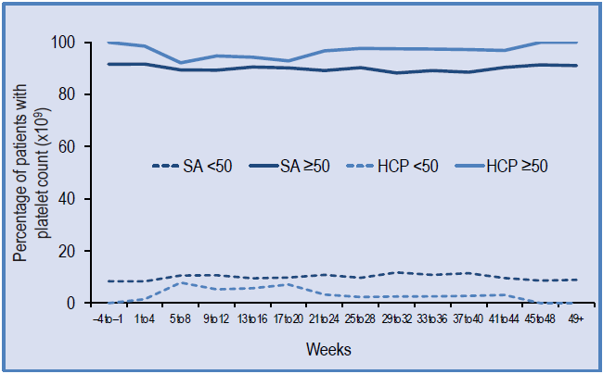
Kuter DJ, et al. Safety and Efficacy of Self-Administered Romiplostim in Patients with Immune Thrombocytopenia (ITP): Results of an Integrated Analysis of Five Clinical Trials
Results (cont.)
Figure 1. Proportions of Patients with Platelet Counts ≥ 50 x 10⁹/L and < 50 x 10⁹/L Immediately Prior to (Weeks –4 to –1) and from Index Week 1 to EOT
EOT, end of treatment; HCP, healthcare provider; SA, self-administration

Slide 17
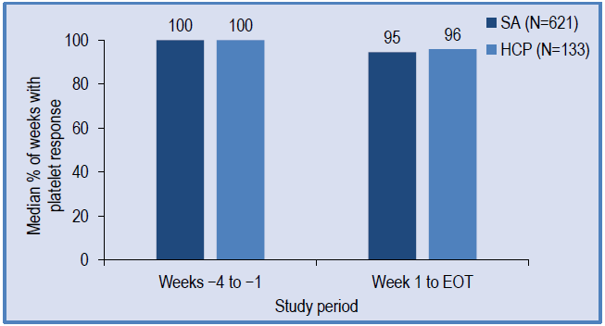
Kuter DJ, et al. Safety and Efficacy of Self-Administered Romiplostim in Patients with Immune Thrombocytopenia (ITP): Results of an Integrated Analysis of Five Clinical Trials
Results (cont.)
Figure 2. Median % of Weeks with Platelet Response Immediately Prior to (Weeks –4 to –1) and from Index Week 1 to EOT
The percentage of weeks in which patients had a platelet response was comparable in the two groups (Figure 2)
EOT, end of treatment; HCP, healthcare provider; SA, self-administration

Slide 18
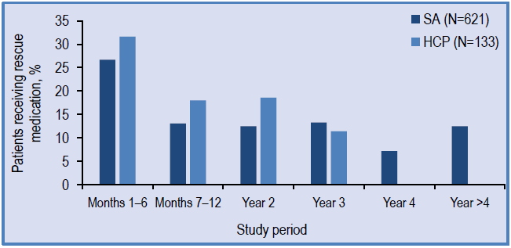
Kuter DJ, et al. Safety and Efficacy of Self-Administered Romiplostim in Patients with Immune Thrombocytopenia (ITP): Results of an Integrated Analysis of Five Clinical Trials
Results (cont.)
Efficacy – Rescue Medication
Rescue medication was most commonly given during the first 6 months of the study period (Figure 3) and – overall – was received by similar proportions of patients in the two groups (37% [n = 230] in the SA vs 40% [n = 53] in the HCP group)
Figure 3. Rescue Medication Requirements
HCP, healthcare provider; SA, self-administration

Slide 19
Kuter DJ, et al. Safety and Efficacy of Self-Administered Romiplostim in Patients with Immune Thrombocytopenia (ITP): Results of an Integrated Analysis of Five Clinical Trials
Results (cont.)
Safety
Duration-adjusted event rates were numerically lower in the SA vs the HCP group for all treatment-emergent adverse events (TEAEs), Grade ≥ 3 TEAEs, serious TEAEs, TEAEs leading to discontinuation and fatal TEAEs (Table 4)
Duration-adjusted rates of all bleeding TEAEs, Grade ≥ 3 bleeding TEAEs and serious bleeding TEAEs were also numerically lower for the SA vs the HCP group
Rates of thrombotic/thromboembolic events were also lower in the SA vs the HCP group
The most frequently reported TEAEs (duration-adjusted) were headache, contusion, epistaxis, nasopharyngitis, arthralgia and fatigue; the most commonly reported serious adverse events (SAE) were thrombocytopenia, pneumonia and ITP
HCP, healthcare provider; ITP, immune thrombocytopenia; SA, self-administration; TEAE, treatment-emergent adverse event

Slide 20
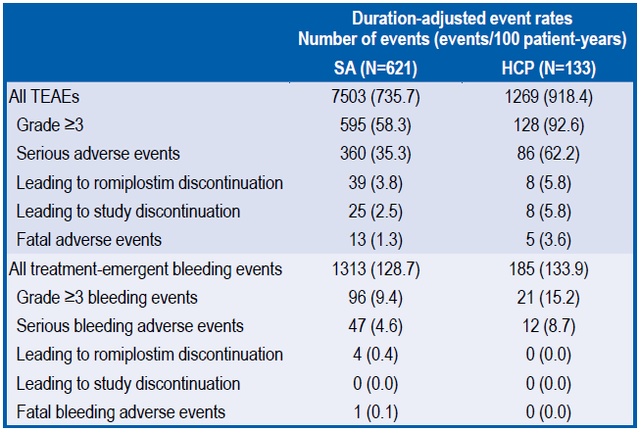
Kuter DJ, et al. Safety and Efficacy of Self-Administered Romiplostim in Patients with Immune Thrombocytopenia (ITP): Results of an Integrated Analysis of Five Clinical Trials
Results (cont.)
Table 4. Overview of Duration-Adjusted Treatment-Emergent Adverse Events and Bleeding Events from Index Week 1 to EOT
EOT, end of treatment; HCP, healthcare provider; SA, self-administration; TEAE, treatment-emergent adverse event

Slide 21
Kuter DJ, et al. Safety and Efficacy of Self-Administered Romiplostim in Patients with Immune Thrombocytopenia (ITP): Results of an Integrated Analysis of Five Clinical Trials
Results (cont.)
Antibody Response
Of patients with a post-baseline antibody result (583 SA, 124 HCP), 36 (6.2%) and 6 (4.8%) patients had romiplostim-positive binding antibodies, respectively
Three SA patients and one HCP-dosed individual had neutralising antibodies against romiplostim; no neutralising antibodies against endogenous thrombopoietin were detected
HCP, healthcare provider; SA, self-administration

Slide 22
Kuter DJ, et al. Safety and Efficacy of Self-Administered Romiplostim in Patients with Immune Thrombocytopenia (ITP): Results of an Integrated Analysis of Five Clinical Trials
Conclusions
This analysis, integrating data from 5 clinical trials of romiplostim, demonstrates that self-administration of romiplostim is associated with comparable efficacy and safety to that of romiplostim administered by an HCP
Romiplostim self-administration therefore provides the potential for improved practicality and convenience among eligible patients (patients who have stable platelet counts ≥ 50 × 10⁹/L for ≥ 3 consecutive weeks and have undergone training)
Limitations of this analysis include:
the non-randomised allocation of patients to SA and HCP-dosing; HCPs may have offered self-administration to ‘fitter’ patients, which may explain the apparent reduced incidence of (S)AEs in this group
reduced number of clinic visits (at which adverse events would be reported) attended by patients in the SA vs the HCP-dosing group
absence of assessment of the impact of SA on quality of life (QoL; not all the included studies assessed QoL)
HCP, healthcare provider; QoL, quality of life; SA, self-administration, SAE, serious adverse event

Slide 23
Tarantino M, et al. Safety and Efficacy of Romiplostim in Over 200 Children With Persistent or Chronic Immune Thrombocytopenia in an Integrated Database of 5 Clinical Trials
Safety and Efficacy of Romiplostim in Over 200 Children With Persistent or Chronic Immune Thrombocytopenia in an Integrated Database of 5 Clinical Trials
Michael Tarantino,¹ Jenny Despotovic,² John Grainger,³ Nichola Cooper,⁴ Donald Beam,⁵ Ashok Raj,⁶ Alexey Maschan,⁷ June Kim,⁸ Melissa Eisen⁸
¹The Bleeding and Clotting Disorders Institute, University of Illinois College of Medicine-Peoria, Peoria, IL, USA; ²Texas Children’s Hematology Center, Houston, TX, USA; ³Department of Haematology, Royal Manchester Children’s Hospital, Faculty of Medical & Human Sciences, University of Manchester, Central Manchester University Hospitals NHS Foundation Trust, Manchester Academic Health Science Centre, Manchester, UK; ⁴Department of Haematology, Hammersmith Hospital, Imperial College London, London, UK; ⁵Cook Children’s Medical Center, Fort Worth, TX, USA; ⁶Pediatric Cancer and Blood Disorders Clinic, Louisville, KY, USA; ⁷Dmitry Rogachev National Research Center for Pediatric Hematology, Oncology and Immunology, Moscow, Russian Federation; ⁸Amgen Inc., Thousand Oaks, CA, USA
Abstract #PF689
European Hematology Association (EHA) 2019
June 13–16, 2019; Amsterdam, Netherlands

Slide 24
Tarantino M, et al. Safety and Efficacy of Romiplostim in Over 200 Children With Persistent or Chronic Immune Thrombocytopenia in an Integrated Database of 5 Clinical Trials
Background
The endogenous protein thrombopoietin (TPO) is the primary regulator of platelet production¹
Romiplostim, a TPO receptor agonist, is an Fc-fusion protein (peptibody) with no amino acid sequence homology to endogenous TPO¹
Romiplostim is approved for use in patients 1 year of age or older with chronic immune thrombocytopenia (ITP) in the EU or for ITP for ≥ 6 months in the USA and other countries who are refractory to other treatments
Five romiplostim trials examined the use of romiplostim in children with ITP¹⁻⁵
Comprehensive data are needed for romiplostim use in children with persistent ITP (6–12 months) or chronic ITP (> 1 year)
The objective of this integrated analysis was to examine the safety and efficacy of romiplostim in children with persistent or chronic ITP across the clinical trials
1. Bussel JB, et al. Blood. 2011;118:28-36. 2. Bussel JB, et al. Pediatr Blood Cancer. 2015;62:208-213. 3. Tarantino MD, et al. Lancet. 2016;388:45-54.
4. Grainger JD, et al. Blood. 2017;130(suppl 1):2334. 5. Tarantino M, et al. Haematologica. 2019; eprint: www.doi.org/10.3324/haematol.2018.202283.

Slide 25
Tarantino M, et al. Safety and Efficacy of Romiplostim in Over 200 Children With Persistent or Chronic Immune Thrombocytopenia in an Integrated Database of 5 Clinical Trials
Methods
Trial Participants
The analysis included pooled data from 5 romiplostim trials (Figure 1)
Each trial enrolled children < 18 years of age with ITP for ≥ 6 months and ≥ 1 prior ITP therapy
Informed consent was obtained for each patient
An institutional review board approved the trial for each investigational site
ITP, immune thrombocytopenia

Slide 26
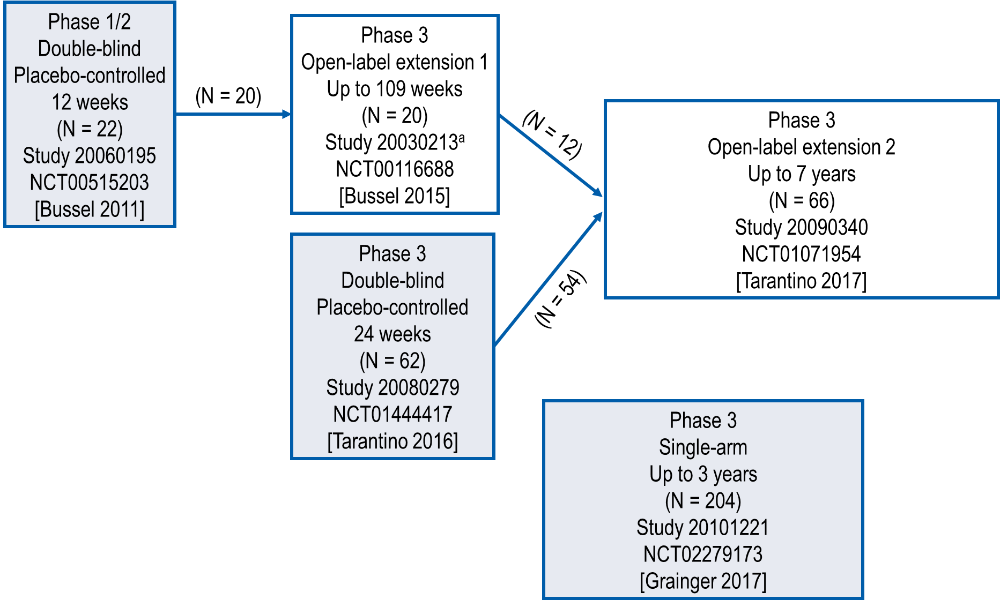
Tarantino M, et al. Safety and Efficacy of Romiplostim in Over 200 Children With Persistent or Chronic Immune Thrombocytopenia in an Integrated Database of 5 Clinical Trials
Methods (cont.)
Figure 1. Romiplostim Trials Included in Pooled Analysis
ªStudy NCT00116688 also enrolled adults; only pediatric patients from that study were included in this analysis.

Slide 27
Tarantino M, et al. Safety and Efficacy of Romiplostim in Over 200 Children With Persistent or Chronic Immune Thrombocytopenia in an Integrated Database of 5 Clinical Trials
Methods (cont.)
Romiplostim Dosing
Romiplostim or placebo was administered subcutaneously
The dose was titrated (1–10 µg/kg/week in most trials) to maintain a platelet count between 50 and 200 x 10⁹/L
For consecutive platelet counts above 200 x 10⁹/L, romiplostim was reduced by 1 µg/kg or withheld if already 1 μg/kg/week
For a platelet count above 400 x 10⁹/L, romiplostim was withheld until the platelet count returned to below 200 x 10⁹/L, then the dose was reduced by 1 µg/kg
Concomitant Treatment
Patients continued to receive corticosteroids, danazol, or azathioprine at the same dose
When platelets were at least 50 x 10⁹/L, patients could reduce or discontinue other treatments
Rescue treatment (intravenous immunoglobulin G, anti-D, platelet transfusions, steroids, or antifibrinolytics) could be administered as medically necessary

Slide 28
Tarantino M, et al. Safety and Efficacy of Romiplostim in Over 200 Children With Persistent or Chronic Immune Thrombocytopenia in an Integrated Database of 5 Clinical Trials
Methods (cont.)
Assessments
Platelet count, treatments, and adverse events (AEs) were recorded at each visit
Antibodies to romiplostim or thrombopoietin were measured as follows:
In double-blind trials, at baseline and end of treatment
In open-label extensions, at baseline and annually
In the 3-year single-arm trial, at baseline, weeks 12 and 52, then every 24 weeks, and end of treatment
Bone marrow biopsies were conducted as follows:
European sites in the 3-year single-arm trial (140 patients): baseline, after 1 or 2 years, or at the end of treatment
Other sites in the single-arm trial (64 patients) and all sites in the other trials: at the investigator’s discretion after detection of abnormalities in peripheral blood smear or loss of response to romiplostim

Slide 29
Tarantino M, et al. Safety and Efficacy of Romiplostim in Over 200 Children With Persistent or Chronic Immune Thrombocytopenia in an Integrated Database of 5 Clinical Trials
Methods (cont.)
Statistical Methods
For this pooled analysis of data from studies with different durations and designs, descriptive statistics were used; no statistical hypothesis testing was conducted
Missing platelet counts were imputed using the last observation carried forward
A platelet response was defined as at least one platelet count of at least 50 x 10⁹/L without any rescue medication use in the prior 4 weeks
A treatment-free response (ie, remission) was defined as a platelet count of at least 50 x 10⁹/L for at least 6 months off all ITP therapies, including romiplostim
ITP, immune thrombocytopenia

Slide 30
Tarantino M, et al. Safety and Efficacy of Romiplostim in Over 200 Children With Persistent or Chronic Immune Thrombocytopenia in an Integrated Database of 5 Clinical Trials
Results
Baseline Characteristics
Of the 286 patients who participated in at least 1 trial:
262 received only romiplostim
20 initially received placebo, then romiplostim
4 received only placebo
Thus, 282 received any romiplostim and 24 received any placebo (Table 1)
At baseline, 24% of patients had ITP for 6–12 months (persistent ITP) and 76% had ITP for > 1 year (chronic ITP)
ITP, immune thrombocytopenia

Slide 31
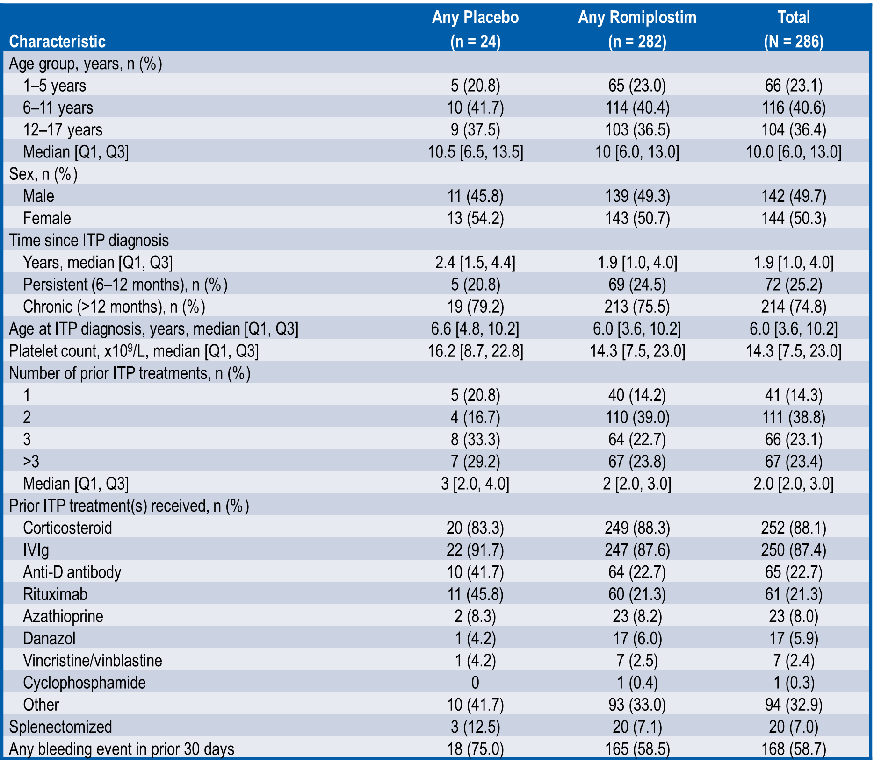
Tarantino M, et al. Safety and Efficacy of Romiplostim in Over 200 Children With Persistent or Chronic Immune Thrombocytopenia in an Integrated Database of 5 Clinical Trials
Results (cont.)
Table 1. Baseline Demographics and Disease Characteristics
ITP, immune thrombocytopenia; IVIg, intravenous immunoglobulin G; Q1, first quartile; Q3, third quartile

Slide 32
Tarantino M, et al. Safety and Efficacy of Romiplostim in Over 200 Children With Persistent or Chronic Immune Thrombocytopenia in an Integrated Database of 5 Clinical Trials
Results (cont.)
Safety
The median duration of romiplostim treatment was 65 weeks (persistent ITP, 65 weeks; chronic ITP, 66 weeks) and 62% of patients received romiplostim for more than 48 weeks; the median dose of romiplostim was 6.6 µg/kg/week
With exposure to romiplostim, 24% of patients (persistent ITP, 17%; chronic ITP, 27%) had a serious AE, most commonly epistaxis (6%)
After adjusting for duration of exposure (Table 2), bleeding and other AEs generally occurred with a similar or lower rate in the romiplostim group compared with the placebo group
AE, adverse event; ITP, immune thrombocytopenia

Slide 33
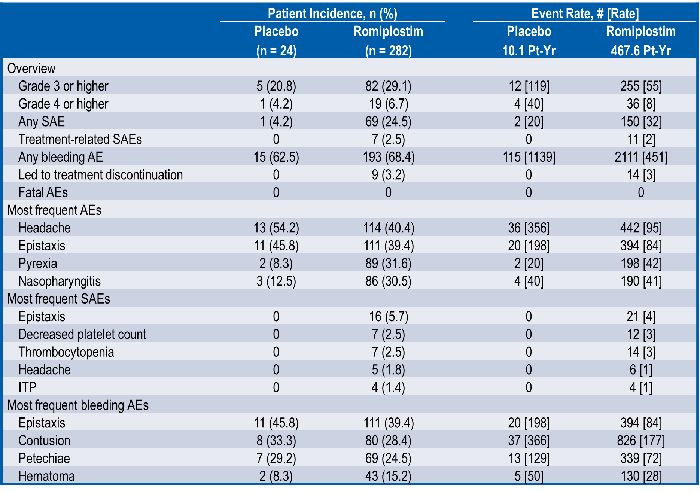
Tarantino M, et al. Safety and Efficacy of Romiplostim in Over 200 Children With Persistent or Chronic Immune Thrombocytopenia in an Integrated Database of 5 Clinical Trials
Results (cont.)
Table 2. Adverse Events
#, number of events; AE, adverse event; ITP, immune thrombocytopenia; pt-yr, patient-years; SAE, serious adverse event.
Exposure-adjusted rates are per 100 patient-years.

Slide 34
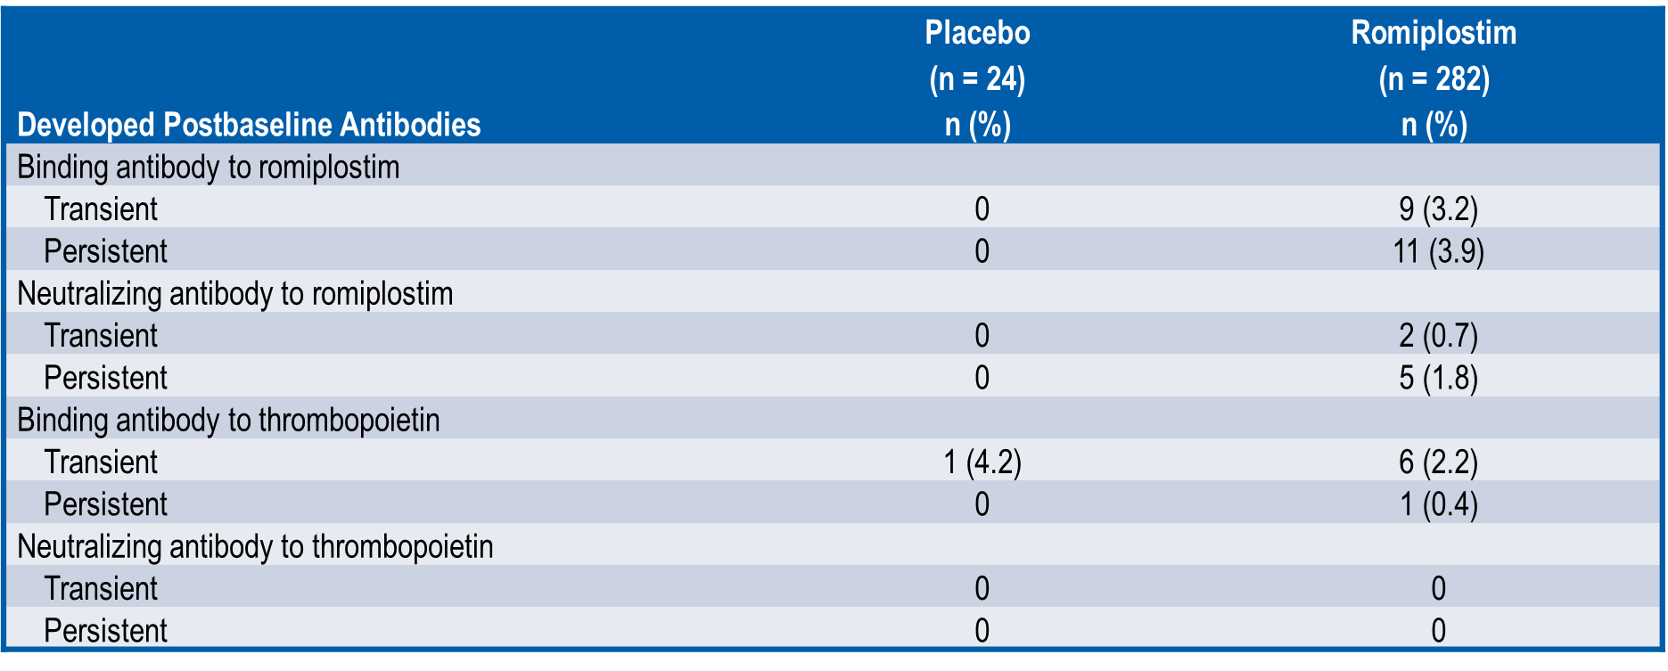
Tarantino M, et al. Safety and Efficacy of Romiplostim in Over 200 Children With Persistent or Chronic Immune Thrombocytopenia in an Integrated Database of 5 Clinical Trials
Results (cont.)
Antibodies to Romiplostim or TPO
Seven patients (2%) had postbaseline neutralizing antibodies to romiplostim (Table 3)
No patient had neutralizing antibodies to endogenous TPO
Table 3. Antibodies to Romiplostim or Thrombopoietin
TPO, thrombopoietin

Slide 35
Tarantino M, et al. Safety and Efficacy of Romiplostim in Over 200 Children With Persistent or Chronic Immune Thrombocytopenia in an Integrated Database of 5 Clinical Trials
Results (cont.)
Bone Marrow
One patient had an increase in modified Bauermeister bone marrow grade from 0 to 2 (fine reticulin fiber network) with no associated AE, platelet count ≥ 30 x 10⁹/L, and no follow-up biopsy
Among patients with bone marrow biopsy in the ongoing 3-year trial (year 1, n = 27; year 2, n = 5), there were no findings of collagen or bone marrow abnormalities vs baseline
Platelet Responses
Overall, 89% of romiplostim-treated patients (persistent ITP, 88%; chronic ITP, 90%) and 8% receiving placebo had a platelet response (≥ 50 x 10⁹/L)
Median time to platelet response for romiplostim was 6 weeks (persistent ITP, 5 weeks; chronic ITP, 6 weeks)
Median platelet counts remained between 50 and 200 x 10⁹/L with weekly romiplostim treatment and dose titration (Figure 2)
Median time per month with platelet response was 76% overall (persistent ITP, 81%; chronic ITP, 74%) and 92% after first response (persistent ITP, 92%; chronic ITP, 93%)
AE, adverse event; ITP, immune thrombocytopenia

Slide 36
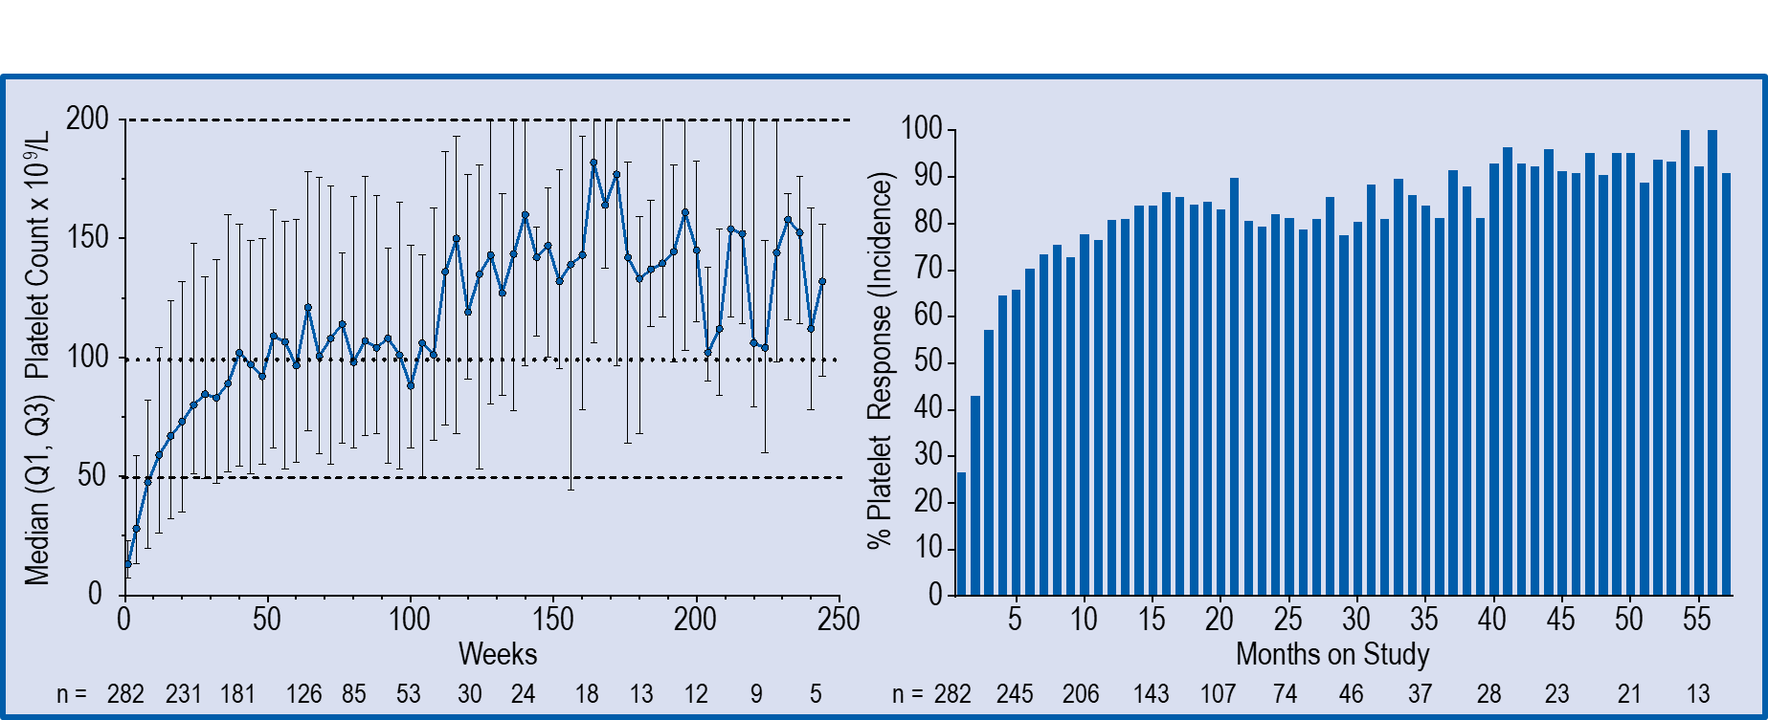
Tarantino M, et al. Safety and Efficacy of Romiplostim in Over 200 Children With Persistent or Chronic Immune Thrombocytopenia in an Integrated Database of 5 Clinical Trials
Results (cont.)
Figure 2. Platelet Counts and Platelet Response Rates Over Time After Starting Romiplostim
Q1, first quartile; Q3, third quartile.
Platelet response was defined as a platelet count of at least 50 x 10⁹/L without a rescue medication (intravenous immunoglobulin G, anti-D, platelet transfusion, steroid, or antifibrinolytic) in the prior 4 weeks

Slide 37
Tarantino M, et al. Safety and Efficacy of Romiplostim in Over 200 Children With Persistent or Chronic Immune Thrombocytopenia in an Integrated Database of 5 Clinical Trials
Results (cont.)
Treatment-free Response
Nineteen patients (persistent ITP, 7; chronic ITP, 12) maintained platelet counts ≥ 50 x 10⁹/L while withholding all ITP therapies for ≥ 6 months (treatment-free response)
The median duration of treatment-free response was 12 months (persistent ITP, 12 months; chronic ITP, 11 months)
All patients with a treatment-free response had received romiplostim
Among patients with a treatment-free response, median age was 7 years and 63% were female (Table 4); other baseline characteristics were similar to those for the overall population
ITP, immune thrombocytopenia

Slide 38
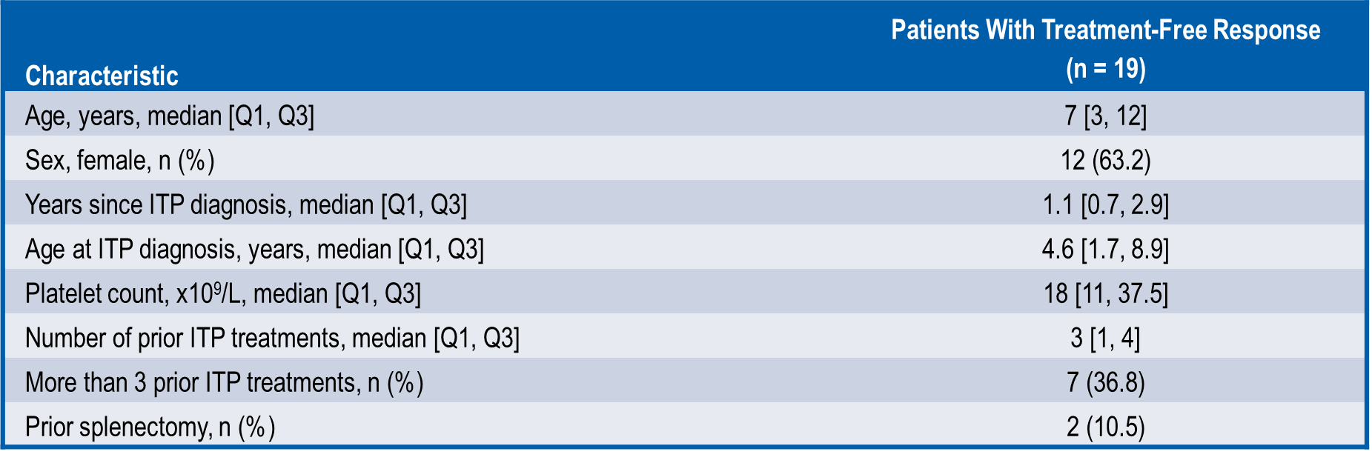
Tarantino M, et al. Safety and Efficacy of Romiplostim in Over 200 Children With Persistent or Chronic Immune Thrombocytopenia in an Integrated Database of 5 Clinical Trials
Results (cont.)
Table 4. Baseline Characteristics of Patients With Treatment-Free Response After Romiplostim
ITP, immune thrombocytopenia; Q1, first quartile; Q3, third quartile

Slide 39
Tarantino M, et al. Safety and Efficacy of Romiplostim in Over 200 Children With Persistent or Chronic Immune Thrombocytopenia in an Integrated Database of 5 Clinical Trials
Conclusions
Romiplostim was well tolerated in this comprehensive database of romiplostim trials for the treatment of pediatric ITP
No immunogenicity or bone marrow issues were identified with romiplostim
Most patients had a platelet response to romiplostim
Some patients achieved a treatment-free response for at least 6 months after romiplostim treatment, without any other ITP therapy
Median treatment duration, tolerability, and platelet responses for romiplostim were similar between children with persistent ITP (6–12 months) and chronic ITP (> 12 months) at baseline
ITP, immune thrombocytopenia

Slide 40
Lozano ML, et al. Biological And Clinical Factors That Favor The Use Of A Specific TPO-RA In ITP Patients. Results From A Spanish Multicenter Study
Biological And Clinical Factors That Favor The Use Of A Specific TPO-RA In ITP Patients. Results From A Spanish Multicenter Study
María L Lozano¹; María E Mingot²; María Perera³; Isidro Jarque⁴; Rosa Campos⁵; Tomás J González⁶; Gonzalo Carreño⁷; Nuria Bermejo⁸; María F López⁹; Aurora De Andrés¹⁰; David Valcárcel¹¹; Felipe Casado¹²; María T Álvarez¹³; María I Orts¹⁴; Silvana Novelli¹⁵; Nuria Revilla¹; José R González¹⁶; Estefanía Bolaños¹⁷; Manuel Rodríguez¹⁸; Elisa Orna¹⁹; Vicente Vicente¹
¹Hospital Morales Meseguer; ²Complejo Hospitalario Regional de Málaga; ³Complejo Hospitalario Universitario de Gran Canaria Dr. Negrín; ⁴Hospital Universitari i Politècnic La Fe; ⁵Hopital de Especialidades de Jerez de la Frontera; ⁶Hospital Universitario de Burgos; ⁷Hospital Universitario 12 de Octubre; ⁸ Hospital San Pedro de Alcántara; ⁹Hospital Universitario a Coruña; ¹⁰Complexo Hospitalario Universitario de Santiago; ¹¹Hospital Universitari Vall d’Hebron; ¹²Hospital Virgen de la Salud; ¹³Hospital Universitario La Paz; ¹⁴Hospital de Sagunto; ¹⁵Hospital de la Santa Creu i Sant Pau; ¹⁶Hospital Universitario de Salamanca; ¹⁷Hospital Clínico San Carlos; ¹⁸Hospital Álvaro Cunqueiro; ¹⁹Hospital Universitari Germans Trias i Pujol
Abstract #PF339
European Hematology Association (EHA) 2019
June 13–16, 2019; Amsterdam, Netherlands

Slide 41
Lozano ML, et al. Biological And Clinical Factors That Favor The Use Of A Specific TPO-RA In ITP Patients. Results From A Spanish Multicenter Study
Introduction
Randomized clinical trials comparing thrombopoietin receptor agonists (TPO-RA) for the treatment of patients with primary immune thrombocytopenia (ITP) have not been performed. Results from indirect treatment comparisons between eltrombopag (ELT) and romiplostim (ROM) should be interpreted with caution due to heterogeneity between the study designs, patient populations, and response definitions. Some of these comparison by means of a network meta-analysis support the perception that both drugs might be equivalent in efficacy and safety for adult ITP,¹ but in contrast, other comparisons using a Bayesian method² or different network meta-analysis³ suggest that ROM may have greater efficacy. Since it is not possible to draw definite conclusions based on current evidence, the choice of which TPO-RA to use is an individual one, based on doctor’s and patient’s preferences.
1. Zhang J, et al. PLoS One. 2018;13:e0198504. 2. Cooper K, et al. Int J Technol Assess Health Care. 2014;30:129-130. 3. Yang R, et al. Hematology. 2019;24:290-299.

Slide 42
Lozano ML, et al. Biological And Clinical Factors That Favor The Use Of A Specific TPO-RA In ITP Patients. Results From A Spanish Multicenter Study
Objective
In the absence of randomized clinical trials indicating which is the best choice of a TPO-RA for an individual patient, the aim of the study was to analyze biological and clinical factors leading physicians and/or patients to the use of a particular TPO-RA.
TPO-RA, thrombopoietin receptor agonist

Slide 43
Lozano ML, et al. Biological And Clinical Factors That Favor The Use Of A Specific TPO-RA In ITP Patients. Results From A Spanish Multicenter Study
Methods
This was an observational, retrospective and multicenter study conducted in Spain from November 2016 to January 2018. The study was approved by the Clinical Research Ethics Committee of the Hospital General Universitario Morales Meseguer (Murcia, Spain). Written informed consent was obtained from every subject. The participant investigators had to recruit through the screening of the clinical records of all adult ITP patients who were seen in their respective site and who had initiated treatment with ROM or ELT as short- (intention to treat of < 2 months) or long-term (intention to treat of > 2 months) therapy from January 2012 to December 2014. Information on patient characteristics, diagnosis, history of disease and previous therapies, bleeding history, TPO-RA administration, and need for hospital medical care were collected from medical records.
ELT, eltrombopag; ITP, immune thrombocytopenia; ROM, romiplostim; TPO-RA, thrombopoietin receptor agonist

Slide 44
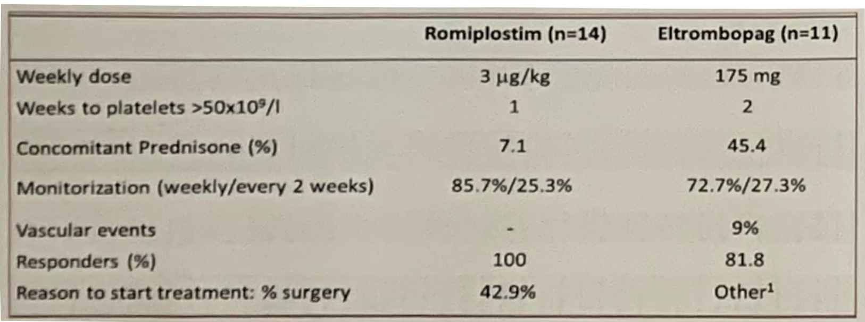
Lozano ML, et al. Biological And Clinical Factors That Favor The Use Of A Specific TPO-RA In ITP Patients. Results From A Spanish Multicenter Study
Results
A minority of patients (n = 25) started TPO-RA as short-term therapy with an intention to treat of < 2 months (14 ROM, 11 ELT). The most frequent single indication for a transient use of TPO-RA was to increase platelet counts before a scheduled surgery; all patients (n = 6) received ROM in this scenario. No differences were observed between ROM and ELT in terms of gender, baseline platelet counts, time to achieve platelets > 50 x 10⁹/L, nor maximal platelet counts after short-time TPO-RA treatment (Table 1).
Table 1. Short-term Use of TPO-RAs
¹Patients’ comorbidities, tooth extraction, lack of response to previous TPO-RA
ELT, eltrombopag; ROM, romiplostim; TPO-RA, thrombopoietin receptor agonist

Slide 45
Lozano ML, et al. Biological And Clinical Factors That Favor The Use Of A Specific TPO-RA In ITP Patients. Results From A Spanish Multicenter Study
Results (cont.)
The majority of patients (n = 121, median age of 63 years; range 19–96 years; 58.7% female) initiated TPO-RA as long-term treatment (ROM 54; ELT 67). Sixty-eight percent of the patients met criteria for chronic, 16% for newly diagnosed and 16% for persistent ITP. There was a trend towards a preferential use of ELT in patients ≥ 65 years (52.2% vs. 35.2% for ROM, P = 0.061). Neither gender, liver disease, history of previous neoplasia or vascular events, phase of the disease, or responses to earlier lines of therapy were associated with the choice of TPO-RA.
We assessed the bleeding severity both at diagnosis and before initiation of TPO-RA therapy according to the Page score.¹ In univariate analysis, ROM was preferentially given to patients presenting with bleeding symptoms at diagnosis (66.7% of those receiving ROM) compared to 41.8% of bleeders among those receiving ELT (P = 0.006) (Figure 1A). The cumulative bleeding scale at diagnosis was also higher in those patients elected for treatment with ROM than ELT (median bleeding score at diagnosis 2 vs. 0; P = 0.003) (Figure 1B).
ELT, eltrombopag; ITP, immune thrombocytopenia; ROM, romiplostim; TPO-RA, thrombopoietin receptor agonist
1. Page LK, et al. Br J Haematol. 2007;138:245-248.

Slide 46
Lozano ML, et al. Biological And Clinical Factors That Favor The Use Of A Specific TPO-RA In ITP Patients. Results From A Spanish Multicenter Study
Results (cont.)
Figure 1. Presence and Severity of Bleeding at Diagnosis and Choice of TPO-RA. Blue bars represent patients that were treated with ROM; red bars represent patients that received ELT
At the time when TPO-RA was initiated, the risk of hemorrhage in terms of bleeding manifestations (median cumulative bleeding score of 1 and 0 for ROM and ELT, respectively; P = 0.037) (Figure 1C) or platelet counts (median 18 x 10⁹/L vs. 25 x 10⁹/L for ROM and ELT, respectively; P = 0.014) (Figure 1D) were also correlated with the selection of TPO-RA.
ELT, eltrombopag; ROM, romiplostim; TPO-RA, thrombopoietin receptor agonist

Slide 47
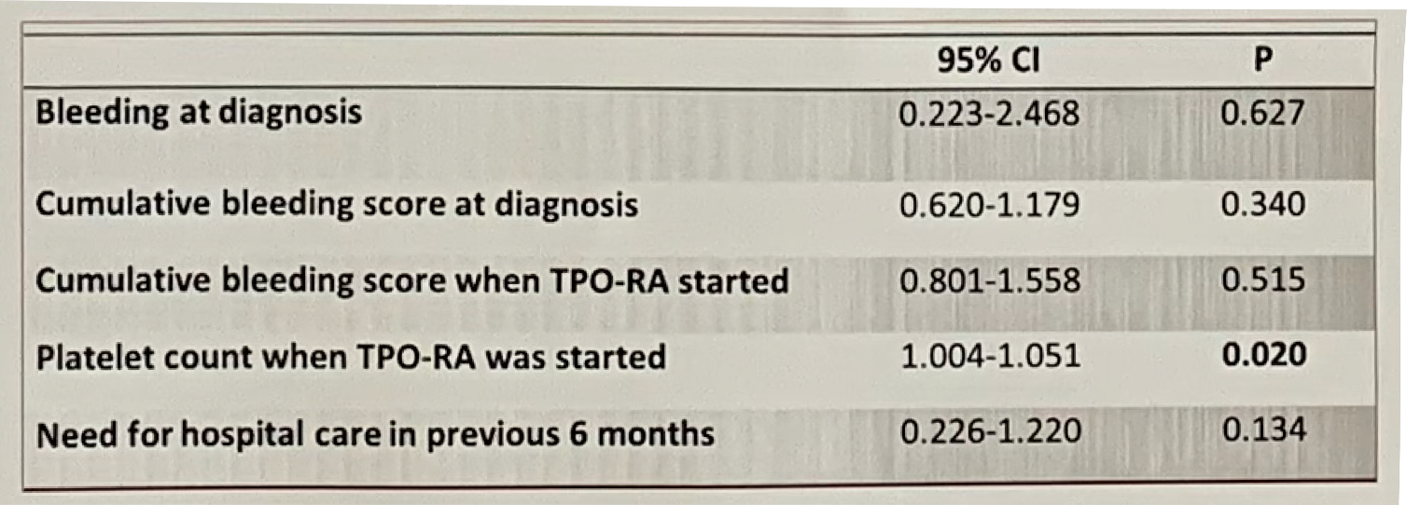
Lozano ML, et al. Biological And Clinical Factors That Favor The Use Of A Specific TPO-RA In ITP Patients. Results From A Spanish Multicenter Study
Results (cont.)
Additionally, six months before the start of TPO-RA, the requirement for hospital care (emergency treatment or hospital admission) was higher in patients that were subsequently treated with ROM than those elected for ELT (55.6% vs. 31.8%; P = 0.009). In multivariate analysis with logistic regression, including the five variables that were significantly associated with the election of one particular TPO-RA, only platelet counts when TPO-RA were initiated correlated with the selection of TPO-RA (Table 2).
Table 2. Variables Influencing the Selection of TPO-RA in the Clinical Practice. Results Show the 95% CI of Choosing Romiplostim as First TPO-RA. Multivariate Model by Logistic Regression Results.
CI, confidence interval; ELT, eltrombopag; TPO-RA, thrombopoietin receptor agonist

Slide 48
Lozano ML, et al. Biological And Clinical Factors That Favor The Use Of A Specific TPO-RA In ITP Patients. Results From A Spanish Multicenter Study
Discussion
Either ELT or ROM are reasonable and likely effective drugs for the therapy of ITP patients. Our observational data indicate that in a real world setting, the choice of one TPO-RA over the other for long-term treatment could be conditioned by attributes other than the conditions of administration of these drugs and/or patient’s preference.
In our multivariate analysis of the long-term use of TPO-RA, we found that the lower the platelet count the higher the likelihood of prescribing ROM over ELT. This suggests that the prescription of the TPO-RA could be related to some extent with the risk of bleeding before initiating treatment. In these situations, ROM, probably based on the wider dosage range of the drug that allows earlier responses with higher doses, and also to avoid dietary interferences and secure adherence to treatment when this may be an issue, may confer an advantage.
ELT, eltrombopag; ITP, immune thrombocytopenia; ROM, romiplostim; TPO-RA, thrombopoietin receptor agonist

Slide 49
Lozano ML, et al. Biological And Clinical Factors That Favor The Use Of A Specific TPO-RA In ITP Patients. Results From A Spanish Multicenter Study
Discussion (cont.)
Recently, by network analysis the probability of achieving early responses, i.e. platelet count ≥ 50 x 10⁹/L at week 2 after the initiation of treatment of different second-line ITP therapies has been analyzed. While results showed that the surface under the cumulative ranking curve (SUCRA) seemed to determine the hierarchy of the earlier efficacy by ROM (80.8%) compared to ELT (59.0%),¹ however only a few randomized clinical trials were included, a limitation that may lead to unreliable assumptions. For that reason, head-to-head trials are critical to provide more evidence supporting the optimal therapy for an individual adult ITP patient.
In conclusion, no specific determinants are considered in the choice of a particular TPO-RA over the other. However, when a rapid increase in platelets is desirable for ITP patients because of bleeding risks (especially related to particularly low platelet counts) or who need elective surgical procedure, our study reflects that in clinical practice the choice of ROM seems to be a preferable option.
ELT, eltrombopag; ITP, immune thrombocytopenia; ROM, romiplostim; TPO-RA, thrombopoietin receptor agonist
1. Yang R, et al. Hematology. 2019;24:290-299.

Slide 50
Lozano ML, et al. Prevalence And Risk Factors For Thrombosis In Adult ITP Patients Treated With TPO-RA
Prevalence And Risk Factors For Thrombosis In Adult ITP Patients Treated With TPO-RA
María L Lozano¹; María E Mingot²; María Perera³; Isidro Jarque⁴; Rosa Campos⁵; Tomás J González⁶; Gonzalo Carreño⁷; Nuria Bermejo⁸; María F López⁹; Aurora De Andrés¹⁰; David Valcárcel¹¹; Felipe Casado¹²; María T Álvarez¹³; María I Orts¹⁴; Silvana Novelli¹⁵; José R González¹⁶; Estefanía Bolaños¹⁷; Manuel Rodríguez¹⁸; Elisa Orna¹⁹; Vicente Vicente¹
¹Hospital Morales Meseguer; ²Complejo Hospitalario Regional de Málaga; ³Complejo Hospitalario Universitario de Gran Canaria Dr. Negrín; ⁴Hospital Universitari i Politècnic La Fe; ⁵Hopital de Especialidades de Jerez de la Frontera; ⁶Hospital Universitario de Burgos; ⁷Hospital Universitario 12 de Octubre; ⁸ Hospital San Pedro de Alcántara; ⁹Hospital Universitario a Coruña; ¹⁰Complexo Hospitalario Universitario de Santiago; ¹¹Hospital Universitari Vall d’Hebron; ¹²Hospital Virgen de la Salud; ¹³Hospital Universitario La Paz; ¹⁴Hospital de Sagunto; ¹⁵Hospital de la Santa Creu i Sant Pau; ¹⁶Hospital Universitario de Salamanca; ¹⁷Hospital Clínico San Carlos; ¹⁸Hospital Álvaro Cunqueiro; ¹⁹Hospital Universitari Germans Trias i Pujol
Abstract #PS1580
European Hematology Association (EHA) 2019
June 13–16, 2019; Amsterdam, Netherlands

Slide 51
Lozano ML, et al. Prevalence And Risk Factors For Thrombosis In Adult ITP Patients Treated With TPO-RA
Introduction
Immune thrombocytopenia (ITP), a disease that represents the paradigm of acquired bleeding disorders, also associates with an increased risk of vascular events (VE). Thrombopoietin-receptor-agonists (TPO-RA) are effective treatments of ITP that could, however, have a potential for enhancing this thrombotic risk. Previous long-term TPO-RA clinical trials have shown that thrombotic events occurred in 6% of TPO-RA–treated ITP patients, with VE appearing to be more frequent in patients of older age and having at least 1 general risk factor for thrombosis.¹
In both romiplostim (ROM) and eltrombopag (ELT) clinical studies, thrombotic events occurred with low, normal, or high platelet level, with no clear relationship with the average or actual dose of either drug, or with length of exposure. The calculated exposure-adjusted event rates (per 100 patient-years) in those trials were in the range of 2.5 to 7.5 VE per 100 patient-years.¹
1. Rodeghiero F. Am J Hematol. 2016;91:39-45.

Slide 52
Lozano ML, et al. Prevalence And Risk Factors For Thrombosis In Adult ITP Patients Treated With TPO-RA
Objectives
The aims of this study were to determine the risk factors, circumstances, and prevalence of venous and arterial thrombosis in patients with primary ITP during long-term follow-up and treatment with TPO-RA.
ITP, immune thrombocytopenia; TPO-RA, thrombopoietin receptor agonist

Slide 53
Lozano ML, et al. Prevalence And Risk Factors For Thrombosis In Adult ITP Patients Treated With TPO-RA
Methods
This was an observational, retrospective and multicenter study conducted in Spain from November 2016 to January 2018. The study was approved by the Clinical Research Ethics Committee of the Hospital General Universitario Morales Meseguer (Murcia, Spain). Written informed consent was obtained from every subject. The participant investigators had to recruit through the screening of the clinical records of all adult ITP patients who were seen in their respective site who had initiated treatment with ROM or ELT as long-term therapy from January 2012 to December 2014. Information on patient characteristics was collected from medical records to assess and compare possible circumstances and risk factors of ITP patients with and without VE.
ELT, eltrombopag; ITP, immune thrombocytopenia; VE, vascular event

Slide 54
Lozano ML, et al. Prevalence And Risk Factors For Thrombosis In Adult ITP Patients Treated With TPO-RA
Results
A total of 121 patients (median age 63 years, range 19–96 years; 68% chronic phase), initiated TPO-RA (ROM 54; EPG 67). During a 329.3 patient-year time under treatment (exposure to ROM and ELT of 161.03 and 168.27 patient-year, respectively) 15 patients experienced 17 vascular episodes (9 arterial, 8 venous).
Seven events occurred with ROM, and 10 with ELT. The annualized risk was 4.2 and 5.9 VE/100 patient-years in ROM and ELT treated patients, respectively (median 5.2). The calculated incidence therefore was of one VE for every 17 patient-year receiving ELT, and one VE for every 23 patient-year receiving ROM.
ELT, eltrombopag; ITP, immune thrombocytopenia; ROM, romiplostim; TPO-RA, thrombopoietin receptor agonist; VE, vascular event

Slide 55
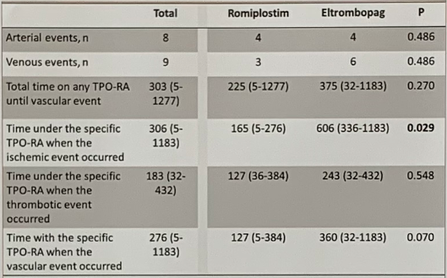
Results (cont.)
Lozano ML, et al. Prevalence And Risk Factors For Thrombosis In Adult ITP Patients Treated With TPO-RA
Most VE occurred in the first year of TPO-RA therapy (median 276 days; range 5–1183), with a trend toward earlier events under ROM than ELT (127 days vs. 360 days, respectively; P = 0.070). In the case of ischemic events the median time to arterial events was 165 vs. 606 days in ROM and ELT treated patients; P = 0.029 (Table 1).
Table 1. Time to Vascular Event (days)
TPO-RA, thrombopoietin receptor agonist

Slide 56
Lozano ML, et al. Prevalence And Risk Factors For Thrombosis In Adult ITP Patients Treated With TPO-RA
Results (cont.)
The comorbidities of patients that subsequently developed included one patient presenting with antiphospholipid antibodies, five having been diagnosed with neoplasia, one with vascular peripheral disease, and two with hypothyroidism — one of whom also had renal disease.
There were no significant differences in the 15 patients vs. the 106 patients that did not suffer from VE in terms of gender, age, diabetes, hypertension, previous VEs, nor time on prednisone as 1st line therapy.
In the bivariate analysis the factors associated with the occurrence of a thromboembolic or ischemic event were previous splenectomy (53.3% vs. 25.5%; P = 0.026), chronic phase of the disease (93.3% vs. 64.1%; P = 0.024) and a personal history of malignancy (33.0% vs. 2.8%; P < 0.001). When the TPO-RA was started, all patients were reported to have sustained complete remission of previous neoplasias (1 colon carcinoma; 1 Burkitt lymphoma; 1 bladder cancer; 1 breast cancer; 1 patient with history of thyroid, breast and ovarian tumors) and none of them were receiving any cancer-specific therapies.
TPO-RA, thrombopoietin receptor agonist; VE, vascular event

Slide 57
Lozano ML, et al. Prevalence And Risk Factors For Thrombosis In Adult ITP Patients Treated With TPO-RA
Results (cont.)
In multivariate analysis with logistic regression, in ITP patients suffering from a VE during TPO-RA, only past medical history of malignancy remained significantly associated with the occurrence of thromboembolic or ischemic event (odds ratio 28.3, 95% confidence interval 4.3 to 188.3; P = 0.001) (Table 2).
Table 2. Predictors of Vascular Events in Patients Being Treated With TPO-RAs. Multivariate Model by Logistic Regression Results.
CI, confidence interval; ITP, immune thrombocytopenia; OR, odds ratio; TPO-RA, thrombopoietin receptor agonist; VE, vascular event

Slide 58
Lozano ML, et al. Prevalence And Risk Factors For Thrombosis In Adult ITP Patients Treated With TPO-RA
Discussion
In this study, we describe an annualized risk of 5.2 VE/100 patient-years in TPO­-RA–treated patients. Venous and arterial thromboembolism are not frequent complications in ITP patients under TPO-RA, except in particular settings, such as in splenectomized and chronic patients.
Interestingly, we found that the history of malignancy was a strong factor associated with the occurrence of thromboembolic/ischemic events. It is well-known that active cancer is associated with a 4- to 7-fold increased risk of venous thromboembolism compared with noncancer patients.^{1,2} While factors due to cancer per se (e.g. a hyper-coagulable state, or treatment-related effects) have been suggested to contribute to VE in cancer patients,³ all ITP patients included in this study were considered to be in remission from their previous neoplasia when the TPO-RA was initiated.
ITP, immune thrombocytopenia; TPO-RA, thrombopoietin receptor agonist; VE, vascular event
1. Timp JF, et al. Blood. 2013;122:1712-1723. 2. Cohen AT, et al. Thromb Haemost. 2017;117:57-65. 3. Grisold W, et al. Acta Neurol Scand. 2009;119:1-16.

Slide 59
Lozano ML, et al. Prevalence And Risk Factors For Thrombosis In Adult ITP Patients Treated With TPO-RA
Discussion (cont.)
There are limited data that suggest that the mechanisms resulting in an increased risk of VE in cancer (be it an inherent pro-thrombotic risk or past treatment related-chemotherapy or radiotherapy-effect) may persist even after the cancer is in remission.¹ However, in our study the risk of VE in ITP patients with a history of previous neoplasia who developed a vascular complication while on TPO-RA was disproportional (28-fold increased risk) compared to conventional risk factors, or to even cancer in the absence of TPO-RA therapy, suggesting a novel association of history of previous neoplasia with thrombotic events in ITP patients under TPO-RA therapy.
Although further research is warranted, this association highlights the importance of the evaluation of comorbidities, including the history of malignancies, in patients with primary ITP and take them into account when managing the care of these patients.
ITP, immune thrombocytopenia; TPO-RA, thrombopoietin receptor agonist; VE, vascular event
1. Lau KK, et al. PLoS One. 2014;9:e88283.

Slide 60
Lozano ML, et al. Predictors of Therapy Free Responses in ITP Patients Receiving TPO-RA. Results from a Spanish Multicenter Study
Predictors of Therapy Free Responses In ITP Patients Receiving TPO-RA. Results From a Spanish Multicenter Study
María L Lozano¹; María E Mingot²; María Perera³; Isidro Jarque⁴; Rosa Campos⁵; Tomás J González⁶; Gonzalo Carreño⁷; Nuria Bermejo⁸; María F López⁹; Aurora De Andrés¹⁰; David Valcárcel¹¹; Felipe Casado¹²; María T Álvarez¹³; María I Orts¹⁴; Silvana Novelli¹⁵; Nuria Revilla¹; José R González¹⁶; Estefanía Bolaños¹⁷; Manuel Rodríguez¹⁸; Elisa Orna¹⁹; Vicente Vicente¹
¹Hospital Morales Meseguer; ²Complejo Hospitalario Regional de Málaga; ³Complejo Hospitalario Universitario de Gran Canaria Dr. Negrín; ⁴Hospital Universitari i Politècnic La Fe; ⁵Hopital de Especialidades de Jerez de la Frontera; ⁶Hospital Universitario de Burgos; ⁷Hospital Universitario 12 de Octubre; ⁸ Hospital San Pedro de Alcántara; ⁹Hospital Universitario a Coruña; ¹⁰Complexo Hospitalario Universitario de Santiago; ¹¹Hospital Universitari Vall d’Hebron; ¹²Hospital Virgen de la Salud; ¹³Hospital Universitario La Paz; ¹⁴Hospital de Sagunto; ¹⁵Hospital de la Santa Creu i Sant Pau; ¹⁶Hospital Universitario de Salamanca; ¹⁷Hospital Clínico San Carlos; ¹⁸Hospital Álvaro Cunqueiro; ¹⁹Hospital Universitari Germans Trias i Pujol
Abstract #PF690
European Hematology Association (EHA) 2019
June 13–16, 2019; Amsterdam, Netherlands

Slide 61
Lozano ML, et al. Predictors of Therapy Free Responses in ITP Patients Receiving TPO-RA. Results from a Spanish Multicenter Study
Introduction
Thrombopoietin receptor agonists (TPO-RA) are a well-established treatment in patients with primary immune thrombocytopenia (ITP). The mechanism of receptor activation is not completely similar between the two available drugs, and for that reason changing TPO-RA can be helpful in both directions. While TPO-receptor activation leads to the main mechanism of action of these compounds, which is the increase of platelet production by megakaryocytes, sustained treatment-free responses (TFR) after TPO-RA discontinuation have been observed in up to 10–30% of ITP patients. This raises the question of potential immunomodulatory properties of these drugs by increasing the regulatory T and B cell compartment and decreasing platelet destruction. Yet, to date there are no predictors to identify in which patients this approach is likely to be successful, and the only variables that seem to relate to increase TFR are earlier start of TPO-RA (which may relate to the pathophysiology of the disease), and robust platelet responses under these drugs.¹⁻³
1. Mazzucconi MG, et al. Eur J Haematol. 2017;98:242-249. 2. González-López TJ, et al. Am J Hematol. 2015;90:e40-e43. 3. Kuter DJ, et al. Br J Haematol. 2019;185:505-513.

Slide 62
Lozano ML, et al. Predictors of Therapy Free Responses in ITP Patients Receiving TPO-RA. Results from a Spanish Multicenter Study
Objectives
The aims of the study were to assess the proportion of patients who could discontinue TPO-RAs and maintain platelet counts ≥ 50 x10⁹/L without any ITP treatments for more than 6 months and no relapse during long-term follow-up, and to evaluate clinical predictors of TFR.
ITP, immune thrombocytopenia; TFR, treatment-free responses; TPO-RA, thrombopoietin receptor agonist

Slide 63
Lozano ML, et al. Predictors of Therapy Free Responses in ITP Patients Receiving TPO-RA. Results from a Spanish Multicenter Study
Methods
This was an observational, retrospective and multicenter study conducted in Spain from November 2016 to January 2018. The study was approved by the Clinical Research Ethics Committee of the Hospital General Universitario Morales Meseguer (Murcia, Spain). Written informed consent was obtained from every subject. The participant investigators had to recruit through the screening of the clinical records of all adult ITP patients who were seen in their respective site and who had initiated treatment with romiplostim (ROM) or eltrombopag (ELT) as long-term therapy from January 2012 to December 2014. Information of patient characteristics, history of disease and previous therapies, TPO-RA administration, response and discontinuation were collected from medical records.
TPO-RA, thrombopoietin receptor agonist

Slide 64
Lozano ML, et al. Predictors of Therapy Free Responses in ITP Patients Receiving TPO-RA. Results from a Spanish Multicenter Study
Results
A total of 121 patients with a median age of 63 years (range 19–96 years), 59% females initiated TPO-RA as long-term therapy (ROM 54; ELT 67)
Sixty-eight percent of the patients treated with TPO-RA met criteria for chronic, 16% for newly diagnosed and 16% for persistent ITP
The median (range) initial doses of the TPO-RA were 350 (150.0–525.0) mg/week for ELT and 2.0 (1.0–7.0) mcg/kg/week for ROM. The median time on TPO-RA treatment was 35.2 (1.0–67.3) months and the median time of follow-up from the initiation of TPO-RA treatment was 44.9 (23.8–67.5) months
From the 121 patients, 67 were initially treated with ELT and 54 with ROM. Due to switching, the exposure to both TPO-RAs was similar during follow-up; 80 patients received ROM and a similar number was treated with ELT, with total exposure (years) of 161.0 and 168.3, respectively
ELT, eltrombopag; ITP, immune thrombocytopenia; ROM, romiplostim; TPO-RA, thrombopoietin receptor agonist

Slide 65
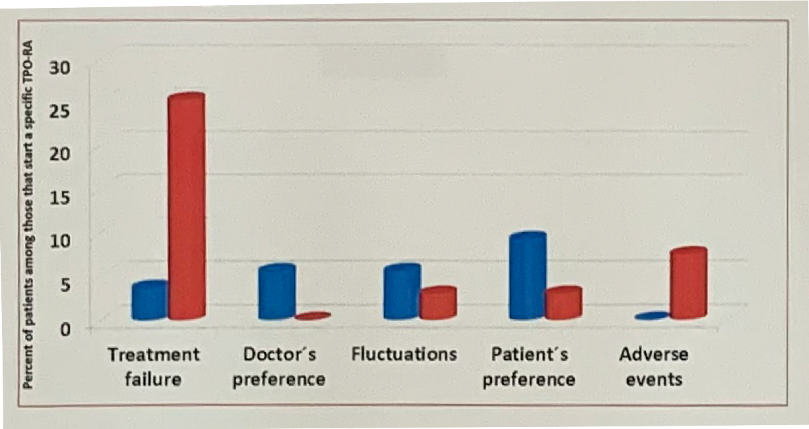
Lozano ML, et al. Predictors of Therapy Free Responses in ITP Patients Receiving TPO-RA. Results from a Spanish Multicenter Study
Results (cont.)
Overall, 39 patients (32.2%) required a switching of TPO-RA, being more frequent among ELT-treated patients (34.3%) than among ROM-treated patients (24.1%).
Reasons for switching the TPO-RA differed between the initial TPO-RA; lack of response was more frequent in the ELT group than in the ROM group (25.4% vs. 3.7%) while patient preference was more frequent in the ROM group than in the ELT group (9.3% vs. 3.0%) (Figure 1).
Figure 1. Percentages and Causes of TPO-RA Switching. Red bars represent patients switching from ELT to ROM; blue bars represent patients switching from ROM to ELT
ELT, eltrombopag; ROM, romiplostim; TPO-RA, thrombopoietin receptor agonist

Slide 66
Lozano ML, et al. Predictors of Therapy Free Responses in ITP Patients Receiving TPO-RA. Results from a Spanish Multicenter Study
Results (cont.)
During follow-up almost one half of the patients (46.3%, n = 56) tapered-off the TPO-RA; 10 out of the 37 cases that discontinued ROM had previously received ELT, and 4 out of the 19 that stopped ELT had switched from ROM.
After a median of 432 days (29–1344) under TPO-RA treatment, 35 patients (28.9%) maintained TFR defined as platelet counts ≥ 50 x 10⁹/L for more than 6 months. In 4 of these 35 cases, TPO-RAs were reintroduced due to loss of response after a median TFR of 20.5 months.
Potential predictors of TFR in the remaining 31 patients (25.6%) with sustained platelet counts (median 32 months, 8–217) were analyzed. No specific patient features (e.g. age, comorbidities, ITP duration, previous treatments, bleeding, nor phase of disease) seemed to consistently predict for sustained response of therapy. However, univariate analysis (Chi-square) did identify statistically significant predictors of TFR.
ELT, eltrombopag; ITP, immune thrombocytopenia; ROM, romiplostim; TFR, treatment-free response; TPO-RA, thrombopoietin receptor agonist

Slide 67
Lozano ML, et al. Predictors of Therapy Free Responses in ITP Patients Receiving TPO-RA. Results from a Spanish Multicenter Study
Results (cont.)
Interestingly, while the specific TPO-RA that was discontinued did not influence the probability to achieve TFR, receiving ROM as first TPO-RA was positively associated with TFR (P = 0.010), while switching TPO-RA negatively predicted sustained platelet responses (P = 0.002). In multivariate analysis with logistic regression both variables predicted significantly higher odds of TFR (Table 1).
Table 1. Predictors of TFR upon TPO-RA Discontinuation (Platelet Counts ≥ 50 x 10⁹/L > 6 Months and With No Loss of TFR During Follow-up in the Absence of Any Agent Meant to Increase Platelets). Multivariate Model by Logistic Regression Results.
CI, confidence interval; OR, odds ratio; TFR, treatment-free responses; TPO-RA, thrombopoietin receptor agonist

Slide 68
Lozano ML, et al. Predictors of Therapy Free Responses in ITP Patients Receiving TPO-RA. Results from a Spanish Multicenter Study
Discussion
There is no doubt that TPO-RAs have revolutionized treatment options in ITP, achieving platelet response in > 70% of patients in randomized clinical studies and in real life. Over the years, it became evident that switching from one TPO-RA to the alternative one is sometimes helpful, not only in cases of adverse reactions, but also in the event of non-response. Most importantly, different reports have suggested the possibility of maintaining the response, without other concomitant or rescue therapies, after discontinuation of either TPO-RA.
ITP, immune thrombocytopenia; TPO-RA, thrombopoietin receptor agonist

Slide 69
Lozano ML, et al. Predictors of Therapy Free Responses in ITP Patients Receiving TPO-RA. Results from a Spanish Multicenter Study
Discussion (cont.)
In this study, a higher proportion of ELT-treated patients than ROM required treatment switching (34.3% vs. 24.1%) and notably, lack of response as reason for switching of TPO-RA was more frequent also among ELT-treated patients (25.4% vs. 3.7%).
These results differ from a total of 268 reported cases that have been switched from one TPO-RA to another in the literature; in total 67/103 (ELT to ROM) and 76/165 (ROM to ELT) switched for nonefficacy issues.^{1,2}
The incongruence of the current and previous data^{1,2} may be based on (i) a different percentage of patients that receive maximum product dose as per prescribing information prior to TPO-RA switching, and (ii) previous reports do not express data as percentage of patients that alternate among those that start a specific TPO-RA, so that results cannot be directly compared.
ELT, eltrombopag; ROM, romiplostim; TPO-RA, thrombopoietin receptor agonist
1. Cantoni S, et al. Am J Hematol. 2018;93:58-64. 2. Depré F, et al. Blood Transfus. 2018;16:307-312.

Slide 70
Lozano ML, et al. Predictors of Therapy Free Responses in ITP Patients Receiving TPO-RA. Results from a Spanish Multicenter Study
Discussion (cont.)
Consistently with these results, while in our study the specific TPO-RA that was discontinued did not influence the probability to achieve TFR, receiving ROM as first TPO-RA was positively associated with a 3-fold greater likelihood of achieving TFR, while switching TPO-RA negatively predicted sustained platelet responses.
In this long-term follow-up analysis, we confirm that platelet response following TPO-RA cessation is sustained in 25.6% of adult patients with primary ITP, and identified variables that in real life seem to predict significantly higher odds of TFR.
Although this study is retrospective in its design, this could rather represent a strength, since it encompasses heterogenous patients with ITP followed in the clinical practice by different doctors and institutions.
However, we regard that results of our study are difficult to put into perspective with previous observational studies because of the differences in populations, follow-up and outcomes. For that reason, a long-term pragmatic randomized clinical trial analyzing ELT and ROM in terms of switching and TFR would be desirable.
ELT, eltrombopag; ITP, immune thrombocytopenia; ROM, romiplostim; TFR, treatment-free response; TPO-RA, thrombopoietin receptor agonist

Slide 71
Slide intentionally left blank

