Slide 2
ASH ITP Guidelines 2019

Slide 3
Conflicts of interest disclosure

Slide 4
Case 1a

Slide 5
Case 1b

Slide 6
What is a guideline?

Slide 7
What is GRADE?

Slide 8
GRADE method – 1

Slide 9
GRADE method – 2

Slide 10
GRADE method – problems

Slide 11
Proposed ASH Guidelines

Slide 12
Question 1a: Should adults with newly diagnosed ITP and a platelet count <30 × 10⁹/L who are asymptomatic or with minor mucocutaneous bleeding be treated with corticosteroids or observation?

Slide 13
Question 1a – corticosteroids or observation Methods – 1

Slide 14
Question 1a – corticosteroids or observation Methods – 2

Slide 15
Question 1b: Should adults with newly diagnosed ITP and a platelet count ≥30 × 10⁹/L who are asymptomatic or with minor mucocutaneous bleeding be treated with corticosteroids or observation?

Slide 16
Question 2a: Should adults with ITP and a platelet count <20 × 10⁹/L and no or mild mucocutaneous bleeding only be treated as an outpatient or be admitted to the hospital?

Slide 17
Question 2b: Should adults with ITP and a platelet count ≥20 × 10⁹/L and no or mild mucocutaneous bleeding only be treated as an outpatient or be admitted to the hospital?

Slide 18
Question 3: Should adults with newly diagnosed ITP be treated with a short course (≤6 weeks) or prolonged continuous use (including treatment and taper) of prednisone for initial therapy?

Slide 19
Question 4: Should adults with newly diagnosed ITP be treated with prednisone (0.5–2 mg/kg/day) or dexamethasone (40 mg/day × 4 days) as the type of corticosteroid for initial therapy?

Slide 20
Q4: Studies assessed

Slide 21
Meta-analysis of dexamethasone vs prednisone trials Dexamethasone works faster

Slide 22
Meta-analysis of dexamethasone vs prednisone trials However, dexamethasone does not increase remissions

Slide 23
Question 5: Should adults with newly diagnosed ITP be treated with rituximab with corticosteroids or corticosteroids alone for initial therapy?

Slide 24
Question 6: Should adults with ITP who are corticosteroid-dependent or unresponsive to corticosteroids and are going to be treated with a TPO-RA receive eltrombopag or romiplostim?

Slide 25
Question 7: Should adults with ITP lasting ≥3 months who are corticosteroid-dependent or unresponsive to corticosteroids undergo splenectomy or be treated with TPO-RAs?

Slide 26
Question 8: Should adults with ITP lasting ≥3 months who are corticosteroid-dependent or unresponsive to corticosteroids undergo splenectomy or be treated with rituximab?

Slide 27
Question 9: Should adults with ITP lasting ≥3 months who are corticosteroid-dependent or unresponsive to corticosteroids be treated with rituximab or TPO-RAs?

Slide 28
Case 1a

Slide 29
Case 1b

Slide 30
Case 1b

Slide 31
SUMMARY General

Slide 32
SUMMARY Proposed ASH Adult ITP Guidelines

Slide 33
SUMMARY Proposed ASH Pediatric ITP Guidelines

Slide 34
International Consensus Report

Slide 35
Disclosures

Slide 36
Updated International Consensus Report

Slide 37
Three new guidelines

Slide 39
Revised consensus guidelines

Slide 41
Role of authors

Slide 42
What’s new?

Slide 43
Consensus structure

Slide 44
New publications 2009–2019

Slide 45
Diagnosis: adults and children

Slide 46
Investigation of adults and children

Slide 47
Bone marrow

Slide 48
Target counts for adults

Slide 49
Goals of therapy

Slide 50
Initial treatment for newly-diagnosed adults

Slide 51
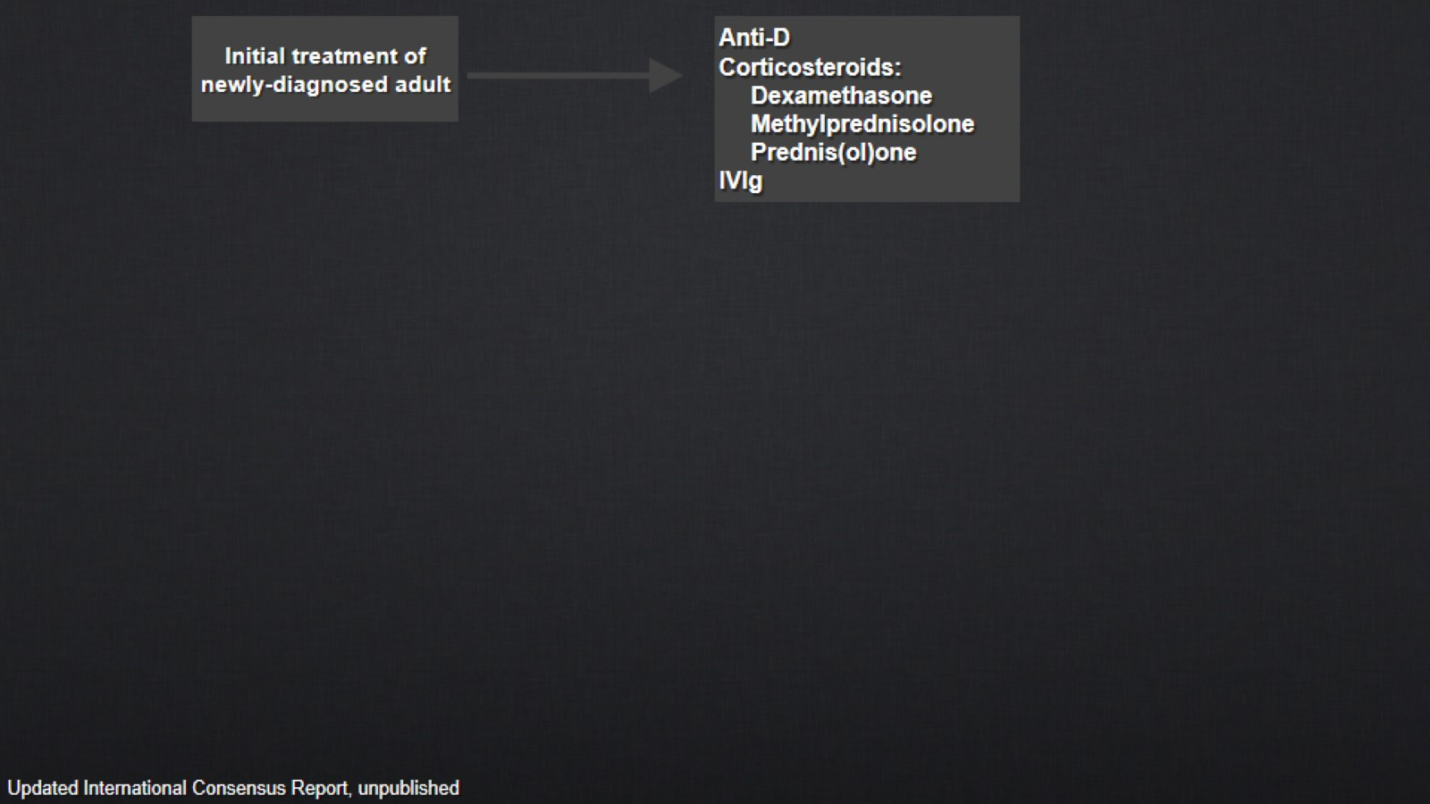

Slide 53
Subsequent therapy: surgical

Slide 54
Adults failing multiple therapies

Slide 55
Emergency treatment (adults)

Slide 56
ITP in pregnancy

Slide 57
Main new additions to revised document

Slide 58
Treatment of ITP in pregnancy

Slide 59
Obstetric analgesia and anesthesia

Slide 60
ITP in childhood

Slide 61
Main changes since 2010 version

Slide 62
Updated bleeding scale for pediatric patients

Slide 63
Management of pediatric ITP

Slide 64
Treatment recommendations for initial treatment of childhood ITP

Slide 65
Recommendations for persistent or chronic ITP in children

Slide 66
QoL in children

Slide 67
Health-related QoL

Slide 68
Patients with ITP have worse outcomes re:

Slide 69
Quality of life

Slide 70
Overall changes

Slide 71
Patient case

Slide 72
Male 29

Slide 73
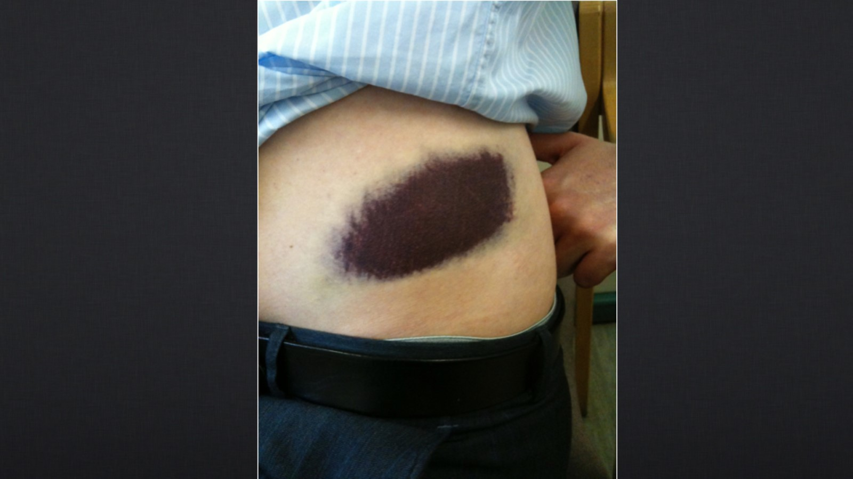

Slide 74
Male 29

Slide 75
Male 29

Slide 77
Male 29

Slide 78
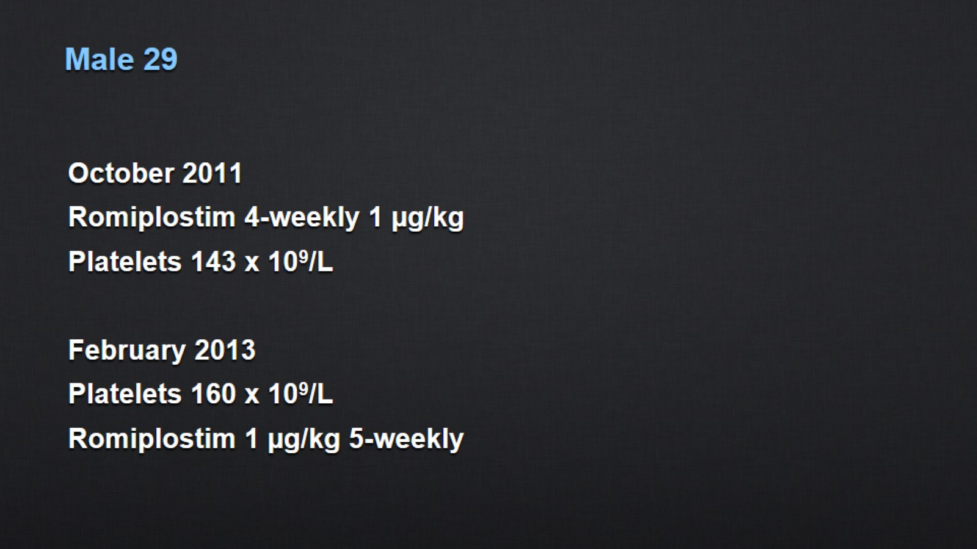
Male 29

Slide 79
Male 29

Slide 80
Summary

Slide 81
Recommendations of German, Austrian and Swiss Haematology Societies

Slide 83
New findings drove the update to German-language ITP guidelines

Slide 84
Evidence levels and grades of recommendation

Slide 85
Grading the severity of bleeding

Slide 86
Bleeding grades according to the WHO and NCI CTCAE

Slide 87
Phases of ITP and treatment goals

Slide 88
Phases of ITP and treatment goals

Slide 89
Diagnosis of ITP

Slide 90
When to treat

Slide 91
Treatment algorithm

Slide 92
First-line therapy

Slide 93
First-line treatment of children and adolescents

Slide 94
Emergency treatment

Slide 95
Second-line treatment with TPO-RAs

Slide 96
Second-line treatment with TPO-RAs

Slide 97
Splenectomy

Slide 98
Third-line therapy with rituximab

Slide 99
Treatment of chronic ITP in children and adolescents

Slide 100
ITP and pregnancy

